Slide 1
Emerging Evidence for the Role of Instrument-Assisted Soft Tissue Mobilization in the Treatment of Tendinopathy
Mike Ploski
PT, ATC, OCS, GTS

Slide 2
Conflict Disclosure
I am a contracted instructor and part-time employee for
Graston Technique, LLC.
No specific brand of instruments will be promoted in this presentation.

Slide 3
Learning Outcomes
Discuss the pathophysiology of tendinopathy, and goals of treatment to affect the pathophysiology of the condition.
Summarize the evidence for the efficacy of IASTM in the treatment of tendinopathy.
Recommend strategies for athletic trainers to incorporate exercise with IASTM for the treatment of tendinopathy.

Slide 4
Topics for Discussion
Tendinopathy
IASTM
Physiologic effects of IASTM
Review of IASTM evidence
IASTM protocol for tendinopathy
Case study

Slide 5
Tendinopathy – Any Disease of a Tendon
Tendon injuries account for 30-50% of injuries in sports
Accounts for 30% of all running-related injuries
Elbow tendinopathy can be as high as 40% in tennis players
Patellar tendinopathy can be as high as 32% in basketball players
Patellar tendinopathy can be as high as 45% in volleyball players
Leads to lost time and performance declines in sports
Long term damage to tendons can affect daily function

Slide 6
Acute Tendinitis
Trauma
Strain
Laceration
Surgery
Goal: Control, then extinguish the fire

Slide 7
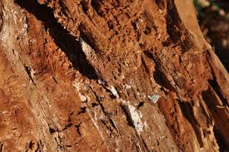
Chronic Tendinosis:
Overuse injuries resulting from multiple microtraumative events
Disruption of the internal structure of the tendon and degeneration of the cell’s matrix
Absence of inflammatory cells
Can occur within 5 days of insult
Goal: Stimulate new growth

Slide 8
Tendon Physiology
Cells
Fibroblasts (tenocytes)
Macrophages
Undifferentiated mesenchyme cells
Extracellular matrix
Fibers (Collagen & Elastin)
Ground substance
Glycosaminoglycans (hyaluronic acid)
Water

Slide 9
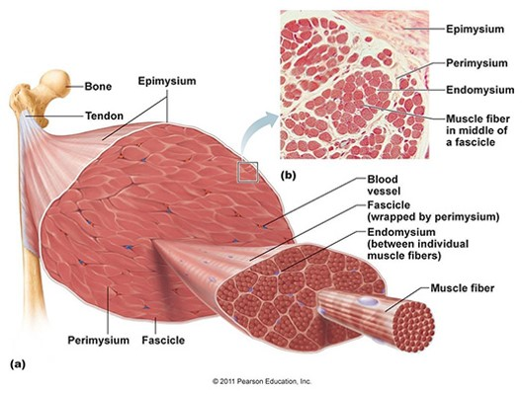
Tendon Structure
Normal tendon contains bundles of ​type 1 collagen, closely packed with ​a few tenocytes between them. ​
These are embedded in a matrix of proteoglycans, glycosamino-glycans, and water. ​
The loose epitenon wrapping is the source of vascularity.

Slide 10
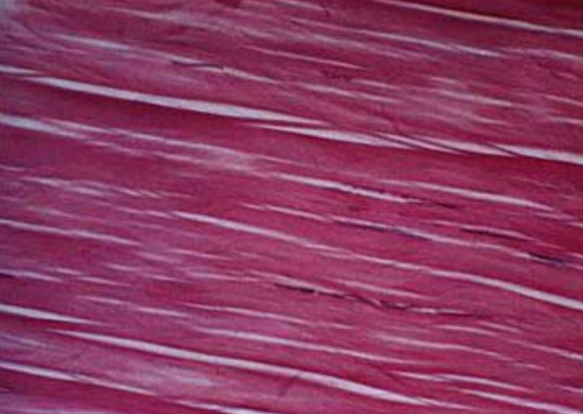
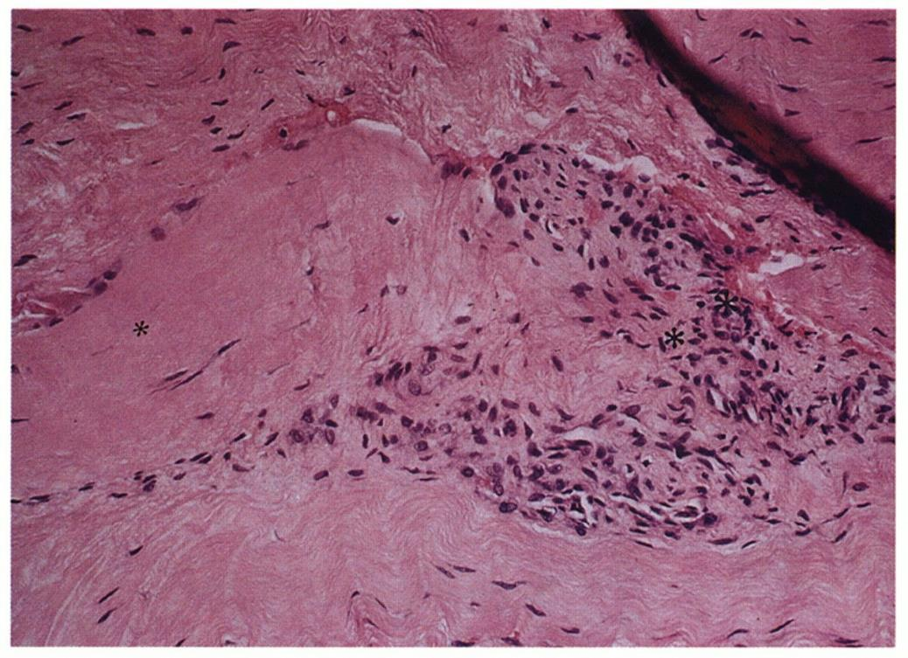
Histopathology of Tendinosis
Degenerative process
Dense populations of fibroblasts
Disorganized collagen
Vascular hyperplasia (non-functional)
Innervation changes
Pain from ischemia, not inflammation
Kraushaar, B. S., & Nirschl, R. P. (1999). Current Concepts Review-Tendinosis of the Elbow (Tennis Elbow). Clinical Features and Findings of Histological, Immunohistochemical, and Electron Microscopy Studies*. J Bone Joint Surg Am, 81(2), 259-278.

Slide 11
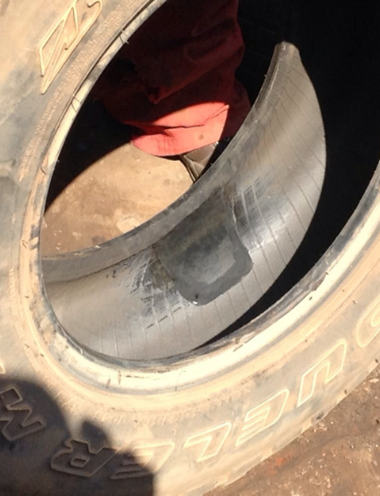
Histopathology of Tendinosis
Fiber separation by increased mucoid ground substance, vascularity, and cellularity
Cellularity is the presence of fibroblasts and myofibroblast, not inflammatory cells
Less tissue homogeneity, less organization and ultimately a stiffer, weaker structure
Khan, K. M., Cook, J. L., Taunton, J. E., & Bonar, F. (2000). Overuse tendinosis, not tendinitis: part 1: a new paradigm for a difficult clinical problem. The Physician and sportsmedicine, 28(5), 38-48.

Slide 12
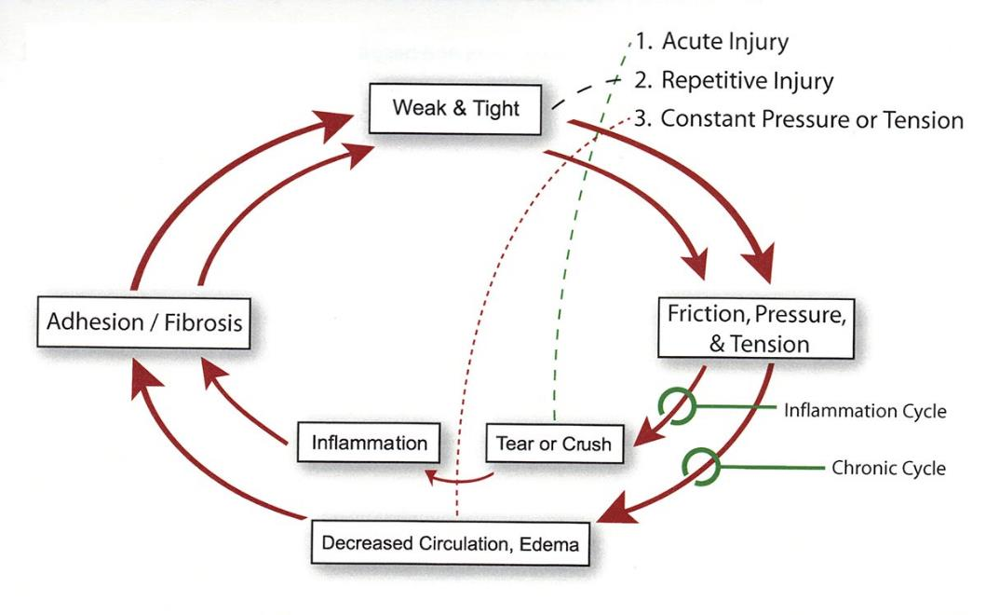
Clinical Findings of Tendinosis
Fibrosis/tendon thickening
Weakness
Decreased Elastic Modulus
Decreased Mobility
Pain
Inability to Tolerate Load
Chronic Degenerative Cycle
Notes:
Reference for this diagram is still unknown.

Slide 13
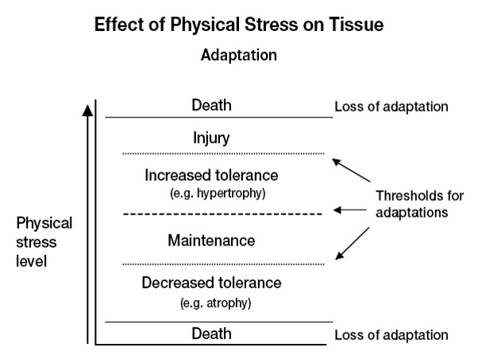
Mechanical Loading Effects on Tendons
Tendons are strengthened by exercise as indicated by an increase in tendon stiffness, cross-sectional area, and tensile strength
Mueller MJ, Maluf KS (2002). Tissue adaptation to physical stress: a proposed “Physical Stress Theory” to guide physical therapist practice, education, and research. Physical therapy, 82(4), 383-403.

Slide 14
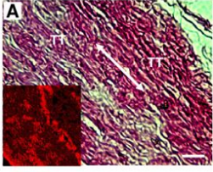
Mechanical Loading Effects on Tendons
Tendon stem / progenitor cells can differentiate into tenocytes and non-tenocytes (adipocytes, chondrocytes, or osteocytes) depending upon load.
In rabbits, under low mechanical load tenocytes are produced, but under high mechanical load chondrocytes, adipocytes, and osteocytes are also formed.
Zhang, Jianying, and James HC Wang. "Characterization of differential properties of rabbit tendon stem cells and tenocytes.” BMC musculoskeletal disorders 11.1 (2010): 10.
Notes:
There has been a major shift in treatment approaches over the last 10 years concerning what we originally thought and labeled as tendonitis. Advances in soft tissue examination techniques (both microscopic and macroscopic) have now proven that in a majority of cases, what we are really seeing is tendinosis.
(Khan et al. 1999, Khan et al. 2000, Scott et al. 2004, Scott et al. 2004, Kraushaar BS, Nirschl RP. Tendinosis of the Elbow. Journal of Bone & Joint Surgery, 81-A, 2;1999)
K Khan 1999 “We conclude that effective treatment of athletes with tendinopathies must target the most common underlying histopathology,
TENDINOSIS, a non-inflammatory condition.”
Tendons, muscles, and bones are strengthened by exercise as indicated by an increase in tendon stiffness, cross-sectional area, and tensile strength
This occurs as a result of increased Type 1 collagen in peritendonous tissues
It is an active tendon response, resulting in a high expression of anabolic growth hormone, also know as mechano-growth factor
An increase in MGF is noted following isometric, concentric, and eccentric movements
It was originally thought that tenocytes made up the majority of tendon cells and were responsible for maintenance and repair of tendons
Recently, a new cell type, a tendon stem cell, also called a tendon progenitor cell has been identified
These cells have the ability to differentiate into tenocytes and non-tenocytes such as adipocytes, chondrocytes, or osteocytes)
In rabbits, under low mechanical load tenocytes are produced, but under high mechanical load chondrocytes, adipocytes, and osteocytes are also formed.

Slide 15
Tendinosis Treatment Concepts
Identify & Eliminate or Modify Intrinsic/Extrinsic Factors
Increase the Strength and Stiffness of the Tissue
Apply Controlled & Progressive Tension & Stress
Fibroblastic Stimulation
Facilitate Healthy Tissue Re-organization
Address the Entire Kinetic Chain
Notes:
Clinically, when addressing a tendinosis condition, there are several factors we must consider:
We need to identify the stage of the condition. Is the condition acute or chronic? Do we need to extinguish the fire, or stimulate new growth.
We need to identify causative factors. Are there extrinsic factors that need to be addressed? What intrinsic factors are contributing to the dysfunction?
We need to consider pain management. Pain alters motor control. In addition to addressing a patient’s primary complaint, we need to manage pain if we are going to have a positive effect on improving function.
And we need to manage load on the tendon. We need to remove the abusive load in the short term, but in the long term, we need to improve the capacity for the tendon to tolerate load.
So based on all this information, it becomes clear that in order to successfully treat tendinosis, we need to incorporate tension, but not too much tension. We need stress, but not too much stress. We need to be able to affect the fibroblasts, and encourage them to lay down collagen in an organized manner.
We need to prevent further breakdown of tissue through invigoration of fibroblasts. We need to strengthen the tendinotic tissue. And we need to address not only the primary lesion, but also the adjacent tissue as well as the entire kinetic chain.
So we need to ask ourselves, are there interventions that we can utilize in order to address these concepts? And, are the treatment interventions we are currently using actually addressing all of these factors?

Slide 16
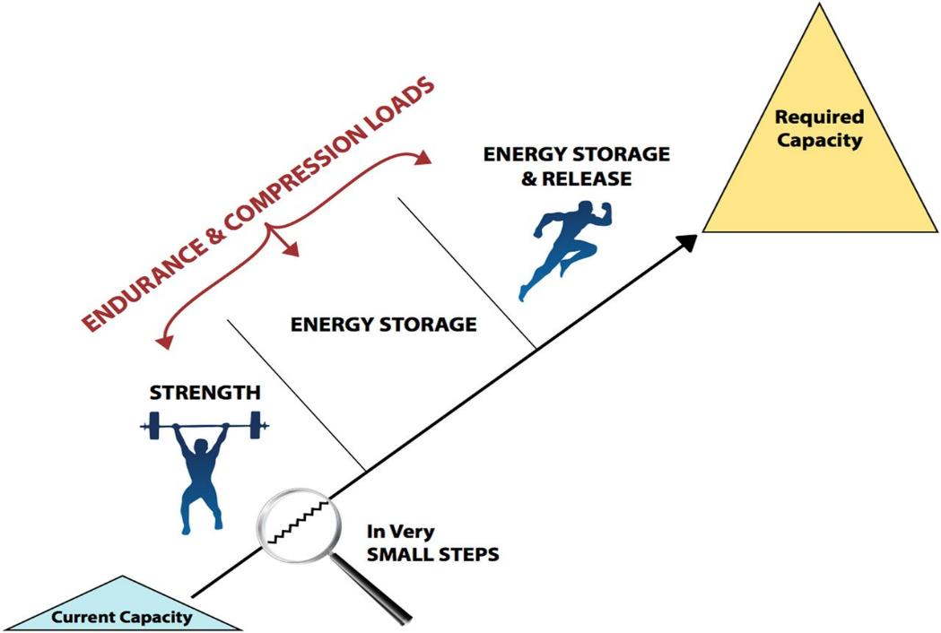
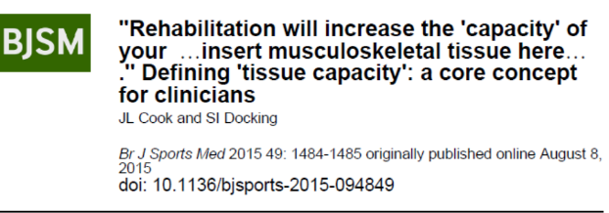
Schematic of Tendon Rehabilitation, Improving Tendon Capacity with Progressive Loads
Copyright © BMJ Publishing Group Ltd & British Association of Sport and Exercise Medicine. All rights reserved.
Notes:
Schematic of tendon rehabilitation, improving tendon capacity with progressive loads. Introduction and progression of endurance and compressive loads are critical within each stage. The start and end points of rehabilitation will vary between individuals.
Instructors, please read this citation as it provides a rationale for why load must be applied to dysfunctional tendons after the acute inflammatory response has ceased.

Slide 17
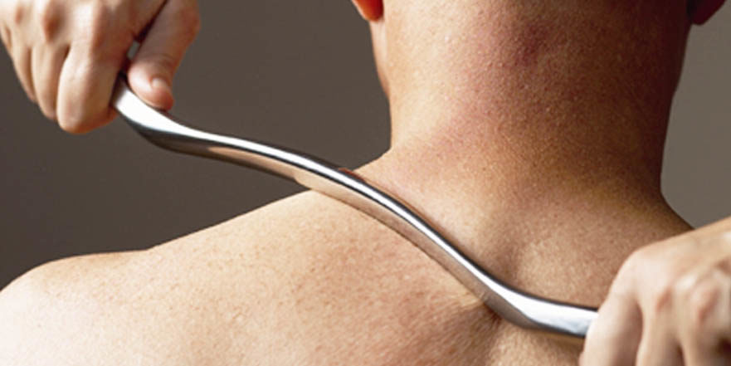
Instrument-assisted soft-tissue mobilization (IASTM)
Use of an instrument to target dysfunction in muscles, tendons, ligaments and fascia to affect pain and mobility
Can be a number of different materials/instrument types

Slide 18
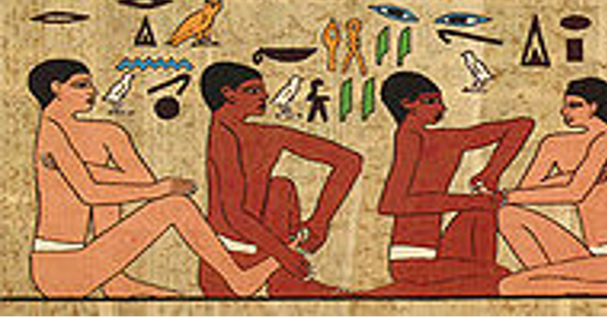
History of IASTM
Necessity is the mother of invention
Based on principles of cross-friction massage
Patented products and protocols
Various modes of application

Slide 19
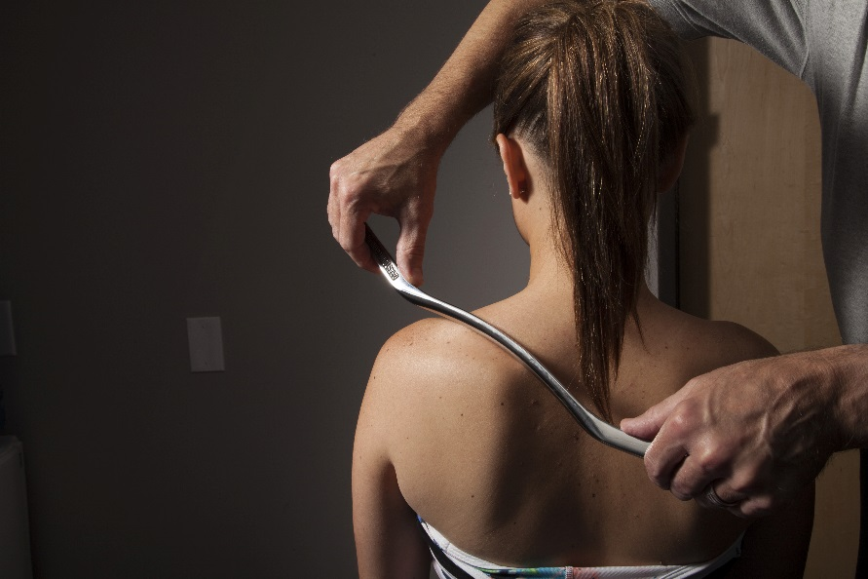
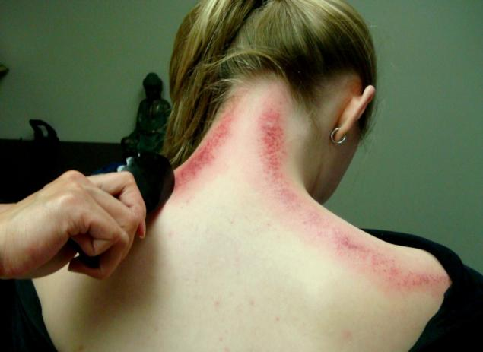
IASTM vs Gua sha
_______________________________
Soft tissue mobilization to affect pain and mobility
Targets muscles, tendons, ligaments, and fascia
Petechiae is avoided
Skin scraping to affect blood stasis
Remove energy blockage
Targets skin and capillaries
Intended petechiae

Slide 20
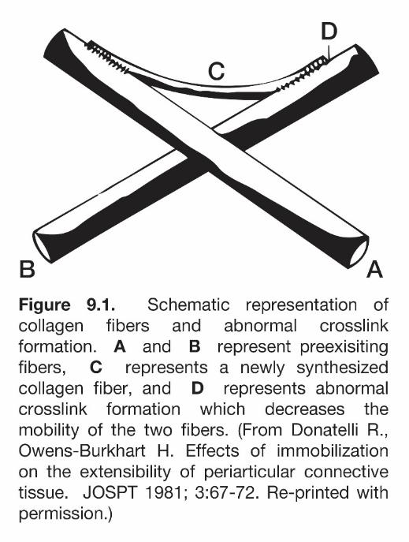
The Effects of Trauma on Connective Tissue
Permanent loss of GAGs & H2O
Collagen synthesis degradation
Irregular laying down of collagen & cross links
Ligaments, tendons & joint capsules weaken
Altered sensory input
Notes:
As a result of prolonged immobilization or trauma (stress, injury), irregular laying down of collagen occurs and cross links form between the normally occurring collagen and elastin fibers. The net result depends on the type of connective tissue that is affected but can include decreased mobility, decreased tensile or contractile strength and ultimately abnormal movement patterns. This diagram which is taken from Donatelli and Owens-Burkhart and illustrates that phenomenon. The lines A, B D represent normal collagen fibers while C represents an abnormal cross links that forms in response to injury, disease and immobilization. Manual therapeutic techniques such as massage, soft tissue mobilization and joint mobilization theoretically break up these cross links to restore normal movement. Properly prescribed and executed therapeutic exercise facilitates the health of the normally aligned collagen and elastin fibers.
Donatelli R, Owens-Burkhart H. Effects of immobilization on extensibility of periarticular connective tissue. JOSPT. 1981; 3 (2): 67-72.
Level of Evidence: 5. Written in 1981, this article suggests a number of hypotheses regarding the effects of immobilization of synovial joints on the periarticular connective tissue. Although the authors acknowledged a lack of empirical support for their theories, many of their hypotheses have been proven with technological advances that allow laboratory study of these phenomena. The diagram included on this slide is adapted from this article and can be used to explain the decreased mobility often experienced after a period of immobilization as a result of cross fibers that form in an irregular fashion between normal collagen fibers that can in turn lead to restricted connective tissue mobility. This article despite its early publication date provided important foundational information for my understanding of how connective tissue behaves in health and following injury or disease.

Slide 21
Effects of Soft Tissue Mobilization
Movement maintains balance between collagen synthesis and degradation
Movement activates alignment of fibroblasts and myofibroblasts in the direction of stress.
Facilitate GAG production, thus maintains inter-fiber distance and lubrication.
Restore gliding between layers of tissue.
Neurophysiological benefits due to rich proprioceptive content of fascia.

Slide 22
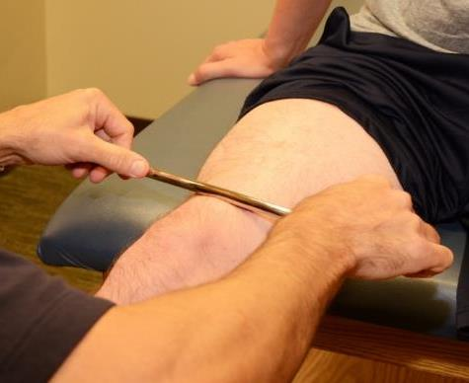
Physiological Effects of Mechanotherapy
______________________________________________________________________
The use of mechanical force to achieve a physiologic response.
Virtually all cells are mechanosensitive.
When the cell surface senses a mechanical stimulus, a biochemical chain reaction occurs.
Directs cellular activity influencing growth, remodeling, and repair, with the ultimate outcomes being altered tissue mass, structure, and quality.
Nearly every intervention in musculoskeletal rehabilitation introduces mechanotherapies, extrinsically via therapist intervention or intrinsically via the prescription of exercise therapy.
Thompson WR, Scott A, Loghmani MT, Ward SR, Warden SJ (2016). Understanding Mechanobiology: Physical Therapists as a Force in Mechanotherapy and Musculoskeletal Regenerative Rehabilitation. Physical therapy, 96(4), 560-569.

Slide 23
Mechanotransduction Physiological process where cells sense and respond to external mechanical loads
Mechanocoupling | Physical transduction of mechanical force (compression, stretch, shear) applied to tissue into local mechanical signals that can be detected by tissue cells. Involves physical derangement or perturbation of the cell, either directly or indirectly.
Biochemical coupling | Process whereby the local mechanical signal is converted into a biochemical signal. Cells sense a load using mechanosensitive structures
Signal Transmission | Process in which a sensor cell signal an effector cell.
Effector response | Cellular outcomes that lead to protein synthesis, remodeling and reabsorption of its matrix. Leads to a tissue level response.
Used with permission from T Loghmani, Indiana University, 2017
Notes:
Cells detect a mechanical force (compression, stretch, or shear)
Mechanical signal is converted into a biochemical reaction
Biochemical reaction is transmitted to an effector cell
Results in protein synthesis, and remodeling of the ECM, leading to a tissue level response

Slide 24
“OPTIMAL THERAPEUTIC LOAD”
SUMMARY OF EFFECTS OF MECHANICAL LOAD
Inadequate Load (Disuse/immobilization) [adaptive shortening] (atrophy, adhesion) | Overload (Re-mobilization) [appropriate modeling] | Excess Overload (Overuse) [over lengthened] (tissue breakdown)
Loss of GAGs Water Loss ⇓ inter-fiber distance ⇓ collagen fiber bundle size ⇑ cross-linking between existing collagen ⇓ inter-fiber mobility Collagen disorganization Eventual net collagen loss Insertion site weakening ⇓ structural properties ⇓ mobility | ⇑ GAG production→ ⇑ inter-fiber distance Cell proliferation & activity ⇑ ECM production ⇑matrix organization ⇑ blood flow ⇑ skin temperature ⇑ tissue extensibility Release of adhesions ⇓ muscle tone ⇑ structural properties ⇑ mobility | ⇑ tissue strain → cell death Inflammation Degeneration Fibrosis
Used with permission from T Loghmani, Indiana University, 2017

Slide 25
Physiological Effects of IASTM: Instrument-Assisted Soft Tissue Mechanotherapy
Notes:
In the last few slides of this section, we will discuss the proposed physiological mechanisms of action of the Graston Technique® therapy. Please share with participants that these proposed mechanisms are supported by some research but have not as yet been irrefutably been proven. References are listed on respective slides when research has been available.
In a recent abstract presented by Terry Loghmani at CSM 2016, she was able to demonstrate that GT has an immediate effect on mobilizing stem cells into circulation. The abstract is discussed in further detail in a new slide following the slide on Mechanotransduction.

Slide 26
Fibroblast Responses to Pressure
________________________________________________________________________
Light Pressure
Control
Medium Pressure
Heavy Pressure
Gehlsen G, Ganion L, Helfst R. "Fibroblast responses to variation in soft tissue mobilization pressure." Medicine and science in sports and exercise 31.4 (1999): 531-535.
Notes:
This study involved 5 groups of rats: A control group, a group injected with collagenase, a group that was injected and then treated with light IASTM, a group injected and treated with medium pressure, and a group injected and treated with heavy pressure.
The control group exhibited parallel collagen fibers, and a few elongated fibroblasts, while the induced tendinitis groups exhibited disrupted, randomly arranged collagen, with an increased number of fibroblasts directly related to the amount of pressure. Increased pressure resulted in increased fibroblasts.
It was concluded from this study that delivering pressure through the tissue with an instrument resulted in proliferation and activation of fibroblasts.
It is plausible to deduce that the same concept would also be true in humans which would mean that the literature would support the concept of increasing fibroblasts in an area with Graston Technique.

Slide 27
Fiber Alignment and Function
___________________________________________________________
Conclusion:
Significant increase in fibroblast counts were present in Group C compared to all other groups.
Improved stride length in Group C
Looked at 4 groups:
Group A: control
Group B: tendinitis
Group C: tendinitis plus IASTM
Group D: IASTM alone
Davidson et al. Rat tendon morphologic and functional changes resulting from soft tissue mobilization. Medicine and Science in Sports and Exercise. 29 (3) March 1997; 313-319.
Notes:
The next study I’d like to review is titled “Rat tendon morphologic and functional changes resulting from soft tissue mobilization.”
This study included 4 groups of rats: a control group, a group whose Achilles tendons were injected with collagenase, a group injected and the treated w/ IASTM, and a group not injected, but treated.
IASTM was performed on the Achilles tendon of groups C and D for 3 minutes 4 times.
Significant increased fibroblastic proliferation was present in the group injected and treated.
Group C also demonstrated improved stride lengths and earlier recovery of limb function.
Since fiber realignment is related to mechanical forces, the authors suggested an earlier return of function would also promote earlier fiber alignment.

Slide 28
IASTM and Ligament Healing
RCT: 20 rats underwent surgical bilateral transection of the MCL.
7 days postoperatively one minute 3x per week for 3 weeks.
Results: 43.1% stronger and 39.7% stiffer
Loghmani, M. Terry, and Stuart J. Warden. "Instrument assisted cross-fiber massage accelerates knee ligament healing." Journal of orthopaedic & sports physical therapy 39.7 (2009): 506-514.
Notes:
This study examined the effects of GT on MCL injuries in a group of rats.
Bilateral MCL’s were surgically transected in the hind limbs in a group of 51 rats. 1 Limb was a control, while the other was treated by strumming with GT6 for 1 minute, 3x / wk.
After 9 treatments, treated ligaments were found to be 43% stronger, and 40% stiffer than the untreated ligament.
Non-treated ligaments were had more adhesions and granular tissue and were more difficult to harvest vs treated ligaments.
Collagen fiber bundles appeared to be oriented more along the longitudinal axis of the ligament compared to the untreated ligament
Treated ligaments were stiffer, stronger, and had improved fiber alignment
The authors postulated GT influences fibroblasts to stimulate collagen production.
There is the potential for GT to assist by assisting in fiber alignment and potentially lead to stronger tissue as a result of influencing collagen production and alignment.

Slide 29
Notes:
This slide contains scanning electron microscopy images taken from an (A) intact medial collateral ligament in a control animal, (B) a nontreated MCL at 4 weeks post injury, and (C) an IACFM treated MCL at 4 weeks post injury.

Slide 30
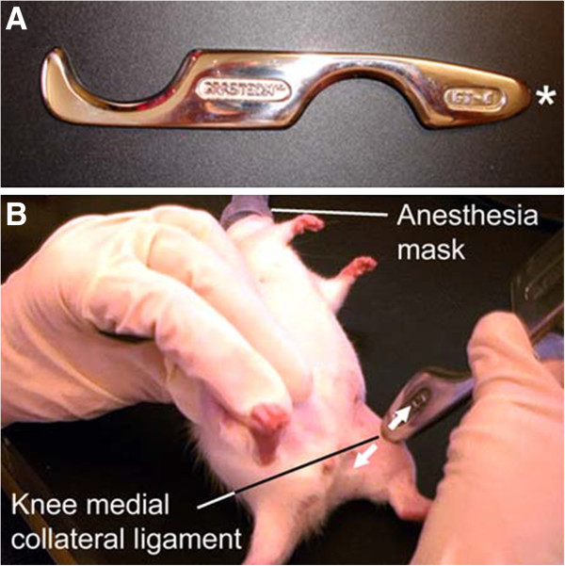
Vascular Response to IASTM
Findings:
• No immediate effect
• Enhanced perfusion at 1 day and 1 week
post treatment
• Increased arteriole-sized blood vessels
Loghmani T., Warden S. "Instrument-assisted cross fiber massage increases tissue perfusion and alters microvascular morphology in the vicinity of healing knee ligaments". BMC Complementary and Alternative Medicine. Sep 2013.
Notes:
A follow-up study was performed looking at the vascular responses to GT.
Regional tissue perfusion was assessed following 1 minute of treatment 3x / wk x 3 weeks
There was no effect on tissue perfusion when assessed immediately, or at 5, 10, 15, or 20 minute after treatment
However, treated hind limbs had enhanced tissue perfusion when assessed 1 day and 1 week following the final treatment
Subsequent investigation found increased proportion of arteriole-sized blood vessels in the tibial 3rd of the ligament.
The findings suggest GT alters regional perfusion and vascularity in the vicinity of the healing ligament.
This study provides additional evidence that Graston Technique has the potential to increase blood flow into an area which has the potential to increase the healing process.

Slide 31
Increased Circulating Stem Cells
Six healthy young males received 6 sessions of IASTM to the back over 3 weeks
There was a significant, 3-fold, acute increase in the percent of circulating tissue-resident mesenchymal stem cells (TR-MSCs)
TR-MSCs are endogenous cells that are critical for vascular repair, tissue healing, and regeneration
Concluded that IASTM has an immediate effect on mobilizing stem cells into circulation which may positively impact healing
Loghmani MT, Fuller EM, Handt R, Neff B, Seasly L, Swartz C, Whitted M, March KL (2016). Instrument-assisted soft tissue mobilization in healthy young adult males mobilizes tissue-resident mesenchymal stem cells into circulation. Journal of orthopaedic & sports physical therapy, 46(1), A107
Notes:
Presented in a poster presentation at CSM, 2016:
INSTRUMENT-ASSISTED SOFT TISSUE MOBILIZATION IN HEALTHY YOUNG ADULT MALES MOBILIZES TISSUE-RESIDENT MESENCHYMAL STEM CELLS INTO CIRCULATION
Mary T. Loghmani, Emily M. Fuller, Rachel Handt, Bruce Neff, Lucia Seasly, Carrie Swartz, Micah Whitted, Keith L. March
Department of Physical Therapy, Indiana University, Indianapolis, IN; School of Medicine, Indiana University, Indianapolis, IN.
PURPOSE/HYPOTHESIS: Mechanotherapy interventions, such as instrument-assisted soft tissue mobilization (IASTM), are often used by clinicians. IASTM is a form of massage that uses rigid devices to deliver a mechani­cal stimulus to the soft tissue. Initial IASTM studies have demonstrated positive results. Interestingly, adult stem/progenitor cells (SCs) and mas­sage-based modalities have demonstrated similar therapeutic capacities, eg, immuno-modulation, antiaging, anti-inflammation and enhanced vascular function. It is known that SC circulation levels can be altered by disease, age and interventions (eg, exercise), but the effects of massage/ mechanical stimulus on circulating SC levels is unknown. It is possible that IASTM stimulates an increase in circulating SC levels which may augment healing. The purpose of this proof-of-concept study was to eval­uate the acute and cumulative effects of IASTM on circulating SC levels and selected clinical outcomes.
NUMBER OF SUBJECTS: Six healthy men (18-30 years old; BMI≥18.5<30.0 kg/m2).
MATERIALS/METHODS: In a single setting, within-subjects, pretest/posttest design, subjects received six 20-minute sessions of IASTM to the back over 3 weeks by a trained examiner. At the first and last sessions, periph­eral vein blood samples were taken at baseline, after 20 minutes of rest, and again after 20 minutes of IASTM. An array of SC subpopulations (circulating endothelial, hematopoietic stem/progenitor, and tissue-res­ident mesenchymal stem cells [TR-MSC]) were characterized based on their surface markers by multiparametric flow cytometry using an estab­lished protocol, and self-reported pain and function and physical mea­sures were obtained. Analysis of main outcome measures were deter­mined using paired t tests (P<.05).
RESULTS: There was a significant, 3-fold, acute increase in the percent of circulating TR-MSCs (CD34+, CD31–, CD45–) from 0.0012 +/- 0.0008 to 0.004 +/- 0.003 (P<.03). Other outcome measures were not statisti­cally significant.
CONCLUSIONS: MSCs are vascular stem cells that reside in the capillaries and adventitia of larger blood vessels throughout the body. Findings sug­gest that IASTM promotes an acute increase in circulating TR-MSCs in healthy young adult males which may positively impact healing. Cumu­lative effects were not observed which may indicate a need to determine optimal timing of and dose responses for IASTM intervention. It is not surprising that other measures were unaltered in this healthy population.
CLINICAL RELEVANCE: Findings from this novel pilot study demonstrate that a form of mechanotherapy, IASTM, has an immediate effect on mobiliz­ing TR-MSCs into circulation; endogenous cells that are critical for vas­cular repair, and tissue healing and regeneration. Future research on the effects of IASTM on SC mobilization, circulation and activity as a func­tion of dose, age, sex and disease is warranted. This underscores the po­tential for noninvasive, mechanotherapy interventions to facilitate innate mechanisms underlying tissue healing and regeneration as means to op­timize therapeutic outcomes.

Slide 32
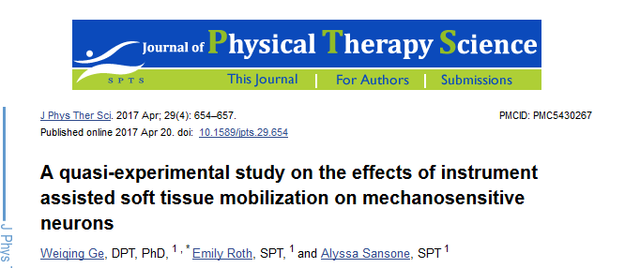
Neurophysiological Effects: Altered neural activity
Effects of IASTM on activities of mechanosensitive neurons
23 subjects received 10-minute application of IASTM to anterior thigh
Increased 2-point discrimination
IASTM alters neural activities of mechanoreceptors
More than a mechanical effect

Slide 33
Neurophysiological Effects: Increased Pain Pressure Threshold
__________________________________________________________________________
RCT of 29 healthy subjects
Six 5-minute treatments over 3 weeks to TrPs in upper trapezius
Statistically significant increase in pain pressure threshold
IASTM can effectively increase pain pressure threshold

Slide 34
Summary of Physiologic Effects of IASTM
Increase in fibroblast proliferation and activation (Gehlsen 1999)
Better tissue organization and fiber alignment in tendons and ligaments (Loghmani 2009)
Stronger and stiffer ligaments (Loghmani 2009)
Increased rate of healing for tendons and ligaments (Loghmani 2009)
Increased blood perfusion to the tissue (Loghmani 2013)
Improved function (Davidson 1997)
Increased circulating stem cells (Loghmani 2016)
Neurophysiologic benefits (Ge 2017, Gulick 2017)
Notes:
This slide identifies the conclusions drawn based on the Animal Studies that have been conducted. While promising, they do represent a low level of evidence according to the principles of evidence-based practice.

Slide 35
IASTM and ROM
_________________________________
Effect of IASTM vs stretching
RCT - 50 healthy track and field volunteers
8 treatments over 5 weeks
IASTM and exercise was more effective than stretching for improving weight bearing dorsiflexion

Slide 36
IASTM and ROM
_____________________________________
Effect of IASTM on GH horizontal adduction and IR
RCT - 35 asymptomatic collegiate baseball players (Level 2b)
1 application of IASTM to posterior shoulder
Horizontal adduction improved 11.1º (vs -0. 1º in control)
IR improved 4.8º (vs -0.1º in control)

Slide 37
IASTM and ROM
_________________________________
Effect of IASTM on hamstring extensibility and pain intensity in patients with LBP
RCT – 24 patients received one 60 second treatment of either IASTM or static HS stretching
Both groups showed significant improvement in LBP
IASTM group showed significantly greater improvement in HS extensibility

Slide 38
Systematic Reviews
___________________________________________
7 RCTs appraised
5 reported to use GT, but excluded parts of the protocol
Evidence is still emerging
Weak evidence supporting ability to increase ROM
Best evidence to date followed the GT protocol

Slide 39
Systematic Reviews
____________________________________________
7 studies met inclusion criteria
Majority demonstrated significant improvements in pain and / or ROM
IASTM is effective for reducing pain and improving function
Further studies with greater sample sizes and longer follow-up are needed

Slide 40
There is moderate evidence to support the use of IASTM to acutely increase ROM in the glenohumeral joint of overhead athletes.

Slide 41
Importance of Exercise
RCT, N = 45
Single treatment
3 Groups:
GT protocol (IASTM + exercise)
IASTM alone
Exercise alone
GT > IASTM > exercise

Slide 42
There is insufficient evidence supporting the use of IASTM as a stand alone treatment for all musculotendinous pathologies.
Moderate evidence supports the use of IASTM combined with stretching and strengthening protocols when treating tendinopathies.

Slide 43
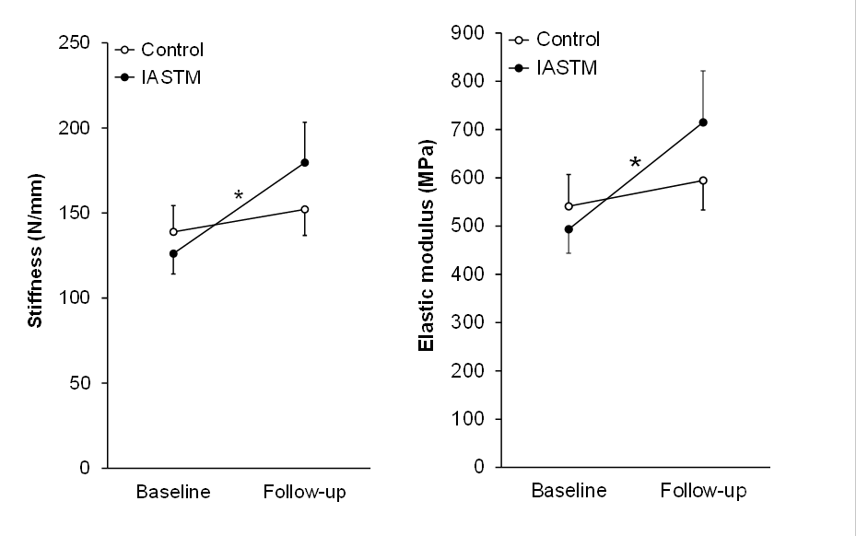
IASTM and Tendons
6 adults with shortened Achilles tendons
8 sessions of IASTM and stretching vs stretching alone
Assessed with real time US imaging and dynamometry
28% gain in elastic modulus with IASTM vs 4% gain with stretching alone
Increase in tendon resting length
IASTM induced adaptation of the mechanical and material properties of healthy, shortened Achilles tendons
Increase in elastic modulus hypothesized to enable more effective force transfer and may alter injury risk
______________________________________

Slide 44
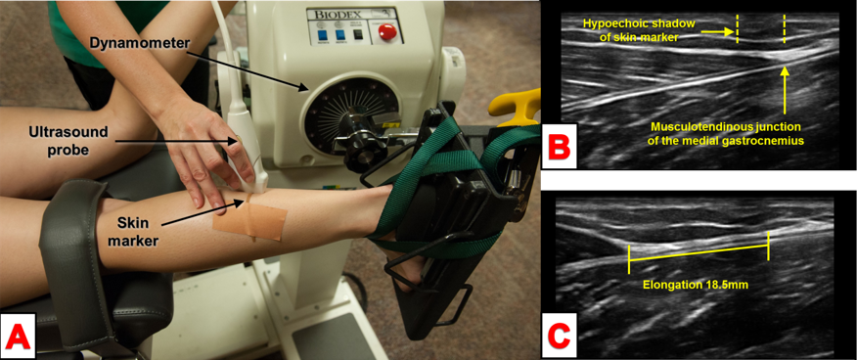
IASTM and Tendons
Three adults with unilateral Achilles tendinopathy
8 sessions of IASTM combined with stretching over a 4‐week period
Used real time ultrasound imaging and dynamometry at both baseline and follow‐up
34.5% gain in elastic modulus and a 31.8% gain in stiffness following IASTM
Mean VISA‐A scores improved 13 points
Average gain of 2.2 cm a weight bearing lunge test
2 subjects reported a full recovery
IASTM appears to be effective for improving function and altering material and mechanical properties in midportion Achilles tendinopathy
______________________________________

Slide 45
The Effects of the Graston Technique® on Cases of Chronic Tendinopathy Measured by Diagnostic Ultrasound by Kelsey K Labodi Master of Science Thesis North Dakota State University
15 collegiate athletes diagnosed with either patellar (13 participants) or Achilles (2 participants) tendinopathy
4 treatments of GT (2x / wk x 2 weeks)
Significant decrease in the amount of tendinosis, a significant increase in LEFS scores, but no significant change in NPRS scores
The area of tendinosis started to improve after 2 treatments
This study refutes current theory that interventions designed to treat tendinopathy cannot improve tendon structure

Slide 46
IASTM Tendinosis Progression
Static Unloaded
Static Loaded (Stretch or Isometric)
Dynamic Unloaded
Dynamic Partially Loaded (PWB)
Dynamic Fully Loaded
Notes:
Based on the previous research, we have developed a GT® therapy Protocol to treat tendinosis. The progression is outlined on this slide.

Slide 47
CASE STUDY

Slide 48
Demographics
53-year-old female freelance photographer
20-year history of recurrent Achilles pain
Frequent walking / standing on uneven terrain
Enjoys walking for exercise
Wants to increase activity level / run

Slide 49
History and Symptoms
Initial injury - crush injury to lower leg 20 years prior
Recurrent episodes of Achilles pain since
Prior treatments only provided temporary relief
Current episode started 2 weeks prior after running 5 min on treadmill
Pain Level 4/10
LEFS = 58/80
Functional limitations: prolonged walking / running / uneven terrain

Slide 50
Clinical Presentation
Observation
LE symmetry, level sacral base
Bilateral pes planus
No evidence of swelling, but visible lump mid-tendon
Functional Testing
Good balance
Gait – excessive pronation
Squat – forward trunk flexion
Lunge – limited translation of knee over foot

Slide 51
Clinical Presentation - Impairments
ROM
Passive dorsiflexion 0-17 (vs 0-20)
Hamstring length WFL
1st MP extension 0-60 (vs 0-75)
Strength
Resisted plantar flexion strong, but painful
Posterior tibialis 4+/5
Toe flexor strength 4/5

Slide 52
Clinical Presentation - Palpation
Manual Palpation
Palpable adhesion medial border of tendon
Tender to palpation
IASTM Assessment Revealed Restrictions:
Medial gastrocnemius
Longitudinal arch
Fascial interface between Achilles and deep posterior compartment

Slide 53
Treatment Objectives
Short Term
Decrease local pain
Decrease load on tendon
Improve DF / Gastroc length
Improve MP ext / PF length
Decrease restrictions in compartment interface
Long Term
Improve capacity of tendon and muscle to manage load

Slide 54
Initial Visit
IASTM:
Treat restrictions in medial gastroc and plantar fascia
Brushing to desensitize lesion in tendon
Stretching (gastroc, soleus, PF)
Activity modification
Pt education

Slide 55
Sweep.mov

Slide 56
Brush.mov

Slide 57
2nd Visit
Active warm-up
IASTM treatment:
Treat restrictions in gastroc and PF
Brushing over adhesion
Treat adhesion in compartment interface
High rep / low resistance exercise to gastroc, toe flexors and PTT
Stretching
HEP: Gastroc and PF stretching

Slide 58
Jstroke.mov

Slide 59
Visits 3 and 4
Continue w/ treatment to gastroc and compartment interface
Added active motion during IASTM treatment
Added strumming to tendon
HEP: Added posterior tibialis and toe flexor strengthening

Slide 60
AROM.mov

Slide 61
Strum.mov

Slide 62
Visits 5 and 6
Continue w/ previous treatment
Added 3D strokes
Added load to muscle / tendon during treatment
Added eccentrics on Shuttle sled

Slide 63
Spiral.mov

Slide 64
Partial load.mov

Slide 65
Visits 7 and 8
Continue w/ previous treatment
Treated tendon w/ motion
Progressed eccentrics to full weight-bearing
Added eccentrics to HEP

Slide 66
Visits 9
Continue w/ previous treatment
Added IASTM in static weight-bearing

Slide 67
Wt bearing.mov

Slide 68
Visit 10 to 13
Added IASTM during eccentrics
Continued to treat gastroc and plantar fascia
Continue w/ eccentric strengthening, posterior tibialis and toe flexor strengthening

Slide 69
Eccentric.mov

Slide 70
Visit 14 - Reassessment
Pain < 1/10
LEFS = 77/80
Full passive dorsiflexion and MP extension
Plantarflexion, post tib, toe flexor strength 5/5, painfree
Able to exercise on TM x 30’ w/o pain
Able to run 12 minutes with minimal pain

Slide 71
Six Month Follow-up
Pain < 1/10 w/ ADL’s
LEFS 75/80
Running tolerance limited by conditioning, not pain
Mild increase in symptoms w/ running on incline

Slide 72
Discussion
Eccentrics have been shown to be effective, but compliance can be poor (pain, frequency, length of protocol), and does not change tendon structure
This case demonstrated successful outcome in 7 weeks
IASTM was used to identify restrictions in kinetic chain responsible for abnormal load on tendon
Progressively adding load through IASTM and exercise
Static Unloaded
Static Loaded (Stretch or Isometric)
Dynamic Unloaded
Dynamic Partially Loaded (PWB)
Dynamic Fully Loaded

Slide 73
Conclusion
IASTM can be used to identify restrictions in kinetic chain
IASTM has been shown to address the pathophysiology of tendinosis
IASTM has been shown to improve the material and mechanical properties of pathologic tendons
IASTM has been shown to improve tendon structure
Moderate evidence supports the use of IASTM combined with exercise for the treatment of tendinopathy

