Slide 1
HCL Annual membership Meeting 2024
September 15, 2024
Notes:
THANK YOU!!!
Welcome new families and members
Looking forward to a great 2022

Slide 2
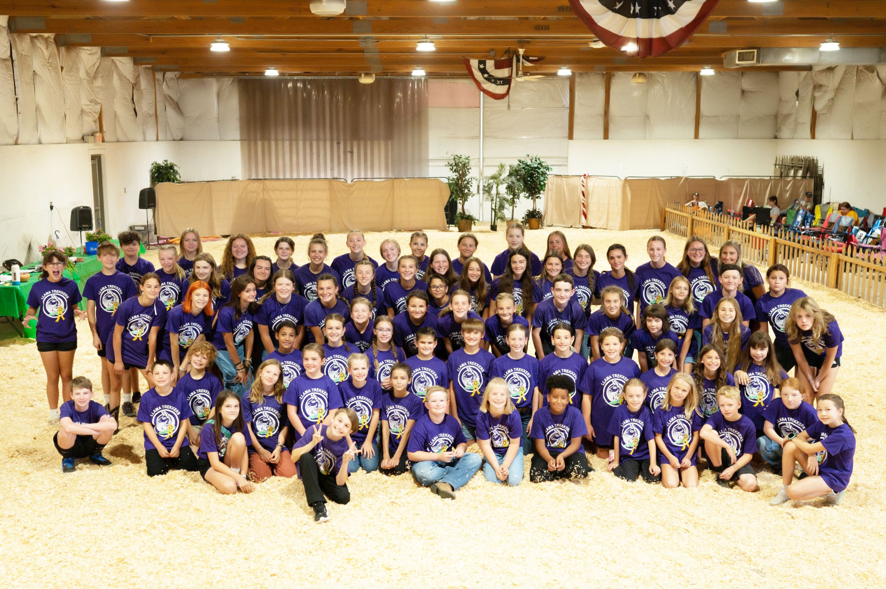
WELCOME All!
September 15, 2024
Notes:
Introduce ourselves and explain who we are
Welcome new families and members
Looking forward to a great 2022

Slide 3
HCL Board Of Directors
Current Board Members
Kitty Bishop - President
Kat Reichel - Vice President
Alicia Tricker - Treasurer
Kitty Bishop - Secretary
Lisa Sims– Member at Large
Jenny Showalter - Member at Large
Mark Zerr - Member at Large
Marilyn Nenni- Advisory Member
Mark Foerder – Advisory Member
Notes:
Thank them !!!!! Time spent, monthly meetings

Slide 4
Hamilton County Llamas, INC.
Who are we? HCL is for the purpose of providing llamas for Hamilton County 4-H Llama Project and offering opportunities to youth in our community.
About Us
Established October, 2014
501c3 non-profit
Functions as a Co-op
We average 80 youth members
ALL is not possible without YOU!!
Notes:
Co-op of approximately 80 youth and 68 families

Slide 5
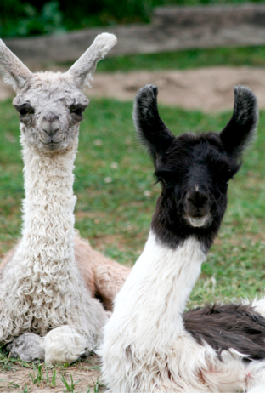
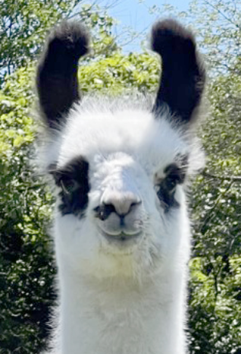
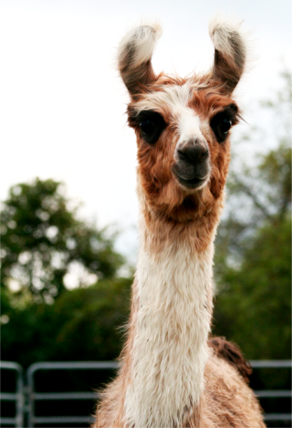
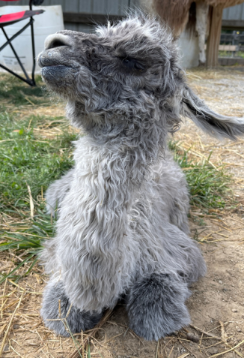
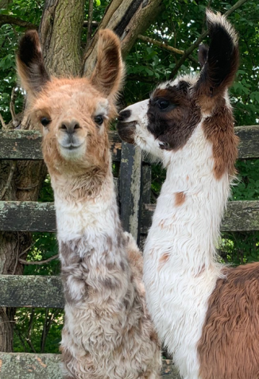
our role
As a Co-op…
We rely on our members to do it ALL for its success
Help care for our herd through herd and farm days
Educate youth through 4-H program
Raise Funds to support our program and care for animals
Participate in community events
Put on events for our youth- Jamboree/Workshops/Parties
Show our animals at Hamilton County Fair
Have a show-quality Breeding Program
Notes:
Our role as Members

Slide 6
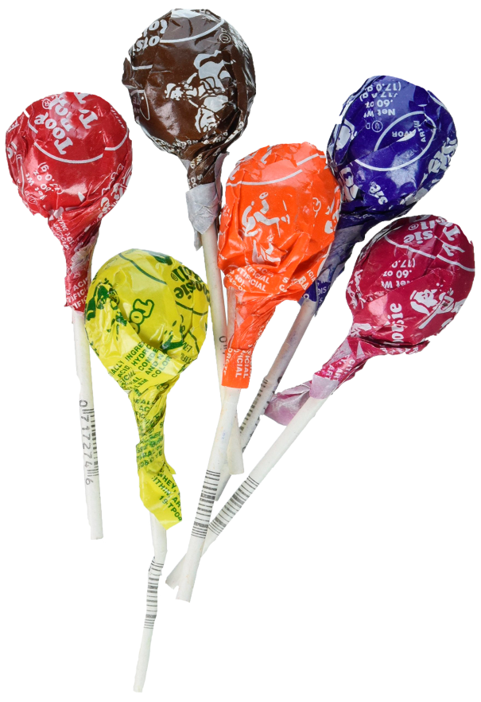
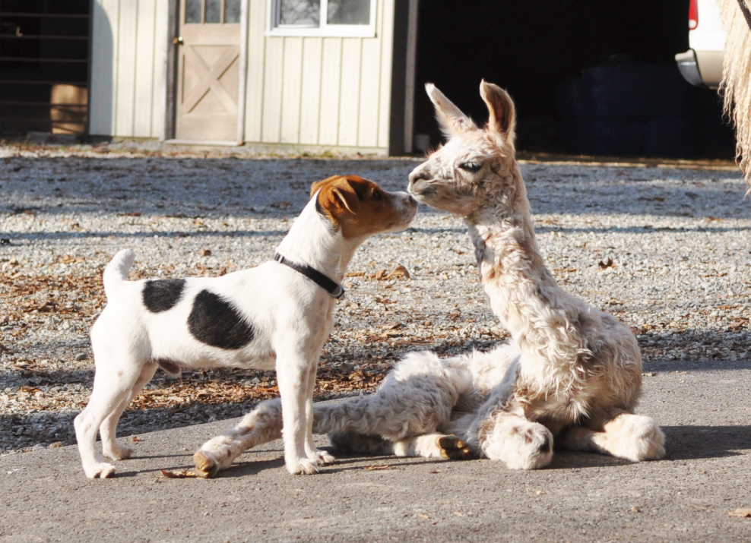
??? Question ???
As a member, what is one thing you do at the farm to help out?
Dip ‘N Dots
Notes:
Sundown Gardens Fall Festival Walk-A-Llama September 30th

Slide 7
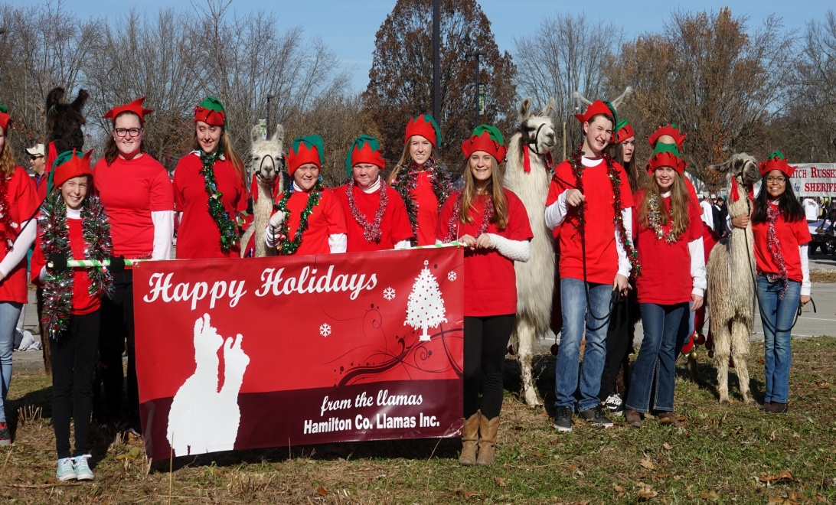
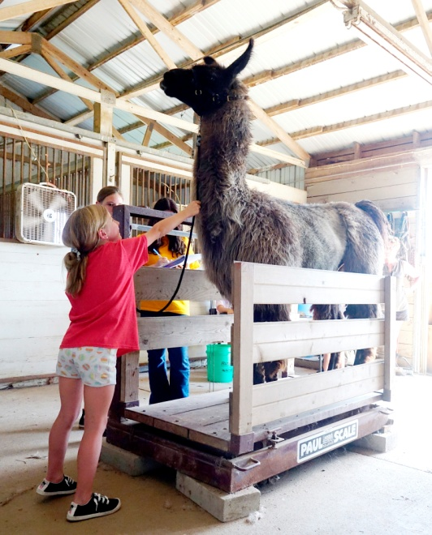
Member’s involvement
Chores- 2 x month
2 Herd Days
1 Farm Day – youth & parents
Help with events throughout the year
Families are encouraged to participate in committees
Required to select an item from the task list
Notes:
Penalties fee for not participatii
Examples of events

Slide 8
Membership manual
Animal Information
Farm Information
Program Information
Updated Annually
HCL Record Sheet
Download from Website
Notes:
Lauren
NEW All of our detailed information, record sheet!!, updated annually, parent record at bottom

Slide 9
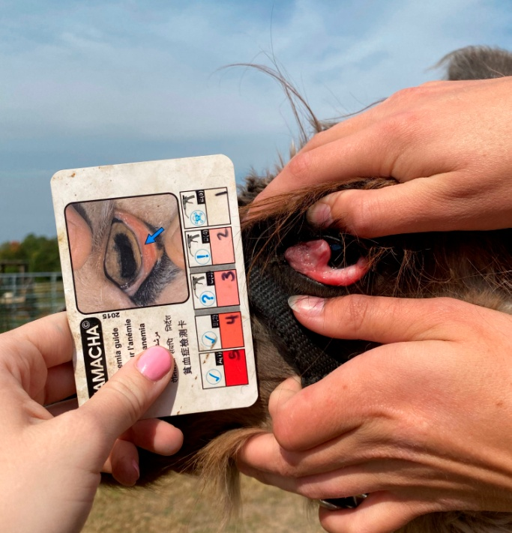
??? Question ???
What is this
test called?
Notes:
Famacha
What is it for?

Slide 10
Treasurer‘s Report ALICIA TRICKER
2024
Notes:
Marilyn

Slide 11
Membership & Financial Update
1st Year = 86 youth from 67 families. (2014-2015)
4th Year = 77 youth from 68 families (2018-2019)
9th Year = 80 youth from 65 families (2022-2023)
10th Year = 88 youth from 68 families (2023-2024)
Checking Account Balance 8-31-2024 = $64,953.46
Checking Account Balance 8-31-2023 = $48,511.67
Checking Account Balance 8-31-2022 = $40,423.15
Checking Account Balance 8-31-2021 = $22,511.97
Checking Account balance 9-30-2018 = $2,500
Monthly Farm Lease Payments = $1,000 Mo. = $12,000 Annually
2024-2025 Membership Dues – NO Increase
$400/year for 1 member
$360/year for 2nd youth
$340/year for 3rd youth
Total Amount or 1st of (2) payments due October 1st
Second payment due April 1st, 2024
New Member One-time Registration Fee = $25.00
Notes:
Turn over to Marilyn

Slide 12
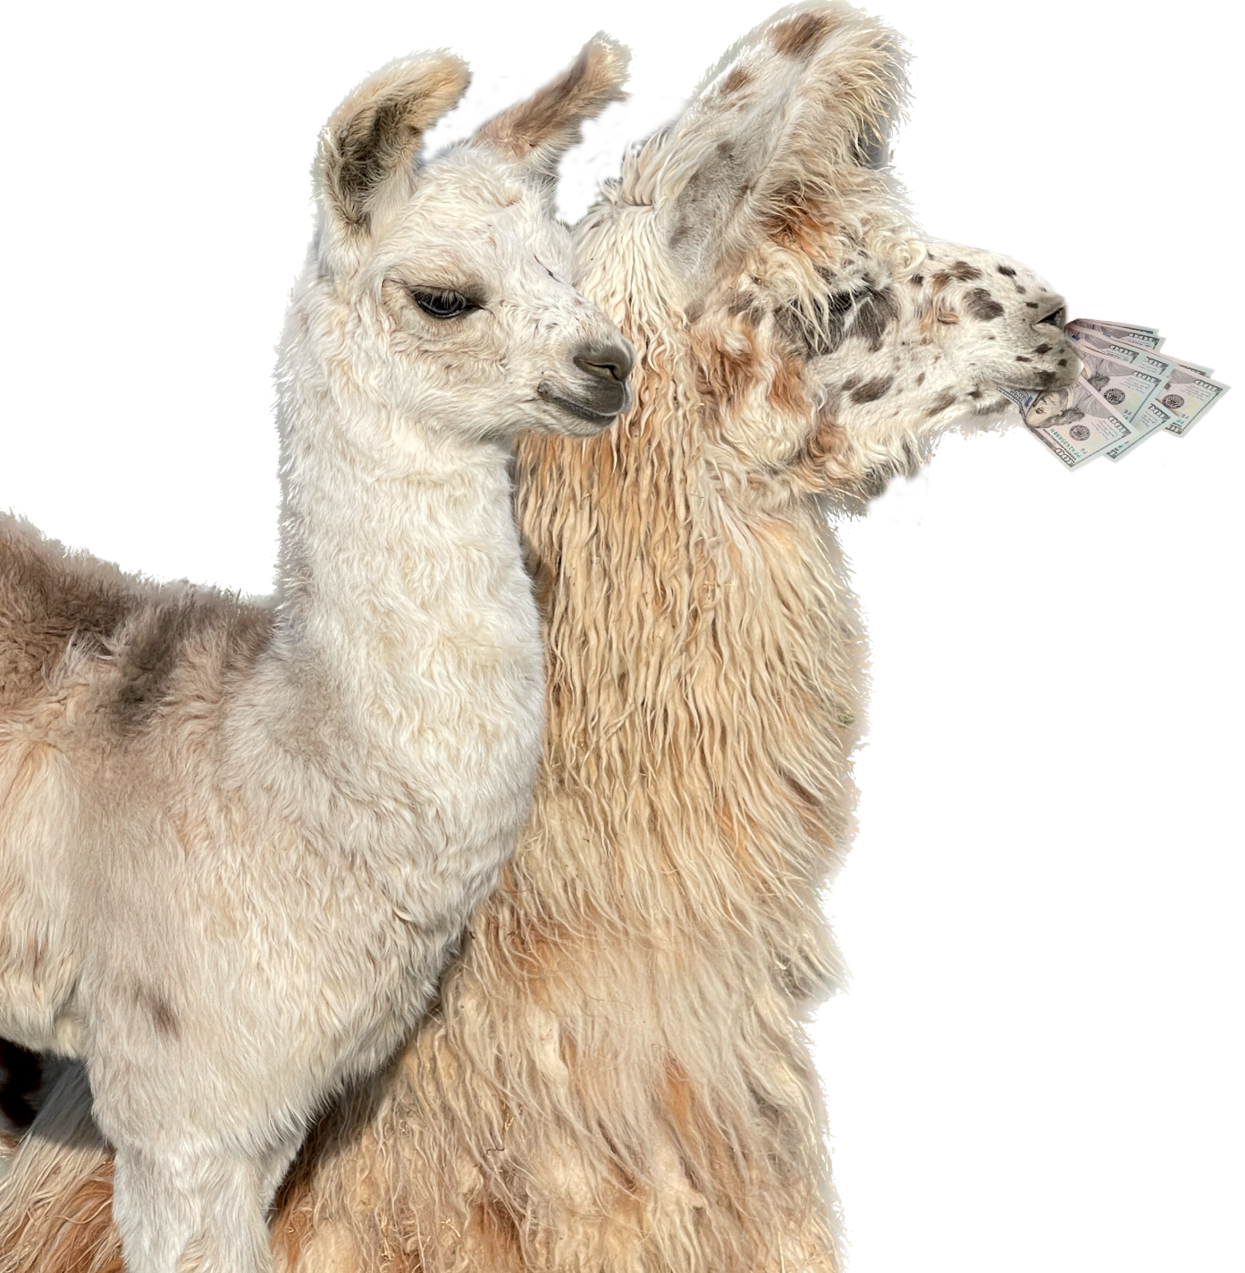
Treasurer‘s Report
Various 2023-2024 Expenses
Hay for winter =
1250 bales - $8,305
_ Llama Feed = $7,042 YTD
Farm Rent = 12 months $12,000
Medical Supplies = $1,369.16 YTD
Llama Purchase = $7,800.00
Various 2023-2024 Income YTD
Membership = $
Walk-A-Llama = $2,720
Llama Visits = $2,550
Community Events = $1,850
Llama Merchandise = 4,072
Dine to Donate = $831
Grants/Gifts = $3,396
Llama Sales = $14,900
Notes:
Marilyn

Slide 13
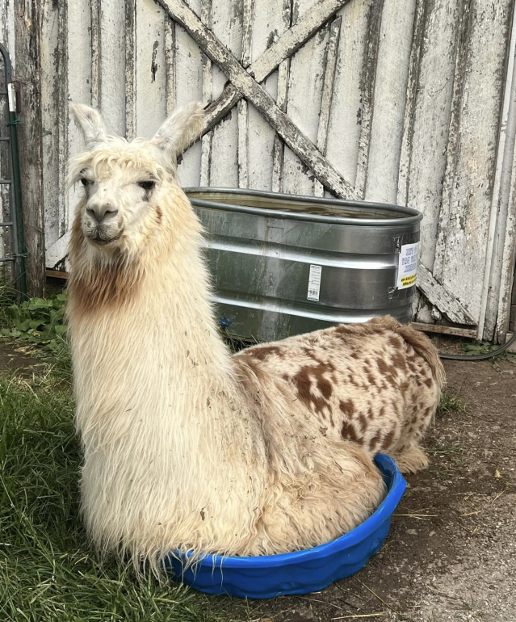
??? Question ???
What is one
sign of heat stress?
Notes:
Staggering, open mouth breathing, not getting up
Bonus Question – What do you do about it?

Slide 14
Llama Trekkers 4-H Information & Leaders
Workshops at the fairgrounds
Llama Record Book
HCL Record Sheet
Training
at the
Farm
Marilyn Nenni
llamas@shagbarkridge.com
317-418-2258
LISA SIMS
lisadsims@yahoo.com
317-501-3932
Notes:
Sophia
Introduce the leaders. 4-H is different than HCL , must be in the llama project, 5-6 meeting sessions at the fairgrounds, move to farm, assigned an animal to train over the summer for the fair
To complete the Llama Project, complete Llama Record Book, Llama Activity Book, HCL Record Sheet

Slide 15
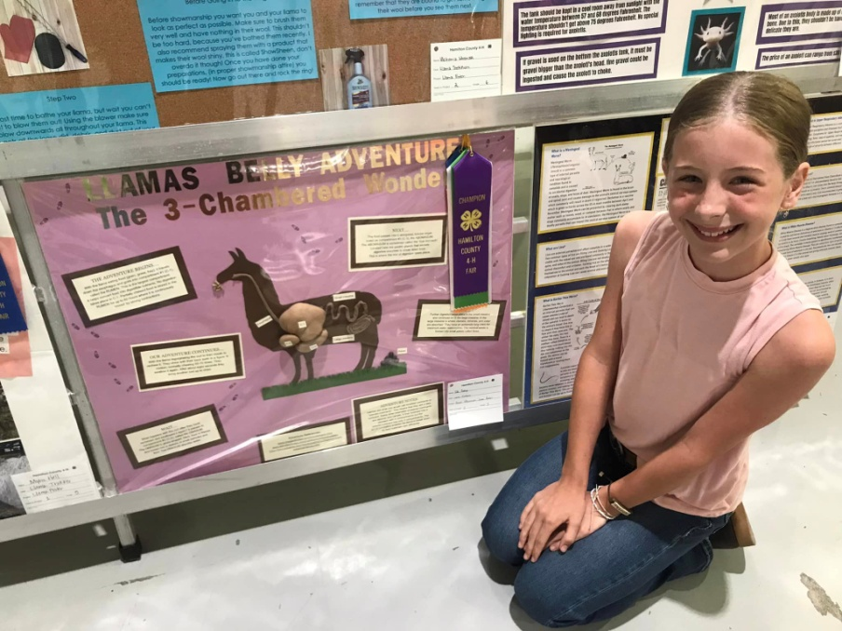
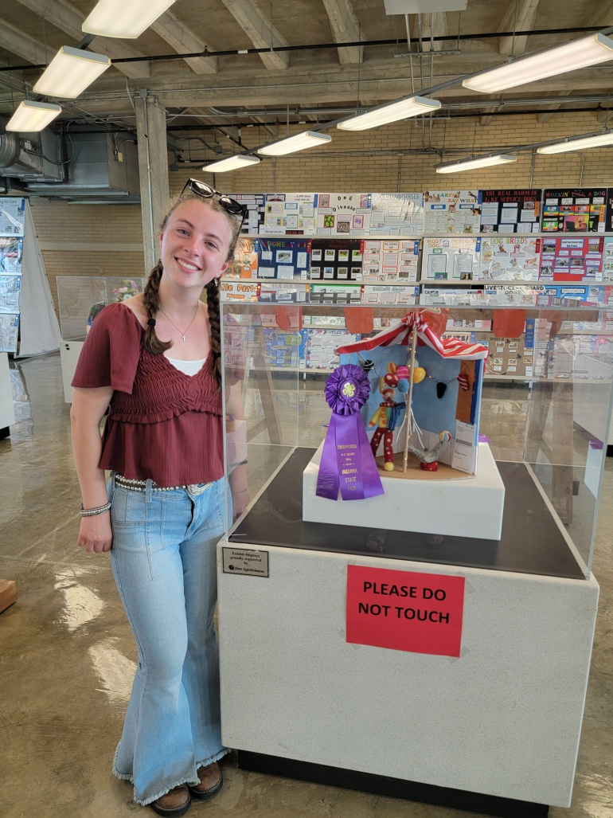
Optional 4-H projects
Llama Fiber
Llama Poster
Blue Merit Junior
at the Indiana State Fair
4-H Sweepstakes Winner
at the Indiana State Fair
Notes:
Sophia
Ada Bishop’s poster was 4-H Sweepstakes Winner this year at IN State Fair. Creative subject. Compared llama spit with human spit.
Fiber: Emma Reichel, Overall Reserve Grand Champion, went to State Fair. Matthew Duprey Jr. Grand Champion went to State Fair.

Slide 16
All American Youth Jamboree
Requested by our Members for 2025
National Youth Show at our Fairgrounds
Sponsored by Llama Trekkers
Late June weekend at our Fairgrounds
Notes:
Requested by our Youth Members
Held at our fairgrounds

Slide 17
Committees
Chores Committee
Farm management
Herd management
Events/fundraising
Grants & Fundraising
Notes:
Sophia
HCL had 5 working committees

Slide 18
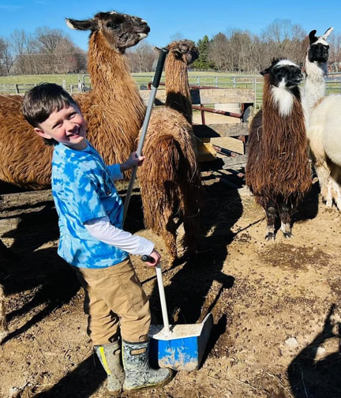
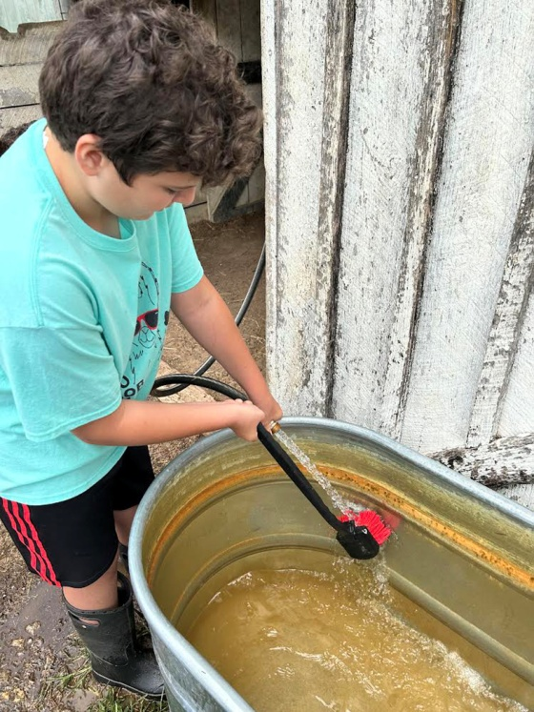
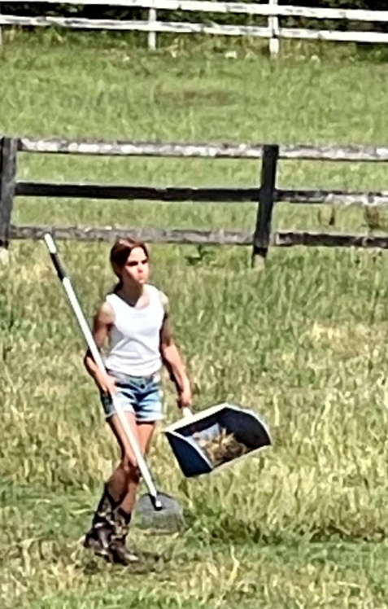
Chores committee
Kat Reichel & Alyson Elder – Co-Chairs
Megan Obrenski
Amy Gehan
Notes:
Thank and Introduce Chores Committee- Chairs may want to say something

Slide 19
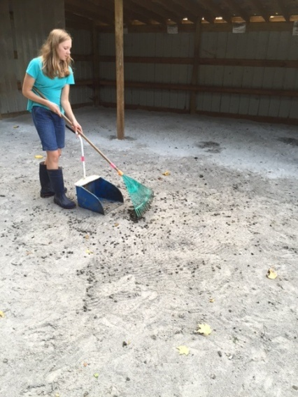
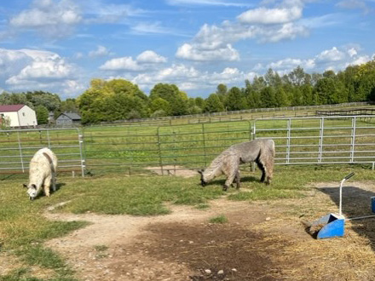
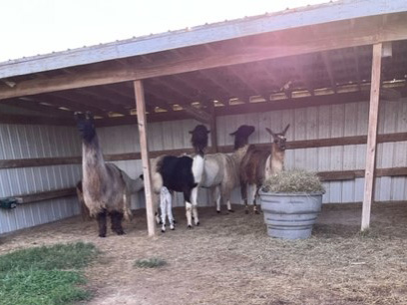
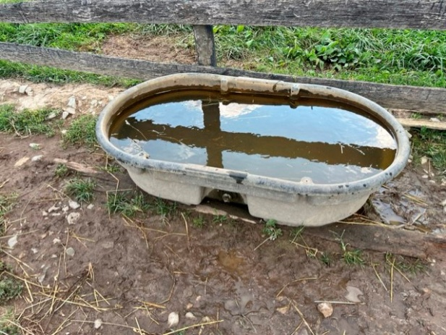
Chores committee
Monitor daily chore emails
Communicate chore changes to members
Maintain chore schedule
Oversee supplies are placed for easy access
Report any emergencies
Chore training for members
Notes:
Lauren
If you think there is something wrong, there probably is
All animals are up and alert
Chores Training

Slide 20
Our Chore responsibilities
Feed
Cleaning pen
One wheel barrow from pasture
Checking if animals are alert and active
Checking/cleaning water
Supplying minerals as needed
Providing hay in season
Checking fans in season
Email Chores Committee when complete
Sign Up two times a month
Notes:
Each one has their own responsibilities
Turn over to Alyson Elder for comments

Slide 21
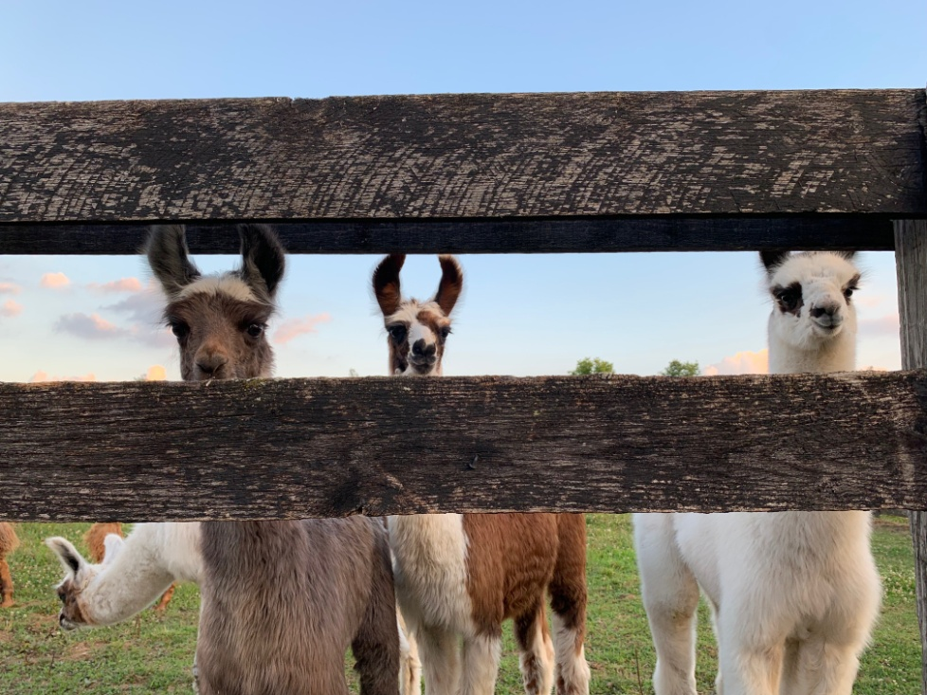
??? Question ???
What is one
Important thing to do when doing chores?
Notes:
Set that everyone is up and eating
Feed, water, minerals

Slide 22
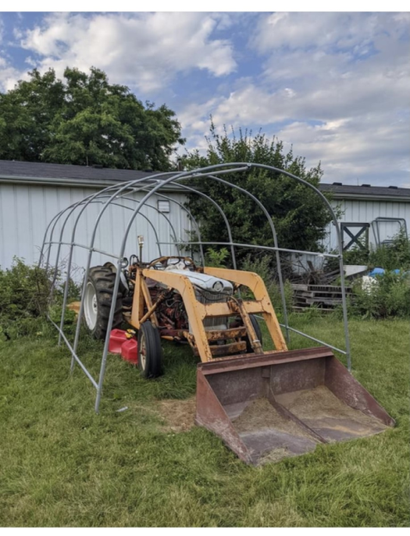
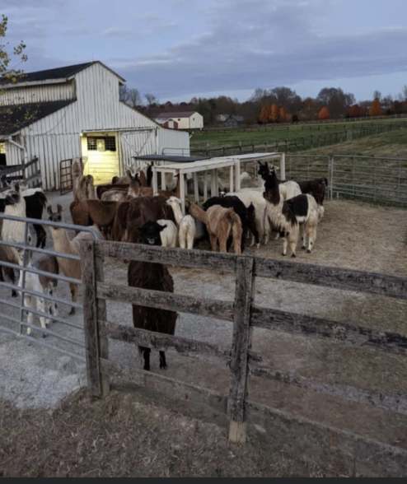
Farm management
Maria Seager: Co-chair
Mark Zerr: Co-chair
Brian Wiggins: Pasture Care
Mark Foerder: Hay Management
Sean Gehen
Plan farm days
Arrange hay deliveries
Trailer maintenance
Oversee maintenance of farm
Notes:
Introduce Committee, ask committee if they have anything to add

Slide 23
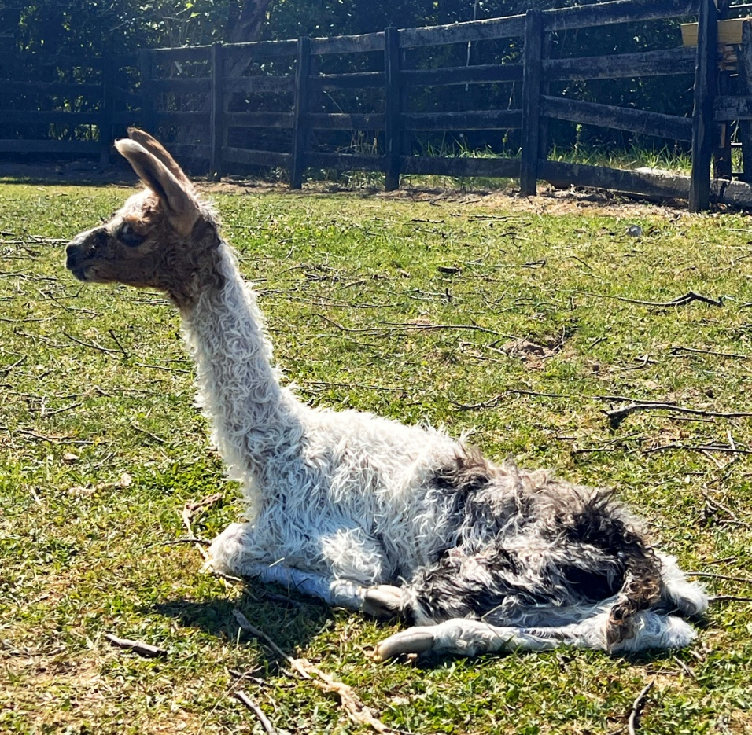
HERD MANAGEMENT
Marilyn Nenni: Chair Melanie Pickett
Lisa Sims Morgan McConahay
Elonda Duprey Maria Seager Kitty Bishop
Notes:
Introduce Herd Management Committee Members

Slide 24
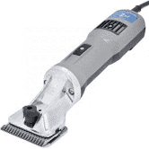
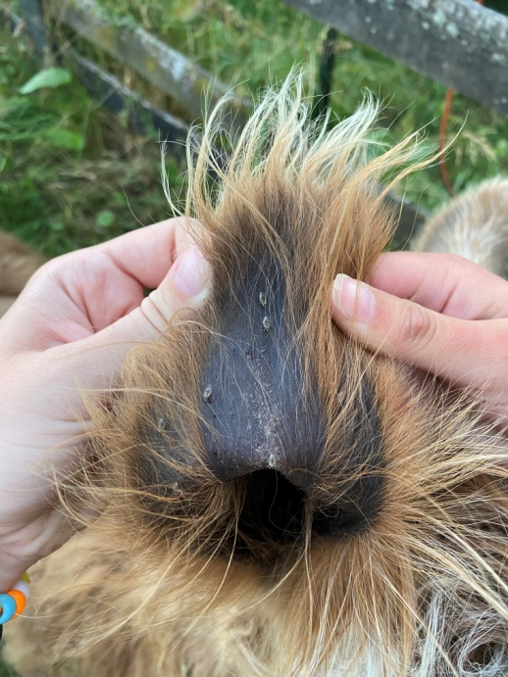
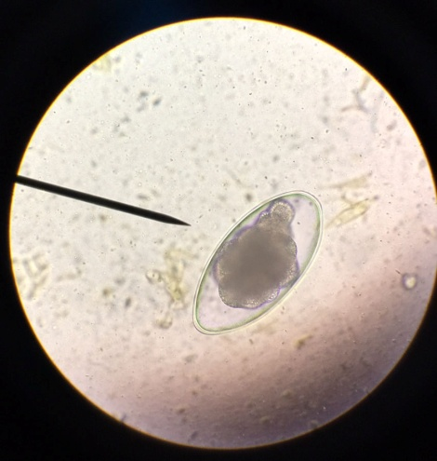
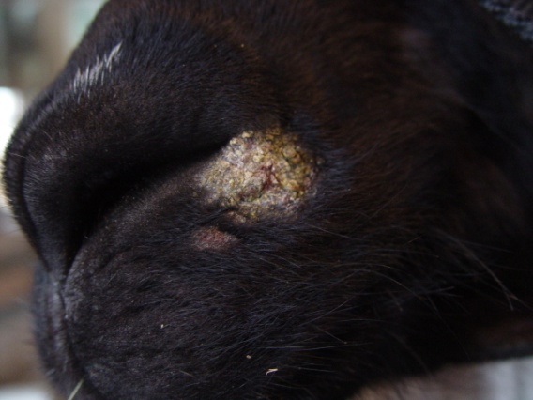
Herd Management
Responsible for
Plan Herd Check days
Annual vaccinations
Shearing
Fecal testing
Breeding/Birthing
Selling and buying of animals
Purchase medical supplies
Maintain animal records
Notes:
Herd Management does ……. Turn over to Marilyn for comments

Slide 25
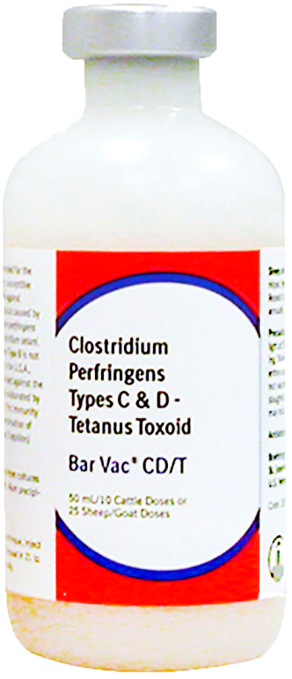
??? Question ???
How often do
we vaccinate a
Llama?
Notes:
Once a year

Slide 26
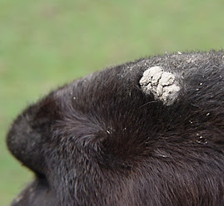
??? Question ???
What is this on
this animal’s nose?
Notes:
Ringworm

Slide 27
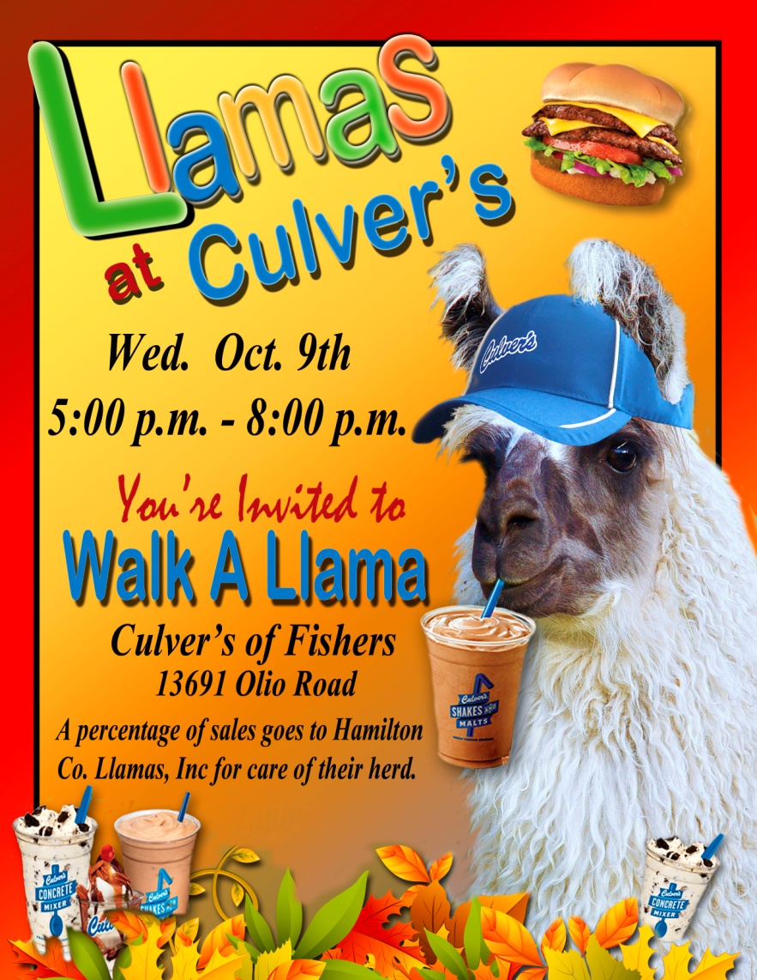
Events/fundraising committee
Stephanie Pisarski
Amy Pommer
Mark Foerder
Amy Robertson
Melinda Wiggins
Notes:
Lauren
Introduce Committee

Slide 28
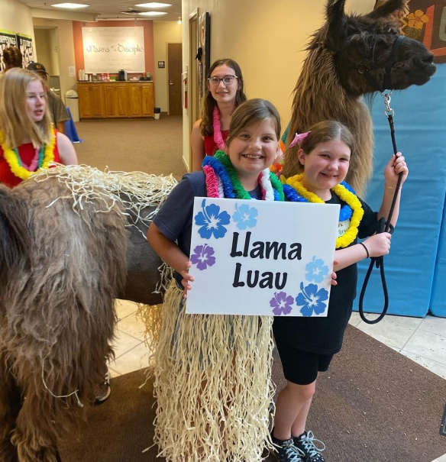
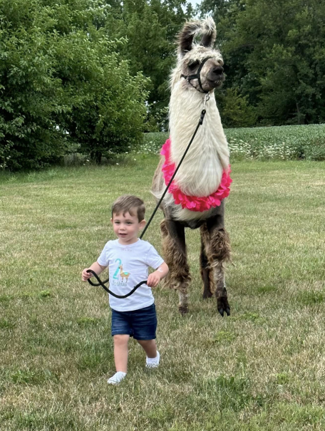
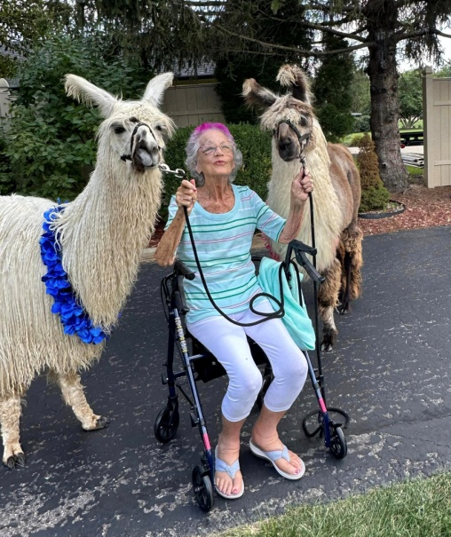
Events/Fundraising
Plan and Promote Community Events
Walk-A-Llama Farm tours
School visits/parties Festivals and parades
Upcoming Events e.g.
Sundown Gardens Fall Festival, Culver’s Westfield Lights
Agape Horse Show, Geist Fall Festival, HTC Christmas
Notes:
Lauren
This committee needs help with visits & transportation. Turn over to Stephanie Pisarski for comments

Slide 29
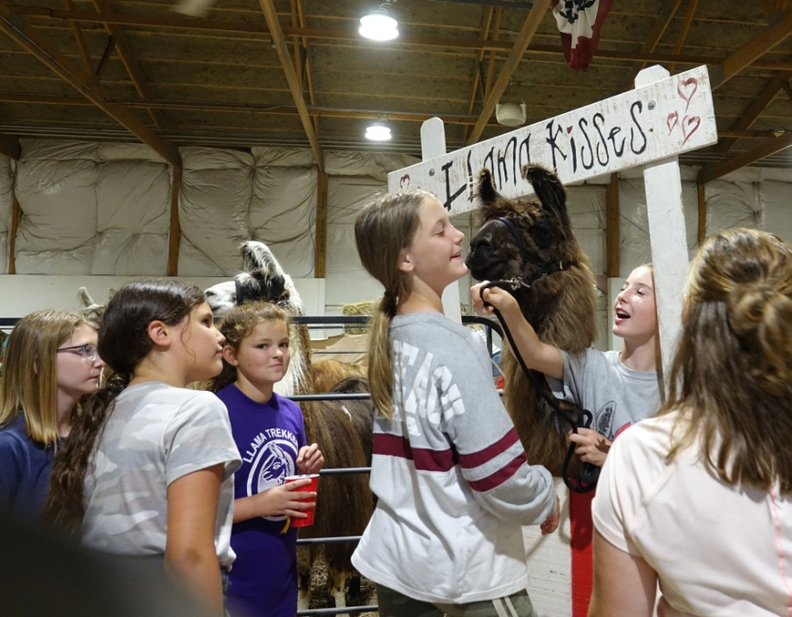
??? Question ???
What is the next HCL
big Event?
Notes:
Sundown Gardens Fall Festival Walk-A-Llama September 30th

Slide 30
committee application for seniors
Would YOU like to serve on a committee?
See the HCL Website for the Youth Committee Application Form
Notes:
Sophia

Slide 31
TASK LIST
e.g.
e.g.
Weed whack Entrance
Help with Breeding
Spray Obstacle
Area
Adjust Waterers
Help with an Event
Build an
Obstacle
Burr Patrol
Clean & Hang Fans
SELECT A TASK OF YOUR CHOICE TO HELP
OUT WITH OUR CO-OP
May be a one-time seasonal job
that fits your schedule.
No Meetings
Sign Up on HCL website
HAMILTONCOUNTYLLAMAS.ORG
Notes:
turn it to Kitty ? Every family should be on a committee and or select a task on the list

Slide 32
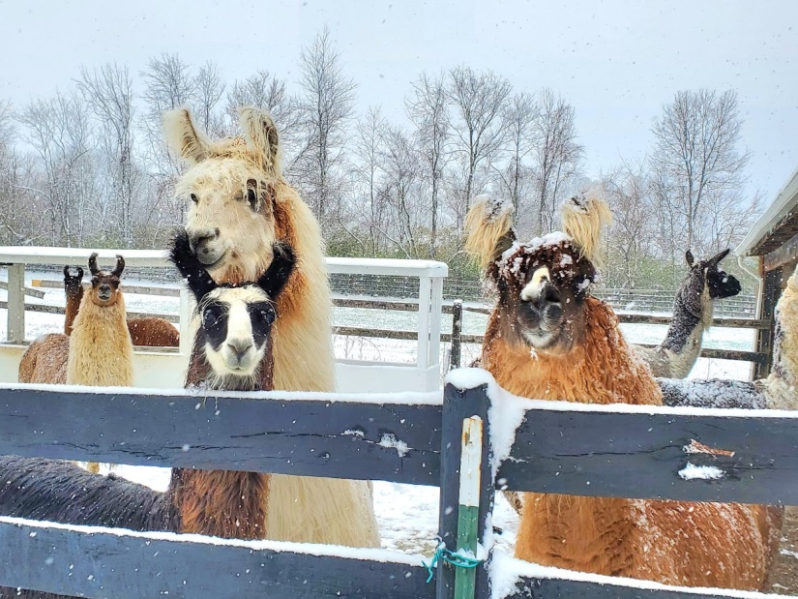
Winter Adoption Judithann Smith
Purpose is to give our animals another extra watchful eye for health concerns, and attention, while we’re not having regular meetings at the farm during the winter season.
Select an animal. Visit, walk, train, give hugs once a week or so.
Send a short report to Judithann at the end of the month.
Program is from November through March. Sign up today.
Notes:
Sophia

Slide 33
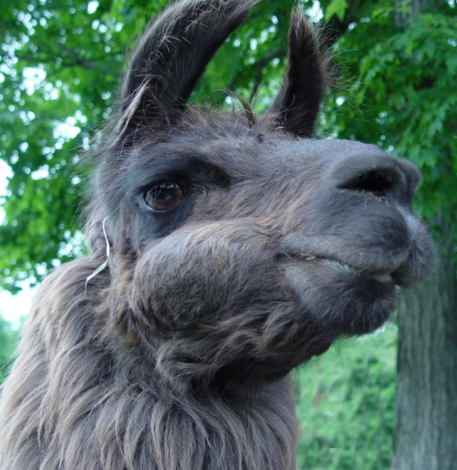
??? Question ???
What is this
Llama doing?
Notes:
Holding his cud & chewing

Slide 34
Raise right FUNDRAISER
Earn money for yourself and for us simply by shopping for your favorite brands/restaurants — turning daily or weekly purchases into funds for our HCL. Half, 50%, of your funds goes to you, the member to use for membership fees. Other half to the HCL. Simply purchase gift cards!
MARIA SEAGER - Chair
Simply download the app. No Selling! You Earn, We Earn!
Detailed Instructions in HCL Membership Manual
Notes:
Introduce Maria Seager as Chair of this project.

Slide 35
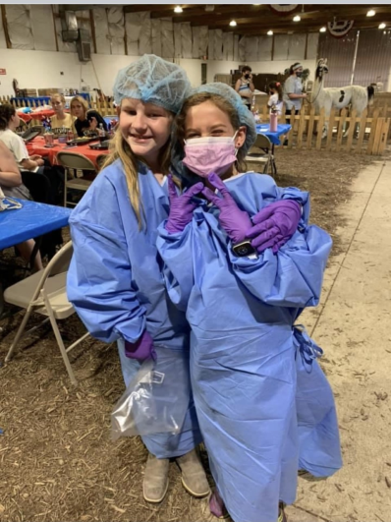
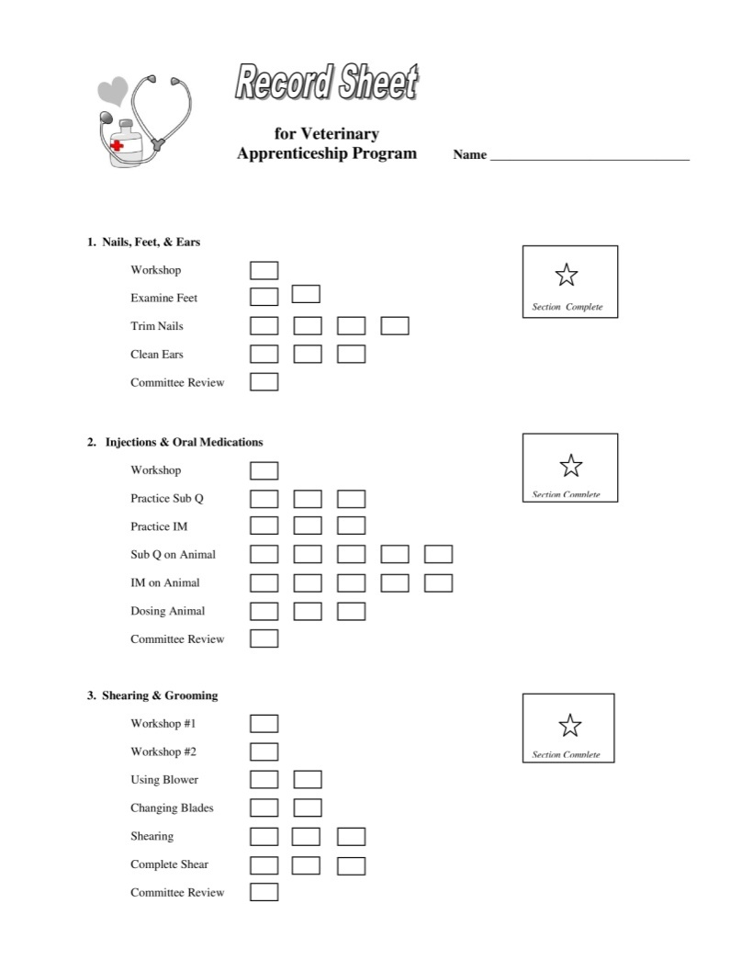
Veterinary Apprenticeship Program
Workshops &
Record Sheet
Help with:
Treatments
Shearing
Birthing
Breeding
Purchase at Bookemon.com
Notes:
For those interested in medical care. Attend the workshops so you can learn to give injections, do the shearing, fecal testing, trim toenails, and give medications.

Slide 36
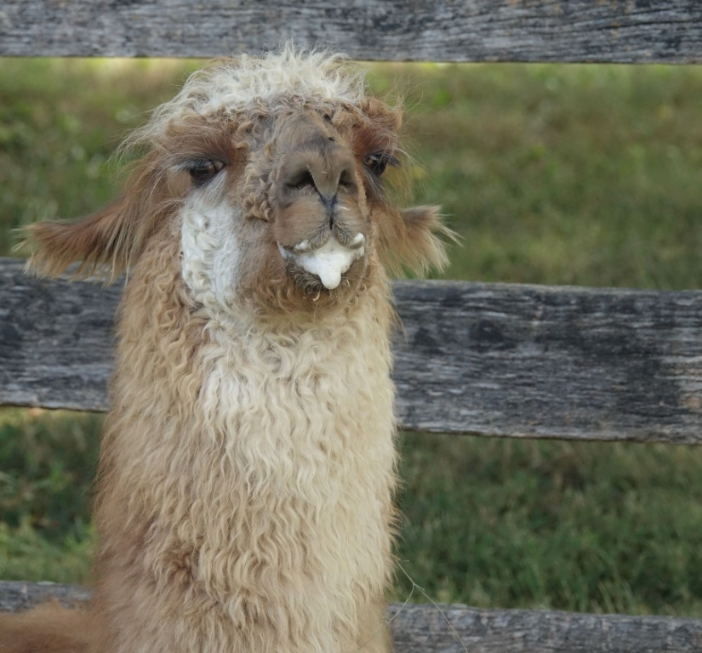
??? Question ???
Uh oh!
What’s happening to this llama?
Notes:
Foam from Chewing the summer clovers

Slide 37
Grants, Gifts employee Matching Funds Volunteer Hours Agricultural/Educational Grants
Notes:
If your workplace has grants we are a non profit who would benefit from it. Looking for different grants to help fund our project: educational/agricultural. Turn over to Kitty Bishop to speak about Grants & Gifts

Slide 38
Free 4-H Program – K thru 2nd grade
4 Meetings Total – Held once a month
Hands-On Llama Experience
Llama Craft
Mini can display at fair
Project Helpers – 8th grade & Up
Earn Community Service Hours
Sign-up in the Hamilton Co. Extension Office
All 4-H Registration Opens October 1st
Notes:
Mini 4-H Llama Program Available K thru 2nd grade
On Hands with the llamas 4 Meetings Sign up in the Extension Officre
April-July

Slide 39
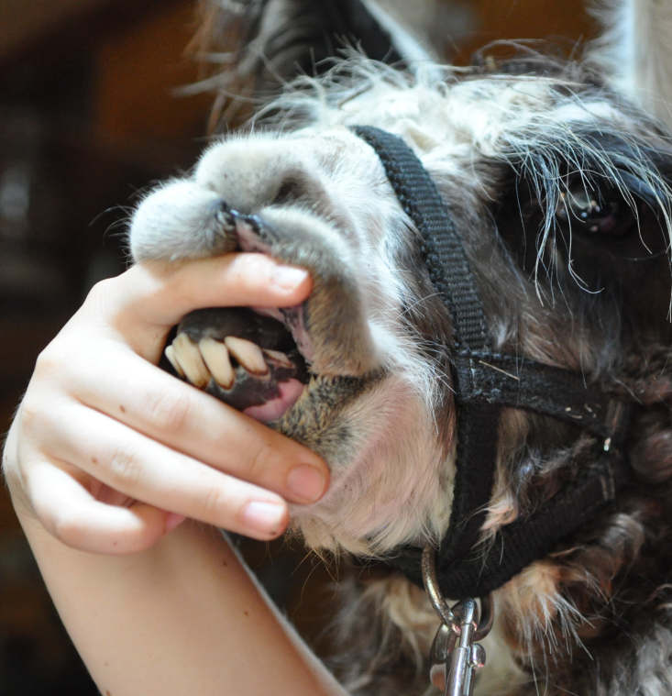
??? Question ???
How many fighting
teeth does a llama have?
Notes:
6 Two up on each side, 1 down

Slide 40
??? Question ???
Where are these dangerous teeth located?
Notes:
6 Two up on each side, 1 down

Slide 41
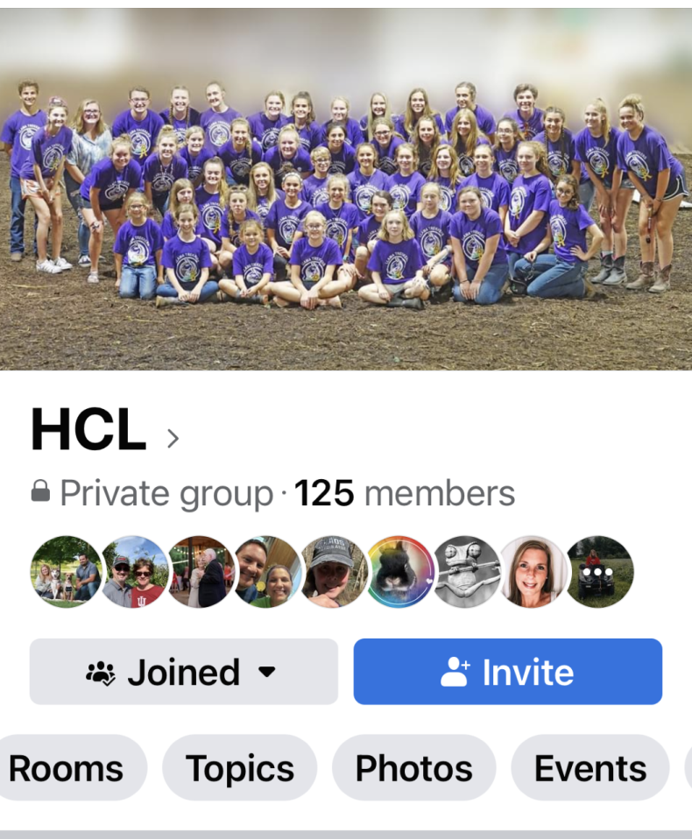
Ways to keep in touch & Social Media
Emails to members with farm, animal, & 4-H news.
Member’s Facebook
This is a closed group – only members.
PR Promotional Facebook
Instagram: hamiltoncountyllamas
Social Media Master: Chris Bishop
Notes:
Lauren
Difference between the facebooks
These addresses are in Membership Manual

Slide 42
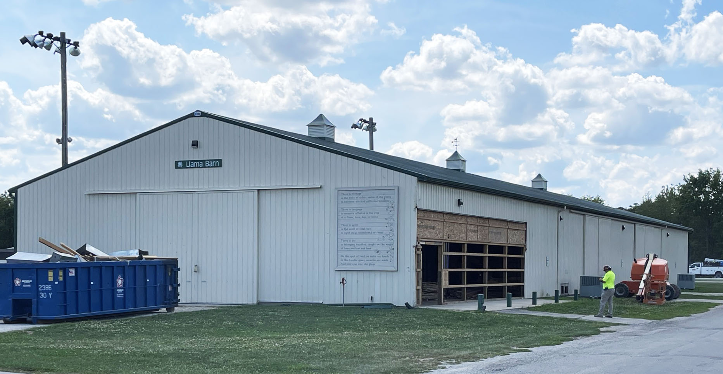
Looking forward to our new llama barn addition 2025
Includes rest rooms, kitchen, & storage room
Notes:
Sophia
New addition to llama barn

Slide 43
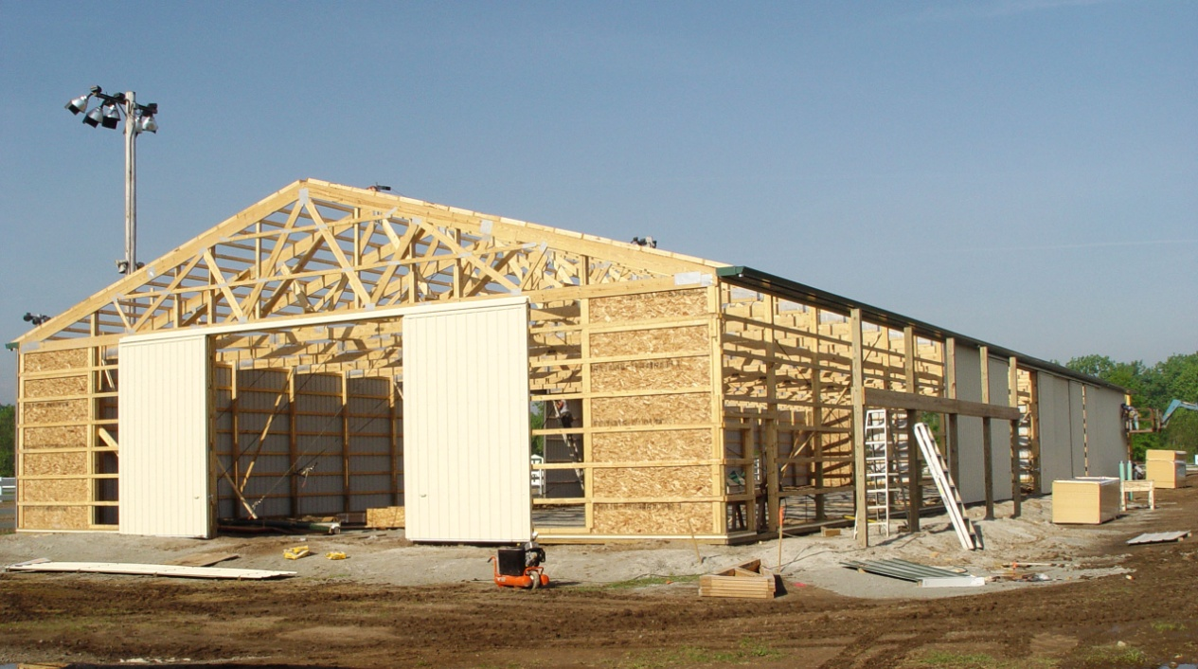
Llama barn history
May 9, 2007
Built by our Llama Trekkers 4-H Club
Planned/saved for ten years
No county money used
Started in April, 2007
Phase 2 (heating & AC) in 2008
Notes:
Where our barn came from

Slide 44
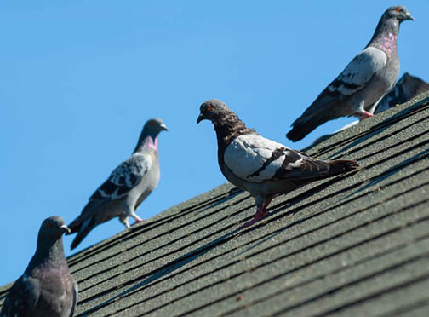
??? Question ???
Not This!
What is on top of our llama barn at the fairgrounds?
?
Notes:
Llama Weathervane on the Cupola

Slide 45
New business to the membership
The Beginning ………….
The Hamilton County llama project was started in 1991. In 2014 a Steering Committee assisted in forming Hamilton County Llamas, Inc.
With this formation, a Board of Directors was formed along with two Advisor roles. Jim and Marilyn Nenni were the initial Advisors.
By-laws were established, Policies & Guidelines were established, and Standing Rules were established.

Slide 46
The current situation
Our current by-laws do not specify that an Advisor is required to be on the bank accounts.
We are an organization that relies on parent involvement. Board seats are for 2-year terms, but unfortunately, special circumstances do occur to have a seat turn-over within the year, which is to be expected when relying on volunteers.
This has caused periods where the bank account is unusable. These instances also do not give us the proper separation of duties.
What is separation of duties? This means that no one person should have sole control. This unfortunately happens when we have either a Secretary or Treasurer leave office. It helps organizations promote transparency and accountability.

Slide 47
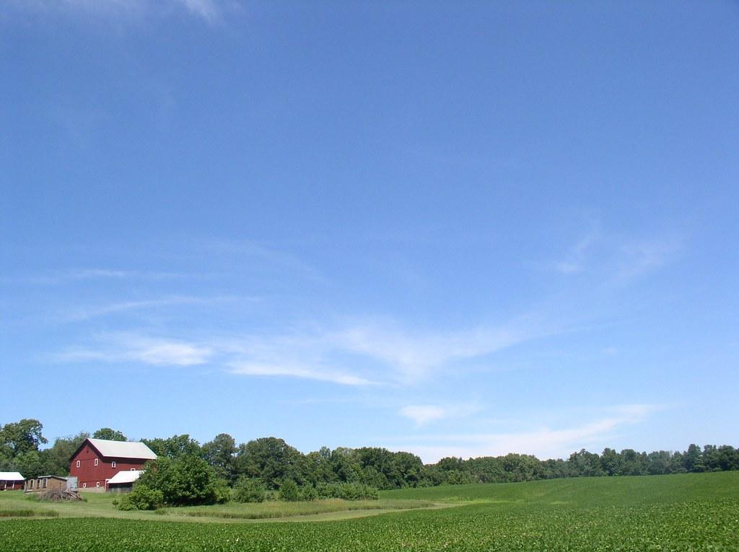
The solution
A solution to the issue would be for one of the Advisors, a consistent non-voting member of our Board, to be allowed to be on the bank account. This would allow our finances to continue as needed while the new Treasurer takes seat. This would be a change in our current bylaws which is done by a member-vote.

Slide 48
Why have Advisors? A person who gives advice in a particular field
* To help a Board of Directors make decisions that are in the best interest of the organization by providing guidance, knowledge, and expertise
* They can offer critical thinking and analysis
* By design, the purpose of an Advisor is to offer advice and guidance to the Board of Directors to help them make decisions that are keeping with the nonprofits mission and vision and that are in the organizations best interest

Slide 49
Who makes a good Advisor?
Someone who has knowledge of the industry and experience
Someone with history of the HCL
Someone invested in the organization
Someone willing to invest in the time commitment
Someone who has an understanding of Board dynamics

Slide 50
Meet our advisors
Marilyn Nenni
-Founder
-Began program in 1991
-Extensive knowledge of llama herd care
-Active Board/Advisor member since Inc founded in 2014
Mark Foerder
-Active member of the organizational committee of the HCL and elected and served as the 1st President
-An active member for 20 years
-3 daughters through the program
-Involved in Board in many capacities including: Treasurer, member-at-large, current active Advisor

Slide 51
Plan for future Advisors:
-Appplication process
-Plan to always have one, not more than two
-voted on by the Board of Directors
-length of term is indefinite but the Board may remove, by a majority vote

Slide 52
Member vote for bylaw change
We hope this has helped you understand the
importance of this needed by-law change.
Current:
There shall be seven (7) members of the Board of Directors (Board) of the HCL all of whom must be HCL members in good standing. In addition, there shall be Advisors, no more than two, as specified in the HCL Policies. The members of the Board of Directors shall consist of four officers, and three other members at large .
Change To:
There shall be seven (7) elected members of the Board of Directors (Board) of the HCL all of whom must be HCL members in good standing. In addition, there shall be Advisors, no more than two, as specified in the HCL Policies. The members of the Board of Directors shall consist of four officers, and three other members at large (elected by the membership).
Reason: Giving definition to the Advisors who have always been a part of the Board of Directors.

Slide 53
Continued…..
Current:
Treasurer: The Treasurer shall be elected by the Board of Directors for a one (1) year term. The Treasurer shall receive all monies and securities belonging to this HCL and shall distribute or otherwise deal with the same as ordered by the Board of Directors. He/she shall keep an accurate account of all monies received and disbursed and shall generally perform such duties as may be required by the member of the Board. The Treasurer shall give a full and comprehensive annual report in writing, of the financial standing and affairs of the HCL to the membership in conjunction with the Annual Membership Meeting. In addition to the Treasurer, another member from the Board of Directors shall be added to the HCL financial accounts.
Change To:
Treasurer: The Treasurer shall be elected by the Board of Directors for a one (1) year term. The Treasurer shall receive all monies and securities belonging to this HCL and shall distribute or otherwise deal with the same as ordered by the Board of Directors. He/she shall keep an accurate account of all monies received and disbursed, give a full financial report at each board meeting as specified in HCL Policies. and shall generally perform such duties as may be required by the member of the Board. The Treasurer shall give a full and comprehensive annual report in writing, of the financial standing and affairs of the HCL to the membership in conjunction with the Annual Membership Meeting. In addition to the Treasurer, another member from the Board of Directors and an HCL Advisor shall be added to the HCL financial accounts.

Slide 54
HCL Business Nomination and Election for 4 new HCL Board Members
Thank you for your term on the HCL Board of Directors:
Kitty Bishop
Lisa Sims
Mark Zerr
2024-2026 Term
Four (4) Open Positions
Term is for (2) Two Years
* Slate of Candidates
* Nominations from the Floor
Notes:
TURN OVER TO Kitty Bishop

Slide 55
Members: We know where we’ve been! We know where we are! But, Do we know Where we are we going?
Notes:
While the votes are being counted

Slide 56
??? Questions ???
NEED FOR CONCERN:
Recent Farm Contract Negotiations
Are We In A Secure Position?
Future Investments In This Property
Just About To Meet Our Goals For Breeding Herd
& Income from Sales
LONG-TERM PLANNING:
What Are Our Goals for the HCL?
Where Do We Want To Be In Two Years?
How To Accomplish Those Goals?
~~~~~~~~~~~~~
Membership Involvement/Dedication/Input
Grants Sponsorships Investors Contacts Partnerships
Land/Farm? Business Plan!
HCL Future Planning Committee?
Hire Consultants?
~~~~~~~~~~~~~
Without Involvement & Planning, We May Be
Facing Dissolution.
Notes:
Important Concerns! What are Solutions? Help Needed!

Slide 57
Open to Comments/Questions?
MEMBER’S COMMENTS
Notes:
Lauren
Questions?

Slide 58
NEXT STEPS TO JOIN
SIGN UP NOW for a Great Year!!
Membership Renewal & New Members
Turn in Today, Mail in, Register Online
First membership fee is due October 1st
Membership Waiver Needed – Online
SIGN UP to Help Committees
SIGN UP on Task List (or we can assign you)
HCL Membership Book
Animal Information
Volunteer in our Co-op – we ALL Share!
Grants & Gifts
Website Links
Information about HCL opportunities offered
HCL Record sheet to turn in with 4-H Books - Mandatory
THANKS TO ALL OUR GREAT FAMILIES!!
Notes:
Ask if anyone has anything to add

Slide 59
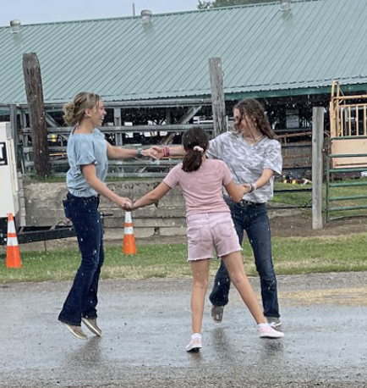
??? Question ???
What are you most looking forward to this coming year?
Notes:
Maybe a new member can answer this

Slide 60
THANK YOU FOR COMING! We look forward to a great llama year!
Notes:
Lauren
Thank you for coming. Looking forward

Slide 61
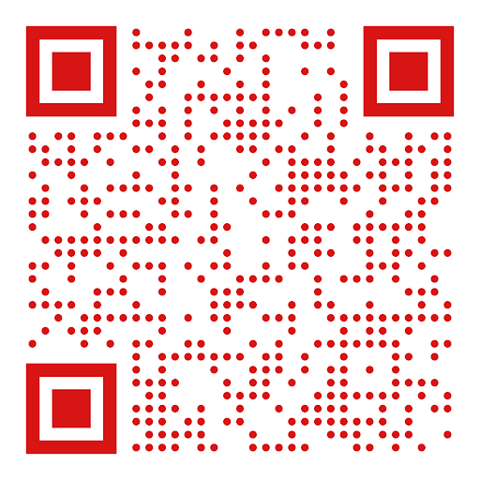
New member registration
Please Complete ALL Items Listed
COMPLETE FORM
SIGN WAIVER AND PAY DUES
SIGN UP ON TASK LIST
Sign Up for 4-H Llama Project
at your convenience on the 4-H
website.
https://extension.purdue.edu/county/hamilton/4H/index.html
Notes:
Sophia

