Slide 1

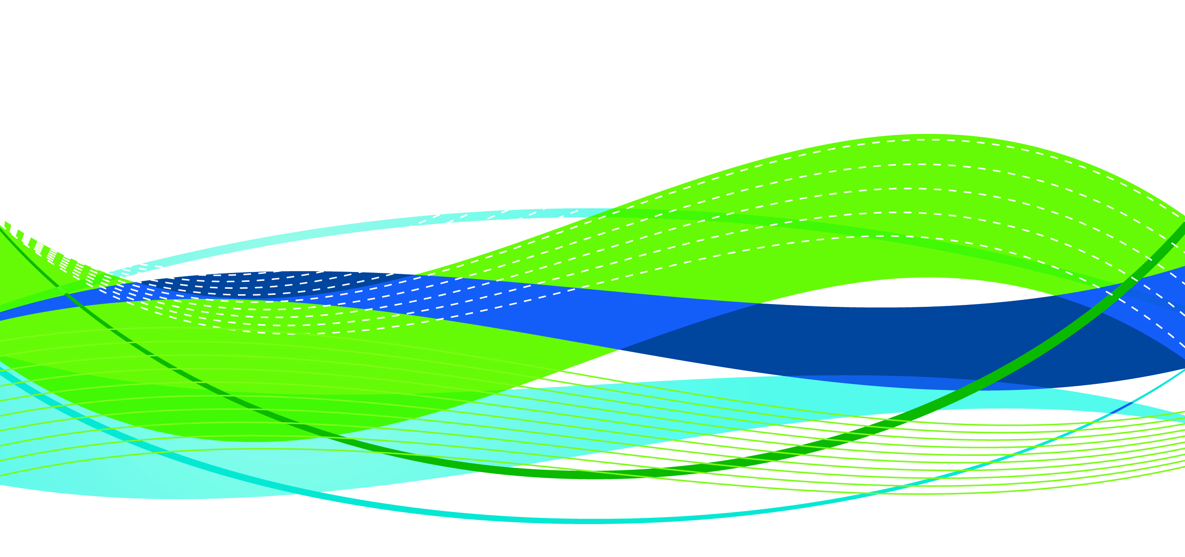
Indiana Rural Health Association
January 23, 2018
Brock Slabach, MPH, FACHE
Sr. Vice-President
National Rural Health Association
Leawood, KS
Notes:
ALAN

Slide 2
Improving the health of the 62 million who call rural America home.
NRHA is non-profit
and non-partisan.

Slide 3
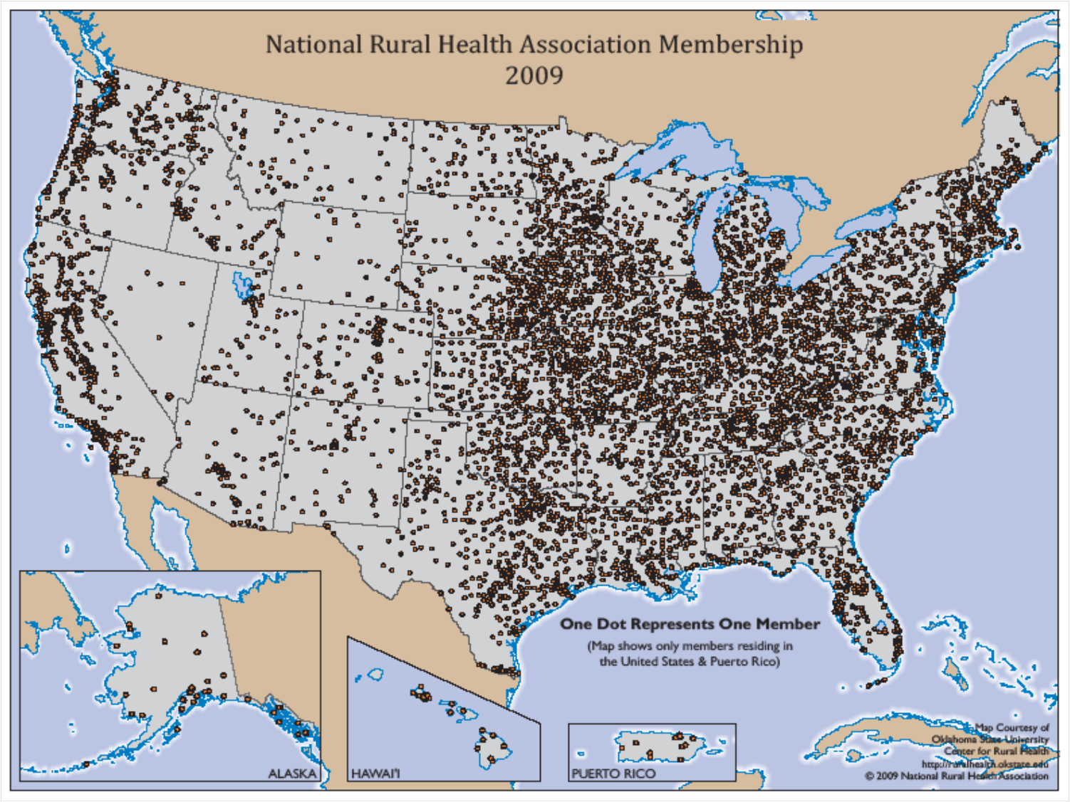
National Rural Health Association Membership

Slide 4

Destination NRHA
Plan now to attend these upcoming events.
Policy Institute—February 6-8, 2018• Washington, DC
Annual Conference—May 8-11, 2018• New Orleans, LA
Rural Hospital Innovation Summit—May 8-11, 2018• New Orleans, LA
RHC/CAH Conference—September 25-28, 2018• Kansas City, MO
Visit RuralHealthWeb.org
for details and discounts.

Slide 5
Indiana Top 20 Hospitals in USA
Top 20 Rural Community Hospitals
Major Health Partners, Shelbyville, IN 2017 Memorial Hospital & Health Care Center, Jasper, IN 2017 Parkview Huntington Hospital, Huntington, IN 2017
Top 20 Critical Access Hospital
Margaret Mary Health, Batesville, IN 2016-17

Slide 6

The State of Rural America
Workforce Shortages
Vulnerable Populations
Chronic Poverty

Slide 7
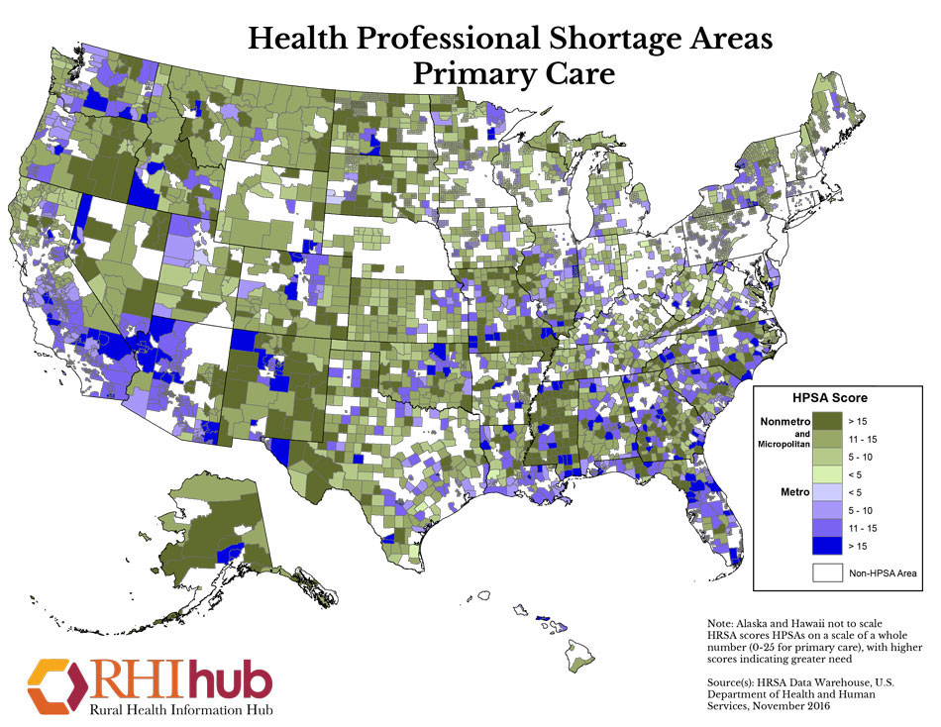
6,000 areas in the U.S. are primary care health shortage areas;
4,300 areas are dental health shortage areas; and
3,500 areas are short of mental health shortage areas.

Slide 8
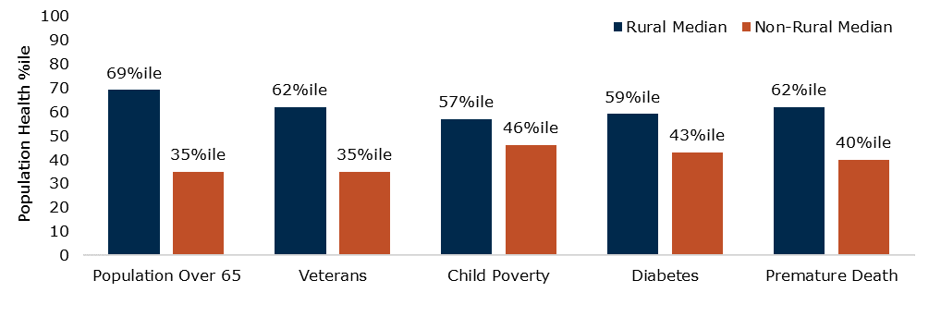
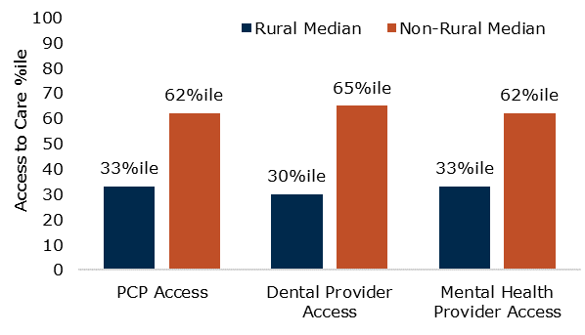
Rural Populations Suffer many Health Disparities
Rural hospitals care for older, poorer, and sicker populations than non-rural providers:
These rural populations also have less access to primary, dental, and mental healthcare:

Slide 9
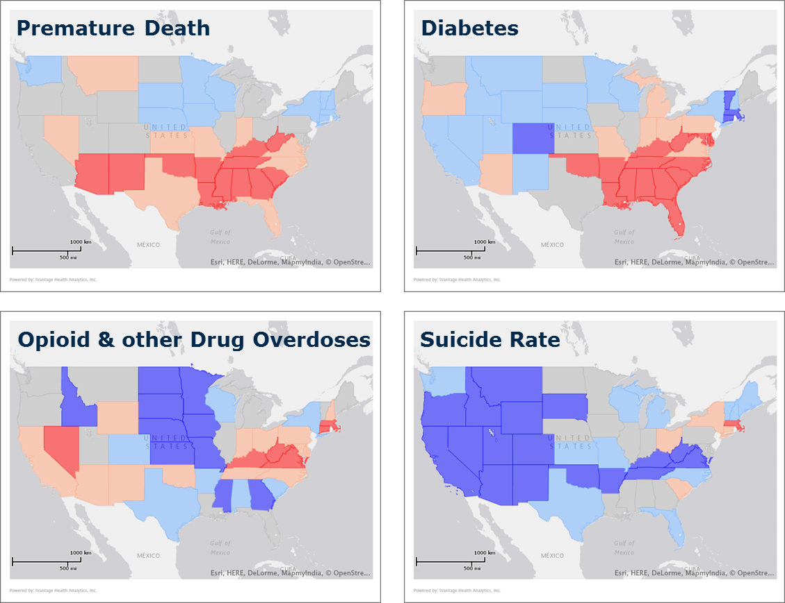
Rural Health Disparities Vary by State
Rural communities in the South are faced with the highest rates of premature death and diabetes in the nation.
Opioid abuse is most prevalent across the Mid-Atlantic and West, while rural populations in the Northeast see the highest suicide rates.

Slide 10

Rural Mortality Rates.
A Rural Divide in American Death
Center for Disease Control January, 2017 Study:
“The death rate gap between urban and rural America is getting wider”
Rates of the five leading causes of death — heart disease, cancer, unintentional injuries, chronic respiratory disease, and stroke — are higher among rural Americans.
Mortality is tied to income and geography.
Minorities, especially Native Americans die consistently prematurely nation-wide, but more pronounced in rural.
Startling increase in mortality of white, rural women. Causes:
  Risky lifestyle (smoking, alcohol abuse, opioid abuse, obesity)
  Environmental cancer clusters
  Suicides
January 2017

Slide 11
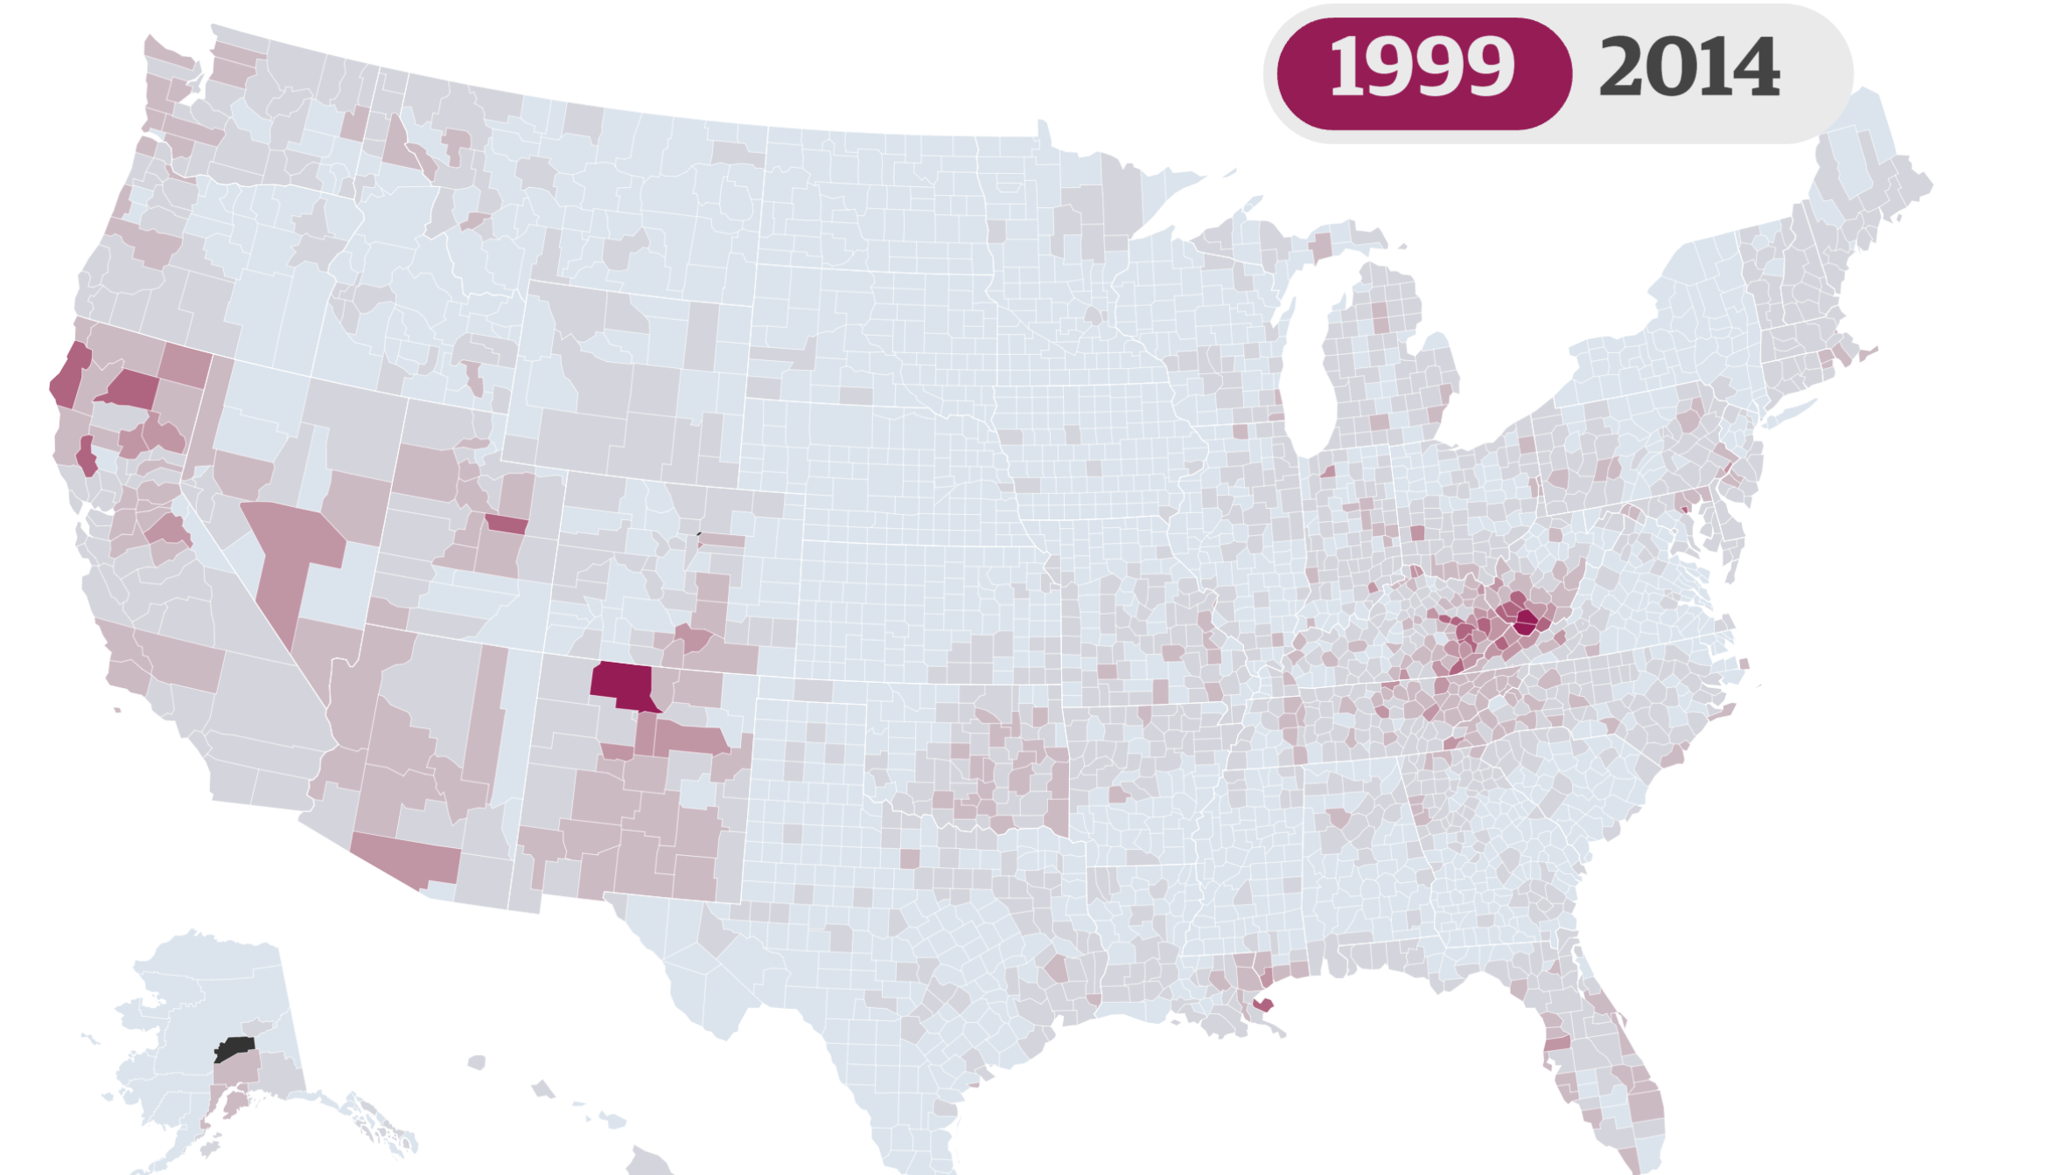
Mapping the Opioid Crisis

Slide 12
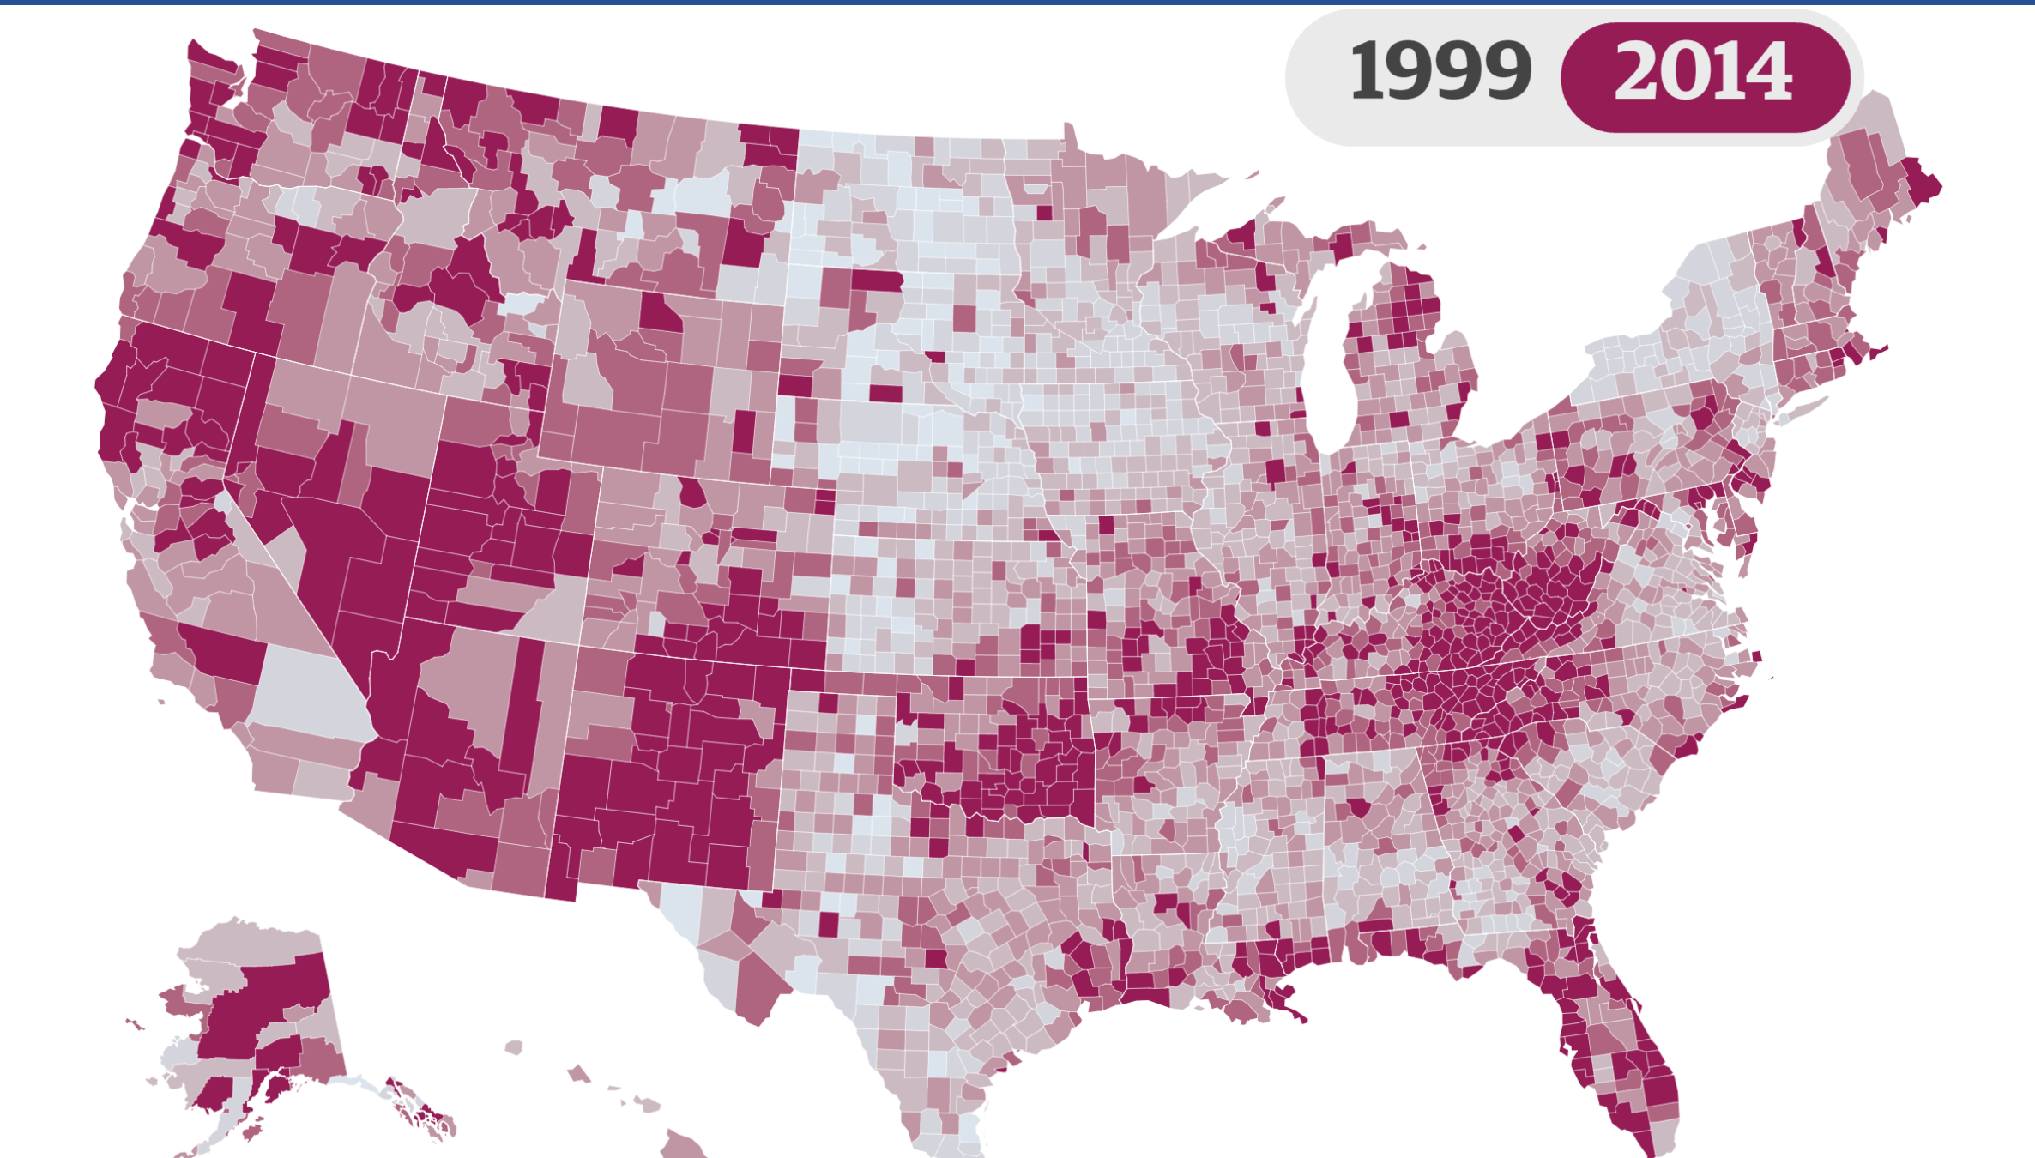
Deaths per 100,000 residents

Slide 13
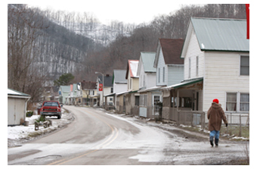
Chronic Poverty

Slide 14
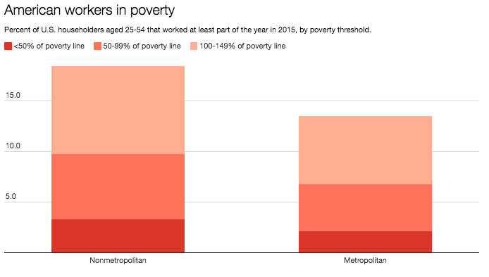
Poverty in Rural America
PBS News, March 2017

Slide 15
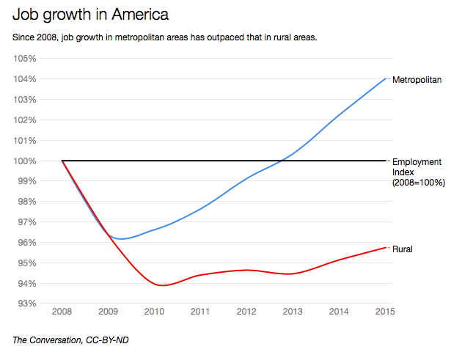

Slide 16
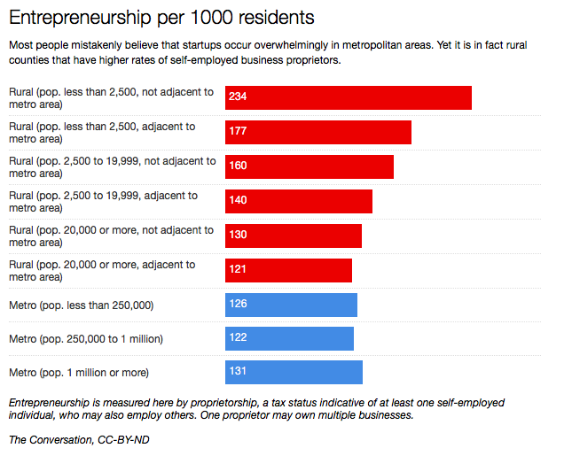
Rural Resilience

Slide 17

The Shutdown Shut Down
18th Government shutdown in since 1976
Last Government shutdown was in 2013
Average days per shutdown: 6.9
Shutdowns are constitutional in nature: Article I, Section 9, which says, "No Money shall be drawn from the Treasury, but in Consequence of Appropriations made by Law.“
Appropriations since Oct. 1, 2017 have been made by Continuing Resolutions (CR), there have been 4 CRs in FY 2018

Slide 18
What is in the 4th Continuing Resolution…
and not?
CHIP reauthorized for 6 years
Government funded through Feb. 8, 2018
Another show down deadline, potentially
Delay ACAs medical device and Cadillac taxes for two years
Delay ACAs health insurance tax for one year
What is NOT in the Continuing Resolution:
Medicare Extenders
  Low-Volume Hospital Program
  Medicare Dependent Hospital Program
  Rural Ambulance Add-on
  Rural Home Health Add-on
  Geographical Practice Cost Index (GPCI)
FQHC ACA Funding Cliff

Slide 19


New Year, Same Rural Issues
Rural PPS Hospital Payment Cuts
Renewed Threats on Swing Bed Payments for Critical Access Hospitals
Rural Hospital Closures
CHIP, Community Health Centers Funding
Continued Medicare Cuts cause continued harm
  Sequestration
  Bad Debt Reductions
Potential for government shutdown - - again.

Slide 20

New Tax Bill has Rural Health Implications
Sweeping tax overhaul bill in a largely party-line vote. (Just one Republican, Tennessee Senator Bob Corker, voted against it on deficit concerns.)
The Congressional Budget Office estimated the bill will cost $1.47 trillion over a decade.
Many Republicans continue to say the bill will pay for itself through greater economic growth.

Slide 21
Not Just a Tax Reform Bill…Significant Health Care Changes Likely
Includes repeal of ACA’s individual mandate.
  The 3 GOP senators who helped prevent Republican efforts to repeal and replace the ACA, each indicated that they have little concerns with eliminating mandate.
  Democrats and other supporters say is this could fundamentally dismantle ACA. (Likely result in 10% increase in exchange plans.)
Other health issues: the medical expense deduction and the orphan drug tax credit (incentivizes research into treatments for rare diseases) – reduced significantly.
Win: Private Activity Bonds Tax Exemption is preserved.

Slide 22

Potential for Sequestration would be devastating to rural providers
Congress could be forced to cut $136 billion, including $25 billion from Medicare, in mandatory spending programs next year.
The current Medicare 2% limitation under the Budget Control Act will be doubled to 4% in this new sequester, resulting in a 6% total cut to reimbursements when stacked on top of the sequester from BCA.
Congress could prevent the cuts, but would need 60 votes in the Senate, requiring several Democrats to support it.

Slide 23



Impact of Sequestration
$2.8 billion
lost in rural Medicare reimbursement (over 10 years)
2%
cut
7,200
jobs lost in rural hospitals and communities (sustained over 10 years)
-0.6%
off the bottom line
30
rural hospitals shifting from profitable to unprofitable
Chartis

Slide 24

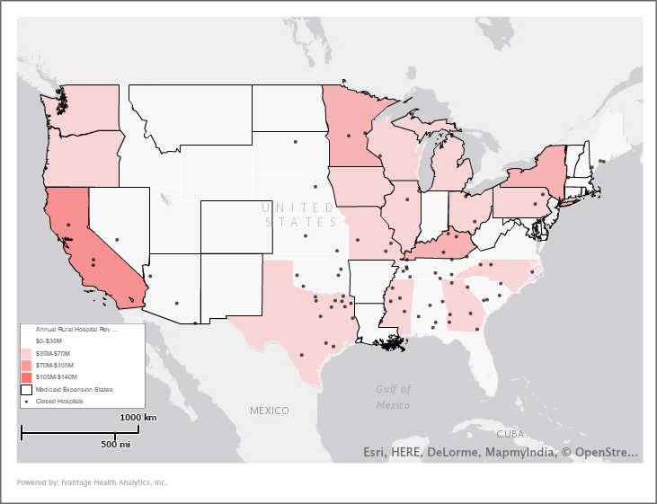



2018: Can We Expect More Proposals to Block Grant Medicaid?
Total Rural Hospital Revenue Lost within the First Year of Medicaid Cuts the AHCA
$1.4B
loss in revenue within the first year
37,000
jobs lost
within the first year¹
$4.1B
loss to GDP
within the first year²
All data sourced from HCRIS, 2017. Please refer to Methodology for additional details.
¹ Methodology sourced from Rural Health Works, 2016.
² Methodology sourced from The World Bank, 2017.

Slide 25
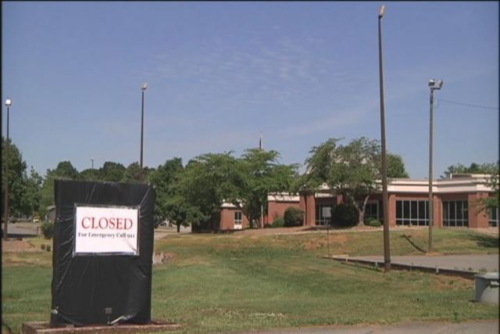
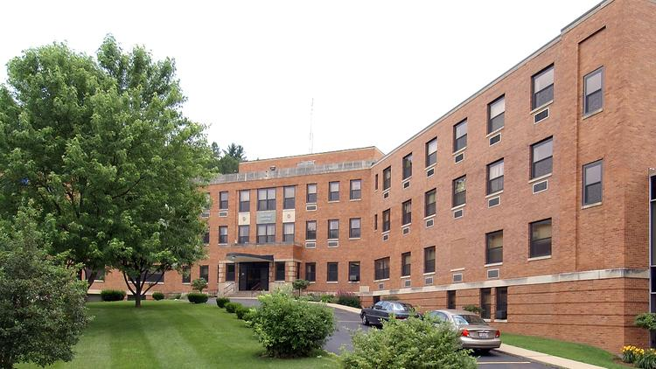
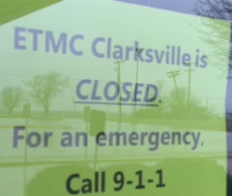
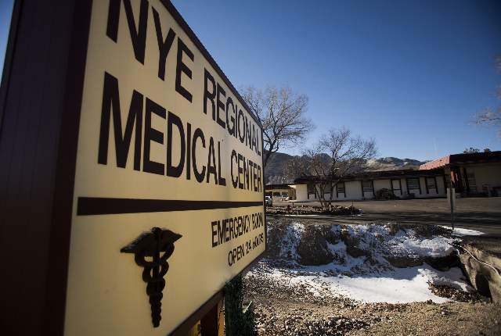
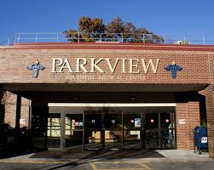
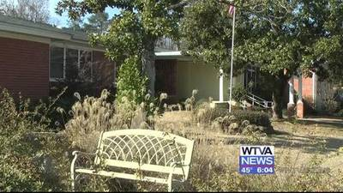
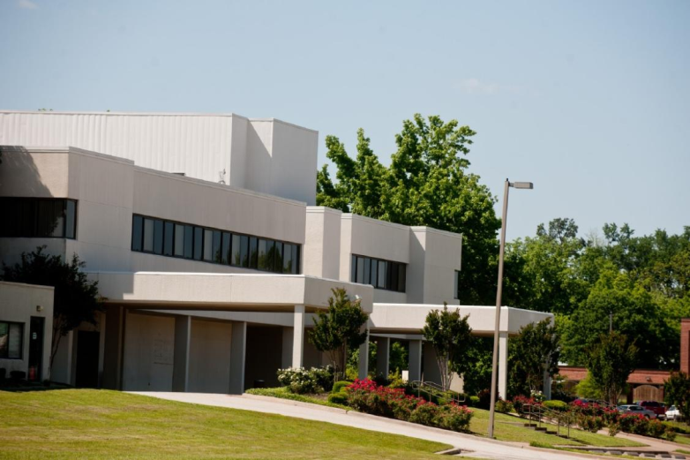

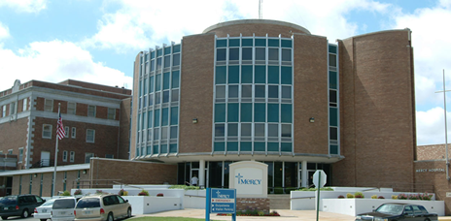
Rural Hospital Closures Continue…

Slide 26
“If you want to watch a rural community die, kill its hospital” Sept. 22, 2017, HuffPost
GLENWOOD, Ga. ― After the Lower Oconee Community Hospital shut down in June 2014, other mainstays of the community followed. The bank and the pharmacy in the small town of Glenwood shuttered. Then the only grocery store in all of Wheeler County closed in the middle of August this year.
On Glenwood’s main street, building after building is now for sale, closing, falling apart or infested with weeds growing through the foundation’s cracks…
The hospital’s closure eliminated the county’s biggest health care provider and dispatched yet another major employer. Glenwood’s mayor of 34 years, G.M. Joiner, doubts that the town will ever recover.
“It’s been devastating,” the 72-year-old mayor said, leaning on one of the counters in Glenwood’s one-room city hall. “I tell folks that move here, ‘This is a beautiful place to live, but you better have brought money, because you can’t make any here.’”
Rural hospitals are in danger across the country, their closures both a symptom of economic trouble in small-town America and a catalyst for further decline.

Slide 27
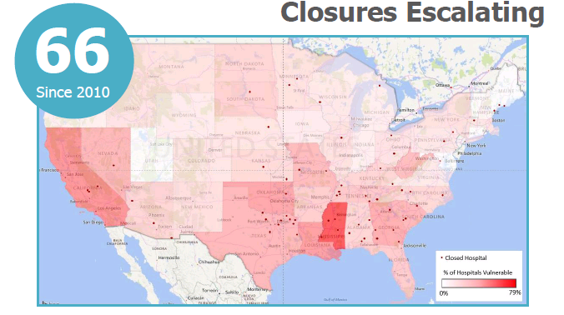
Rural Hospital Closures and Risk of Closures
83
X
Percent Vulnerable
35%

Slide 28
New Rural Data From Chartis
Rural Hospitals Continue to Lose Money:
44% of rural hospitals operate a loss (up from 41% according to our research from one year ago)
30% operating below -3% margin (vs. 29% previously).
The median rural hospital margin falls at a thin 1.3%.
Why are Rural Hospitals Losing Money?
Across the nation, rural hospitals absorb a combined $318M in annual revenue cuts due to sequestration ($351M under previous research).
Bad debt cuts cause $3.8 billion/ten more to be lost.
For 30 rural hospitals, this was the difference between operating in the black (prior to sequestration) and the red (actual margin).
The median rural hospital loses $71K annually from the sequester.

Slide 29
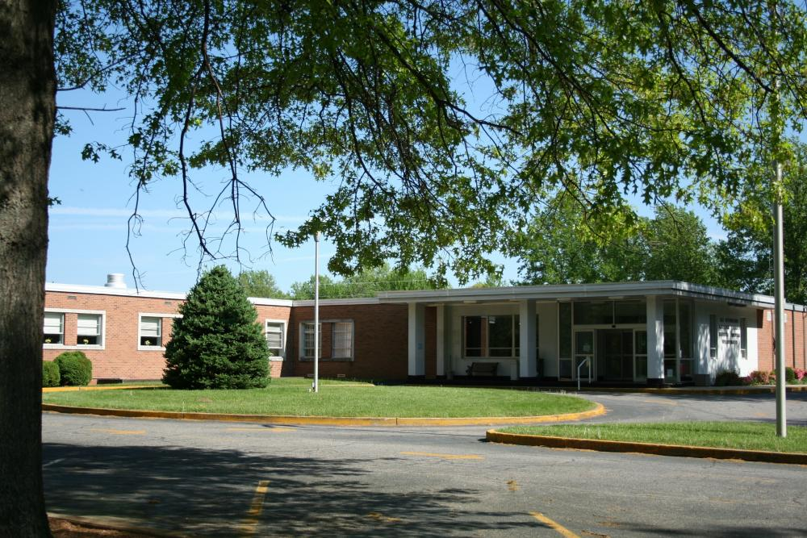
The latest closures…
Pioneer Community Hospital in Stuart, Virginia.
25-bed facility with 2200 emergency room visits each year.
“To me, closing the hospital is one of the most terrible things that could happen to the county.”
Roger Hayden, County Supervisor
EMS - - transport times will now be
2-3 hours instead of 30 minutes.

Slide 30
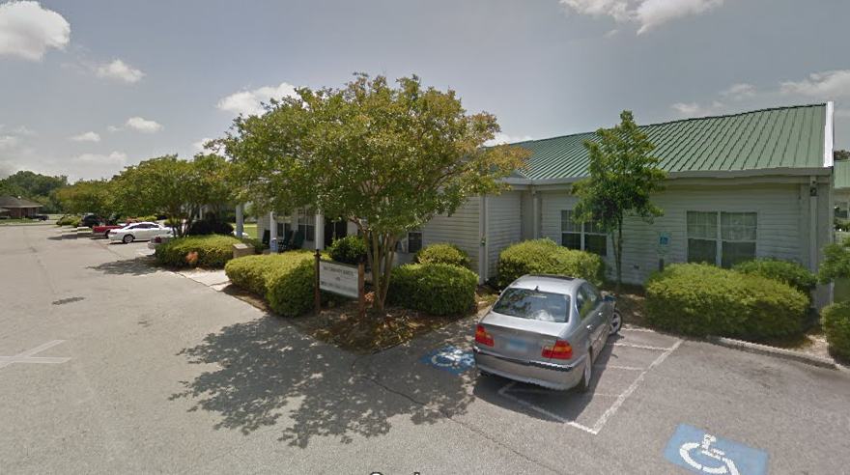
“Small Eastern North Carolina Town Losing its Hospital”
Hill-Burton 20-bed CAH
County’s unemployment rate 30% higher than rest of state.
“Our hospital, like many small rural hospitals, reflect the local economy.”

Slide 31
CAH Lab Services
“Vulnerable Rural Hospitals Face Tough Decisions On Profitable But Questionable Billing Schemes”
KCUR and KBIA in Missouri ran a story outlining issues regarding reference lab billing programs. Brian Bauer, Esq, Hall Render was interviewed in this clip.

Slide 32


Slide 33
Rural communities are still grappling with the economic consequences of the Great Recession
200,000 jobs were lost per year in rural counties during the Great Recession
749 non-metro communities are still experiencing increasing unemployment
95% of the jobs that have returned since the Recession have been in urban areas
With rural hospitals closing, more jobs and more communities are at risk
This can, and should, be a part of any impending infrastructure package from Congress and the White House

Slide 34
Focus on rebuilding rural health in the infrastructure package
In order to incorporate rural health programs into infrastructure legislation and plans, we’ve developed a three-prong approach:
Save Rural Hospitals
  Pass legislation to keep rural hospitals open, maintain jobs, and ensure access to care
Cut Red Tape
  Reform existing programs that don’t bring grants and funding to the communities that need it most
Build Infrastructure
  Improve telehealth and transportation services to increase availability and delivery of care

Slide 35
New Threats on CAH Swing Beds in Ways and Means Rural Extenders Bill
“Yesterday, the urban-centric House Ways and Means Committee is advancing legislation that will result in the closure of even more rural hospitals, further decimating access to health care and further escalating economic decline in rural communities across the country. Instead of advancing policies to improve the plight of rural America (where health disparity and mortality gaps between urban and rural populations escalate, and unemployment rates continue at levels of the Great Recession), the Ways and Means Committee calls for payment reductions to rural safety net hospitals known as Critical Access Hospitals. And, perhaps the most hypocritical factor, is that the Committee plans to use this devastating payment cut to Critical Access Hospitals to partially pay for other important rural health programs that Congress has irresponsibly let expire.”

Slide 36

Vigilance/Re-education is Needed to Protect Swing Beds
According to UNC Sheps, the March 2015 OIG Report was flawed:
  The OIG report over-estimates the potential Medicare savings by removing swing beds from cost-based reimbursement.
  The OIG report ignores the fact that skilled nursing days in rural SNF facilities increased roughly one third faster than stays in swing beds.
  The OIG report overstates the limited evidence that outcomes and characteristics of swing patients in CAHs are similar to patients in SNFs.
UNC Shep’s conclusion on the OIG report in 2015: “We believe the OIG has made methodological choices that resulted in errors, and therefore, the conclusions and policy recommendations are suspect.”
Even then CMS Administrator Sylvia Burwell critizes GAO report.

Slide 37
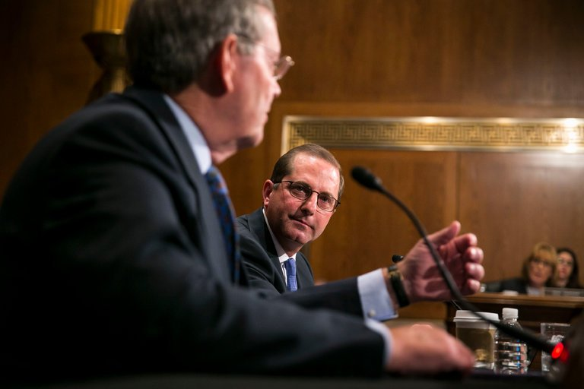
New HHS Secretary Nominee
Alex Azar - - President’s nominee for HHS Secretary
Senate Finance Committee reported out positive recommendation
Full Senate confirmation vote not scheduled, hopeful end of January
Azar was grilled on whether he was firmly committed to reducing drug prices.)
NRHA submitted questions at Senate HELP Committee and will do the same at Senate Finance
So far 3 Senate Democrats announced they will vote for confirmation

Slide 38
Important New Pieces of Legislation
NOSORH Reauthorization Legislation to be introduced (Roberts and Franken)
The Veterans Community Care and Access Act of 2017 – (McCain and Moran)
  Specifically acknowledges the crucial role that CAHs can play in providing local care for rural veterans;
  Requires prompt pay and requires cost-based reimbursement for CAHs. This will help CAHs keep their doors open to provide care while giving veterans even more choices for localized community care.
  Additionally, expands the VA’s telemedicine program, and works to ensure safe opioid prescribing practices.

Slide 39
Save Rural Hospitals Act, HR 2957
Rural hospital stabilization (Stop the bleeding)
  Elimination of Medicare Sequestration for rural hospitals;
  Reversal of all “bad debt” reimbursement cuts (Middle Class Tax Relief and Job Creation Act of 2012);
  Permanent extension of current Low-Volume and Medicare Dependent Hospital payment levels;
  Reinstatement of Sole Community Hospital “Hold Harmless” payments;
  Extension of Medicaid primary care payments;
  Elimination of Medicare and Medicaid DSH payment reductions; and
  Establishment of Meaningful Use support payments for rural facilities struggling.
  Permanent extension of the rural ambulance and super-rural ambulance payment.
Rural Medicare beneficiary equity. Eliminate higher out-of pocket charges for rural patients (total charges vs. allowed Medicare charges.)
Regulatory Relief
  Elimination of the CAH 96-Hour Condition of Payment (See Critical Access Hospital Relief Act of 2014);
  Rebase of supervision requirements for outpatient therapy services at CAHs and rural PPS See PARTS Act);
  Modification to 2-Midnight Rule and RAC audit and appeals process.
Future of rural health care (Bridge to the Future)
Innovation model for rural hospitals who continue to struggle.

Slide 40
Future Model: Community Outpatient Model
24/7 emergency Services
Flexibility to Meet the Needs of Your Community through Outpatient Care:
  Meet Needs of Your Community through a Community Needs Assessment:
  Rural Health Clinic
  FFQHC look-a-like
  Swing beds
  No preclusions to home health, skilled nursing, infusions services observation care.
TELEHEALTH SERVICES AS REASONABLE COSTS.—For purposes of this subsection, with respect to qualified outpatient services, costs reasonably associated with having a backup physician available via a telecommunications system shall be considered reasonable costs.”.
“The amount of payment for qualified outpatient services is equal to 105 percent of the reasonable costs of providing such services.”
$50 million in wrap-around population health grants.

Slide 41
VBP for Critical Access Hospitals
National
Voluntary
Permanent
Advanced APM
Value Based Payment Model
No down side risk
FFS-based; Not MA
Participating CAHs will be expected to:
Promote-evidence based medicine and patient engagement;
Report on quality measures; and
Coordinate care using telemedicine, remote monitoring or similar technologies.

Slide 42
CAH VBP Timeline
5-year contract with two phases
Phase 1- no bonus if you do not turn in measures
  Year 1; 2% bonus on inpatient/outpatient FFS for turning in quality measures
  Year 2; 2% bonus for turning in quality measures
Phase 2 – if you do not turn in measures you do not get shared savings
  Year 3; shared savings
  Year 4; shared savings
  Year 5; shared savings
If you drop out early, you are not eligible for savings and cannot rejoin until that contract would have ended
If you drop out early and do not continue to report measures, you pay back 1 percentage point of bonus

Slide 43
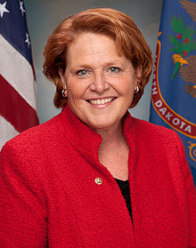
Senate Rural Health Caucus
Senator Heitkamp will be new Democratic Lead

Slide 44

The Administration

Slide 45


NRHA Meeting with Seema Verma,
CMS Administrator
Jodi Schmidt, Past-President of NRHA and Brock
Slabach discussed regulatory burden and new
models, Including CAH VBP Program
Ms. Verma visted NRHAs
Leawood, KS Office on Nov. 6, 2017

Slide 46
Rural Regulatory Wins
Sole Community Hospital Exemption for Medicare payments of 340B drugs
Changes to Quality Payment program (QPP)
  Low volume exemption expanded
Change in enforcement of 96 hour (Condition of Payment) rule for CAHs
Two year moratorium on enforcement of direct supervision requirement for outpatient therapy services
Sociodemographic risk is Hospital Readmission Reduction Program
Change to the calculation of the additional payment available to SCHs and MDHs when they experience a 5% or greater decrease in inpatient volume
New Chronic care management codes for RHCs and FQHCs

Slide 47
340B and the rural hospitals
CMS Proposed HOPPS rule proposed a reimbursement change for Part B drugs purchased by 340B hospitals from Average Sales Price (ASP) +6% to ASP - 22.5%
  NRHA opposes this change and strongly urging CMS to protect the 340B program for rural hospitals, providing examples of the good work rural hospitals do with the 340B program
  Final rule exempted SCHs for 2018
We are not waiting until the next threat to the program…We need to share the good the 340B program does for rural hospitals with Congress and the Administration

Slide 48
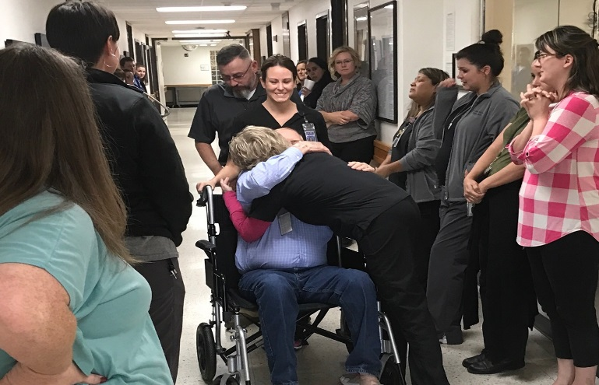
HHS Listened…
NRHA succeeded in getting HHS to exempt Sole Community Hospitals for 2018– CMS spent over two pages quoting NRHA’s comment letter
  SCHs shared their stories and it made HHS listen! Multiple hospitals stories are summarized in the Final regulation
CMS extensively cited NRHA’s comment letter (and those of hospitals that worked with NRHA to draft responses) including quoting sections of the comment letter
Saying goodbye to a patient being discharged from the Childress Regional Medical Center…this patient didn’t need to travel over 100 miles for chemotherapy because of the 340B program at his local rural hospital

Slide 49

340B Means Direct Dollars to Rural Hospitals
Example of what this exclusion meant to one rural Sole Community Hospital in Missouri:
“The increase of non-drug payments by 3.2% with the 340B “proceeds meant about a $250,000 increase to us.”
This increase is on top of the current benefit of 340B which was approximately $450,00.”
Total 340B impact: $700,000!

Slide 50
Expect More on 340B
Will continue to be a target on both Capitol Hill and with the Administration.
Partial rural victory achieved in recent final rule, but must be vigilant.
National Academies of Sciences Nov. 30th Report – calls for significant increases in oversight and reporting requirements.

Slide 51
MedPAC on MIPS: Burdensome and Inequitable
Reporting Burden: $1B reporting burden in 2017 alone
Much of the reported info is not meaningful
Each clinician scored on different measures representing different level of effort
Results in non-comparable scores across clinicians, nonetheless used to allocate payments
CMS has exempted more clinicians in 2018 than are required to participate!
MedPAC Proposal: Voluntary Value Program (VVP)

Slide 52
Resources (Thank you, CMS)
TCPI: Practice Transformation Networks (PTN)
  Designed for all clinicians/clinic type
  RHC/FQHC eligible
  Listing of PTN Contractors
  National Rural Accountable Care Consortium (NRACC) national in scope PTN and focuses on rural practices (RHCs)
Support for Small Practices: Small Underserved and Rural Support (SURS)
  RHC and FQHCs are not eligible to participate, PFS clinics only
  HPSA will qualify for service
  15 Clinicians or less
  TMF is the Oklahoma contractor: QPP-SURS@tmf.org
Additional resources:
  QPP.CMS.GOV
  Quality Improvement Organizations (QIO)

Slide 53
Practice Transformation Networks
That Are Recruiting
PTN Name | Recruitment Region | Target Clients | Contact Name/Email
NRACC | Nationwide | All Practice Types | Kate Angellotti kangellotti@nationalruralaco.com
Northern New England | Maine, New Hampshire, Vermont | All Practice Types | Eleesa Marnagh Emarnagh@mainequalitycounts.org
The Care Transitions Network | New York | Behavioral Health, Primary Care | Samantha Holcombe SamanthaH@TheNationalCouncil.org
VCSQI SAN 2.0 | Nationwide | All Practice Types | Deborah (Nadzam) Melnyk, PhD debnadzam@gmail.com

Slide 54
Practice Transformation Networks
That Are Recruiting
PTN Name | Recruitment Region | Target Clients | Contact Name/Email
Southwest Pediatric | Southern CA (Orange and San Diego Counties) | Pediatric | Michael German mgerman@choc.org
WDOH | Washington | Children 0-20 Primary Care, Specialty Care | Melissa Thoemke Melissa.Thoemke@doh.wa.gov
AZHEC (Health Current) | Arizona | Pediatrics, Integrated Health Homes, FQHCs, Specialists | Stacey Rochman piirecruitment@piiaz.org
Health Quality Innovators | Maryland, Washington D.C., Virginia, West Virginia | Primary Care | Candace Mangum cmangum@hqi.solutions

Slide 55
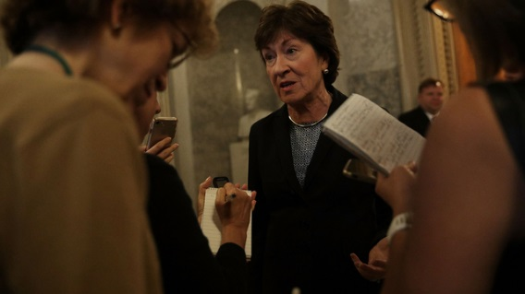
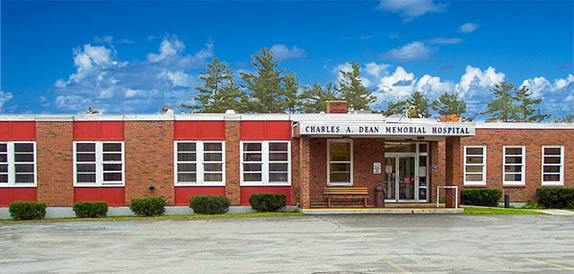
Final Note: Remember the Power of Rural
“If Medicaid is cut, that hospital will not survive. It’s the biggest employer in town. It has 180 good-paying jobs. So not only would people lose access to health care that they need, it would be a devastating blow to the community. You could go all over the state and find that would be true.”
Senator Susan Collins speaking about rural hospital in Greenville, Maine.

Slide 56
NRHAs Key Advocacy Priorities
The FQHC Funding Cliff
Extending critical rural programs and policies to help ensure care continues in rural hospitals
  Medicare Dependent Hospital (MDH) Program
  Low Volume Hospital (LVH)
  GPCI
  Rural Ambulance add-on
CR expiration on Feb.8, federal rural programs appropriations
Save Rural Hospitals Act (new provider type)
CAH VBP Program Legislation
Stabilize Health Insurance Marketplaces Exchanges; Funding for the cost-sharing reductions (CSR)
Oppose offsets to Medicare Extenders, particularly the site-neutral Swing-Bed Policy.

Slide 57
IMPORTANCE of POLICY INSTITUTE
The Administration and Congress is Listening.
Make your Voice Heard
First Time Ever- Rural Health Disparities Summit
Registration is Open
February 6-8, 2018 – Washington, DC

Slide 58
Questions?
THANK YOU
Brock Slabach Senior Vice President National Rural Health Association bslabach@nrharural.org

