Slide 1
Injury and Incidence Rates in Pre-Collegiate Female Gymnasts
Sharon M. Frank, MS, ATC
Cincinnati Children’s Hospital Medical Center

Slide 2
Disclosure
I have no actual or potential conflict of interest in relation to this presentation

Slide 3
Objectives
Recognize gymnastics-related injuries that commonly occur in pre-adolescent and adolescent gymnasts.
Define the injury incidence and injury rates among novice to high level gymnasts.
Analyze the risk of injury as a gymnast advances in the sport.
Generate strategies to minimize the risk of injury at varying skill levels.

Slide 4
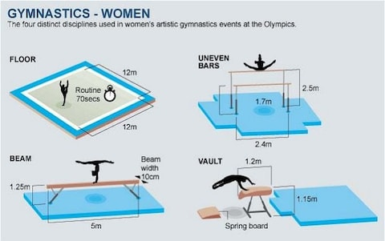
Women’s Artistic Gymnastics

Slide 5
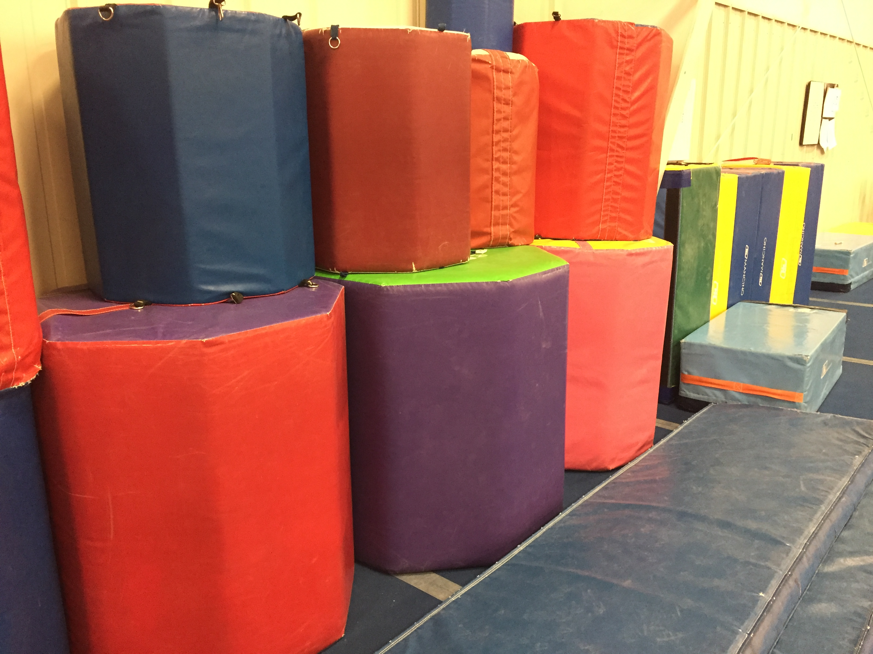
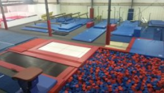
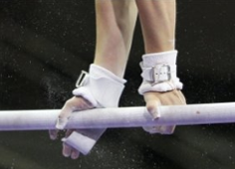
Training Equipment

Slide 6
Levels of Competition
Notes:
Xcel 1 = bronze, silver
Xcel 2 = gold, platinum, diamond

Slide 7
Training Volumes
Gymnasts commonly practice 9 to 32 hours a week depending on skill level and facility
Range of Weekly Practice Hours
Xcel 1 | 6 hours | Level 7 | 16-20 hours
Xcel 2 | 9 hours | Level 8 | 20-22 hours
Level 3 | 9 hours | Level 9 | 20-22 hours
Level 4 | 12-15 hours | Level 10 | 20-22 hours
Level 6 | 15-16 hours

Slide 8
Sport Specialization
Current recommendation: delay sport specialization until late adolescence
Risks include increased injury rate, psychological stress, and burnout
“With the exception of a few sports such as gymnastics and figure skating, the odds of excelling to elite level in sports do not appear to be increased by early sports specialization” (Myer 2015)
Structured competition through USA Gymnastics begins at age 4; however, not really competitive until Level 4
1997: International rules changed Olympic participation requirements to a minimum age of 16
Few elite gymnasts continue to compete past early 20s
Notes:
What to do about this? – closely monitor for signs of burnout, overuse injury, poor performance due to overtraining
-- plan for periods of strength/conditioning and periods of neuromuscular training

Slide 9
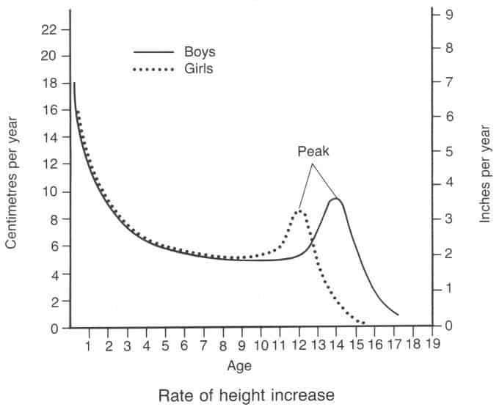
Peak Height Velocity
Peak performance occurs before physical maturation

Slide 10
Injury Definition
An injury was defined as an injury that
Occurred as a result of participation in an organized practice or competition and
resulted in a limitation or modification of sport participation of at least one part of a session and
received attention from the ATC or physician.

Slide 11
Defining Subgroups
Level 10
Level 9
Level 8
Level 7
Level 6
Level 4
Xcel 2
Level 3
Xcel 1
High Level
Advanced
Intermediate
Novice

Slide 12
Demographics
Three calendar years (2016-2018) of epidemiological data collected
Average of 232 female gymnasts each year participating at private gymnastics clubs
Ages range from 5-18 years old
Annual Average Number of Athletes per Group
High Level | 44.3
Advanced | 50.6
Intermediate | 66.3
Novice | 70.6

Slide 13
Injury Incidence
Total injuries captured = 644
Acute = 341 (53%) Chronic = 292 (45%) Other = 11 (2%)
Total Injuries per Group
High Level | 323 | 50%
Advanced | 165 | 26%
Intermediate | 116 | 18%
Novice | 40 | 6%

Slide 14
Injuries by Level

Slide 15
Injury Incidence by Age
“The adolescent growth spurt is associated with an increased risk for injury” (Caine 2008)
Notes:
Epiphyseal fractures and growth-plate inflammation (attributable to increased muscle-tendon tightness)
Also noteworthy association between peak height velocity and peak fracture rate

Slide 16
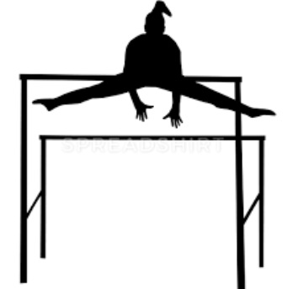
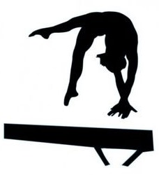
On what event do most injuries occur?
Acute Injuries by Apparatus
Vault | 49 | 16%
Bars | 48 | 16%
Beam | 88 | 29%
Floor | 85 | 28%
Warm-up/Conditioning | 22 | 7%
Other | 11 | 4%
Vault
Bars
Beam
Floor
Notes:
Total acute injuries: 341 - 38 unknown = 303 injuries

Slide 17
Injuries by Event in the Literature
Pre-Collegiate (%) |  |  |  | Collegiate (%)
Floor | 33.3 | Floor | 32.1 | Floor | 41.9
Bars | 32.4 | Beam | 20.7 | Bars | 28.2
Beam | 16.7 | Bars | 17 | Beam | 16.5
Vault | 9.8 | Vault | 13.2 | Vault | 13.4
(Caine 2003) |  | (O’Kane 2011) |  | (Kerr 2015)
Notes:
Beam 29% / Floor 28% / Bars 16% / Vault 16%

Slide 18
What area of the body is injured most?
Injuries by Body Segment
Head/neck | 24 | 4%
Torso/spine | 68 | 10%
Upper extremity | 128 | 20%
Lower extremity | 424 | 66%
Weighted average of 12 studies with 843 female gymnasts (Thomas 2018)
Head/neck 0.8%
Torso/spine 13%
Upper extremity 30.8%
Lower extremity 51%

Slide 19
Which body parts are injured most?
Injuries by Body Part
Head/face | 21 | 3%
Neck | 3 | 1%
Shoulder/clavicle | 14 | 2%
Arm/elbow/forearm | 37 | 6%
Wrist/hand | 77 | 12%
Trunk | 68 | 11%
Hip/thigh/upper leg | 61 | 9%
Knee | 86 | 13%
Lower leg/calf | 21 | 3%
Ankle | 116 | 18%
Foot | 140 | 22%
(Saluan 2015)
1. Ankle
2. Knee
3. Foot
4. Back
5. Wrist
(Caine 2003)
1. Lower back
2. Ankle
3. Knee
4. Wrist
5. Foot

Slide 20
What types of injuries occur?
Types of Injury
Ligament sprain | 109 | 17%
Muscle/tendon strain | 58 | 9%
Inflammation | 204 | 32%
Impingement/entrapment | 35 | 5%
Concussion | 18 | 3%
Contusion/abrasion/laceration | 49 | 8%
Fracture | 74 | 11%
Stress fracture | 44 | 7%
Dislocation/subluxation | 10 | 2%
Other | 43 | 7%
Notes:
Inflammation includes mostly tendinitis, bursitis, apophysitis, sesamoiditis, fasciitis, patellafemoral pain, ITB/tibial stress syndromes

Slide 21
What types of injuries occur?
Types of Injury |  |  | NCAA (%)
Ligament sprain | 109 | 17% | 20.3
Muscle/tendon strain | 58 | 9% | 18.7
Inflammation | 204 | 32% | 11.2
Impingement/entrapment | 35 | 5% | 3.1
Concussion | 18 | 3% | 2.9
Contusion/abrasion/laceration | 49 | 8% | 7.7
Fracture | 74 | 11% | 3.6
Stress fracture | 44 | 7% | 3.8
Dislocation/subluxation | 10 | 2% | 3.4
Other | 43 | 7% | 25.4
Apophysitis accounted for 13% of all injuries!
Notes:
(from Inflammation) → Apophysitis / 81 / 13%

Slide 22
Injury Incidence by Age and Apophysitis

Slide 23
Injury Rates
Common methods to express:
Injuries per 1000 athletic-exposures (A-Es)
Injuries per 1000 hours of exposure
Injuries per 1000 gymnasts per year

Slide 24
Injury Rates (A-Es)
Total = 4.78 injuries/1000 A-Es
Injury Rates by Group
High Level | 9.09
Advanced | 4.91
Intermediate | 3.15
Novice | 1.40
Notes:
High levels typically 5 practices/wk = 15 total per week.
i.e. Level 8/9/10 team of ~17 gymnasts would have ~1000 A-Es over 1 month. Could expect ~9 injuries per month. That’s 2.25 per week.

Slide 25
Injury Rates (hours of exposure)
Total = 1.32 injuries/1000 h
Injury Rates by Group
High Level | 2.12
Advanced | 1.24
Intermediate | 1.01
Novice | 0.46
Notes:
If exposed 20 hours per week (high level gymnasts), 1000 hours roughly equates to 1 year. → i.e. Each Level 10 gymnast is injured ~2.89x per year
Roughly 3000 exposure hours per week. → roughly 4 injuries per week

Slide 26
Injury Rates - Practice vs. Meet
 | High Level | Advanced | Intermediate | Novice | Total
Practice | 9.1 | 4.9 | 3.1 | 1.5 | 4.8
Meet | 10.6 | 4 | 5.3 | 0 | 4.6
Per 1000 A-Es

Slide 27
Injury Rates - Practice vs. Meet
 | High Level | Advanced | Intermediate | Novice | Total
Practice | 2.1 | 1.2 | 1 | 0.5 | 1.3
Meet | 3 | 1.1 | 1.5 | 0 | 1.3
Per 1000 exposure hours

Slide 28
Injury Rates in the Literature (A-Es)
8.5-22.7 injuries/1000A-Es (Thomas 2018)
Weighted average not calculated because of discrepancies
8.5 injuries/1000 A-Es (Caine 2003)
8.2 for practice
14.9 for meet
9.2 injuries/1000A-Es (Kerr 2015)
8.7 for practice
14.5 for meet
Notes:
4.78 total / 4.8 practice / 4.6 meet
High Level = 9.1
Level 10 = 12.4

Slide 29
Injury Rates in the Literature (h)
1.5 injuries/1000 h (Thomas 2018)
Weighted average among 6 studies with 476 female gymnasts
1.3 injuries/1000 h (O’Kane 2011)
0.52 injuries/1000 h (Lindner 1990)
2.5 injuries/1000 h (Caine 2003)
2.2 injuries/1000 h (Saluan 2015)
Among 4 subgroups, rates decreased
2.86 → 2.82 → 1.67 → 0.69
Notes:
1.32 total / 1.3 practice / 1.3 meet
2.12 → 1.24 → 1.01 → 0.46

Slide 30
Limitations when comparing gymnastics injury data
“wide range of definitions of injury”
Key parts were loss of practice/competition time and/or referral to physician
“studies varied in the type of rate chosen to report injuries and many studies did not provide data to compute rates”
“weighted averages could be computed for only 2,914 of total 18,219 gymnasts (16%)”
Notes:
Per USA Gymnastics safety manual: A gymnastics injury is “any injury sustained during gymnastics participation resulting in the gymnast missing any portion of a workout or competitive event” (Hart 2018)

Slide 31
Quiz Question
What group of gymnasts reported the highest injury rate?
High Level
Advanced
Intermediate
Novice

Slide 32
Take Aways
Who?
High level gymnasts had the greatest injury rate, especially Level 10 gymnasts, despite having the least number of participants
Where?
Most injuries occurred in the lower extremity with the ankle, foot, knee, trunk, and wrist being the most commonly injured body parts
What?
Fractures/stress fractures were a frequent type of injury along with ligament sprains and growth-related injuries

Slide 33
Take Aways
Injury rates increased…
As weekly practice hours increased
As a gymnast advanced in level/difficulty of gymnastics (generally)
Injury incidence was highest during the years when young gymnasts were
at peak rate of puberty/growth spurt (13 y.o.)
adding practice hours in the gym
at the highest level/difficulty of skills

Slide 34
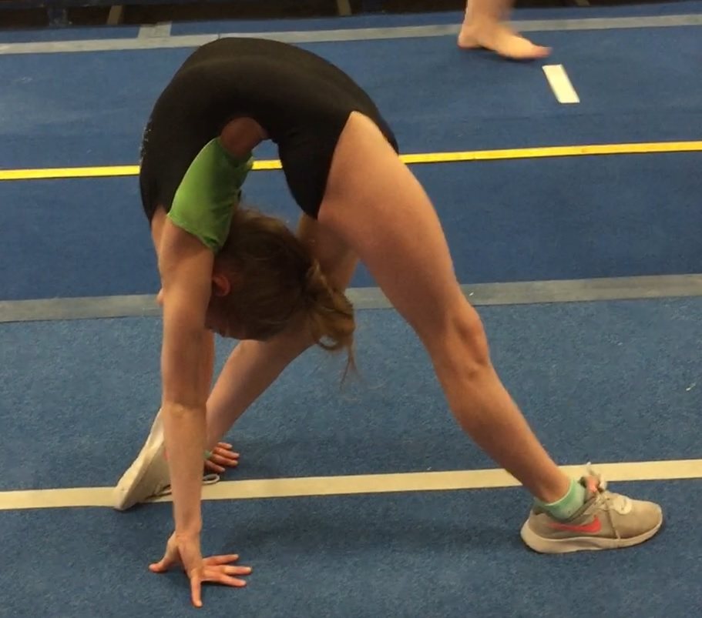
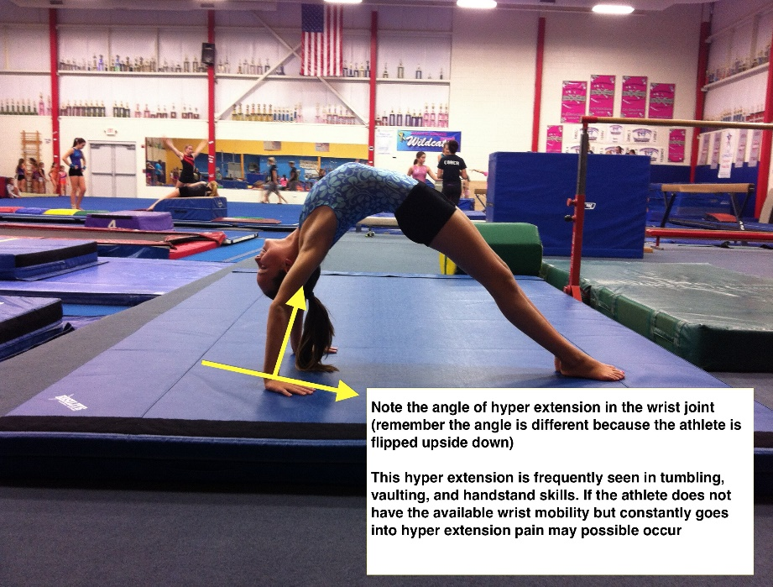
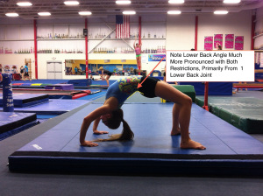
Reducing Risk of Injury
Novice gymnasts (approx. 6-9 hours/week)
Master the basics!
Consistency with good biomechanics is key

Slide 35
Reducing Risk of Injury
Intermediate/Advanced gymnasts (approx.10-16 hours/ week)
Gradually incorporate new skills/drills, especially after a recent increase in practice hours
Lower reps/softer mats → Higher reps/firmer mats
Monitor for growth-related injuries
Lower extremity stretching/foam roll programs
Quarterly growth tracking?
Bracing?

Slide 36
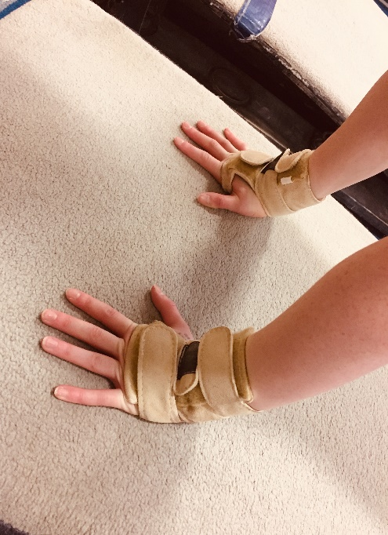
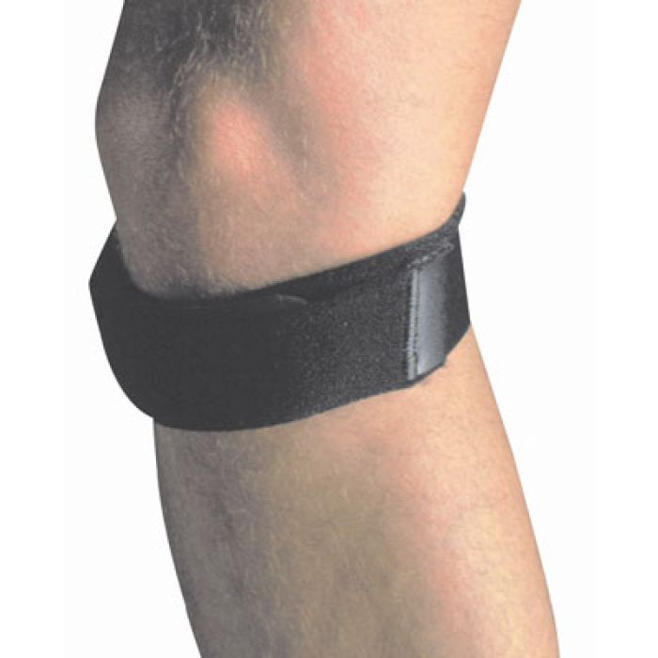
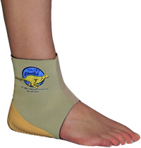
Bracing in Gymnastics
For injury management:
X Brace
Patellar strap
Cheetah heel cup
Ankle brace/tape
For prevention: Tiger Paws
recommend to gymnasts with
history of wrist pain or injury
training a Yurchenko vault

Slide 37
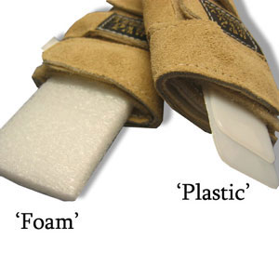
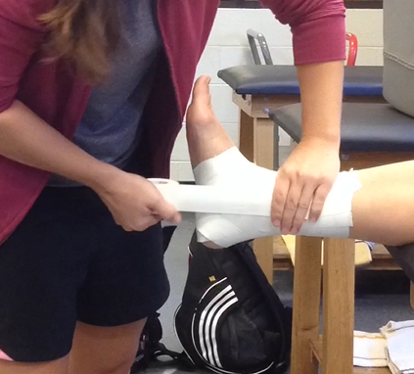
Reducing Risk of Injury
High Level gymnasts (approx. 20+ hours/week)
Proper padding on equipment, especially during skill development or high impact events
Landing surfaces and rep count… know when to “go soft” and “light”
Work-to-rest ratio… quality over quantity
Consider long-term practice modifications/alterations in unique cases
Wrist bracing Ankle Tape/
brace
Notes:
A travel day is not an ‘off’ day

Slide 38
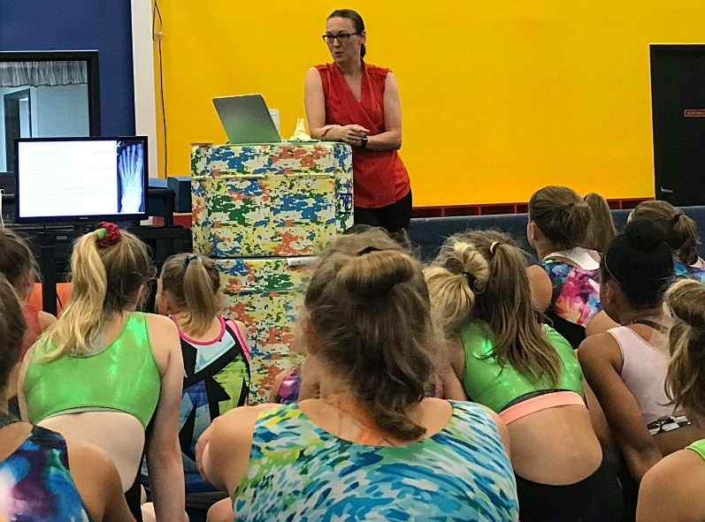
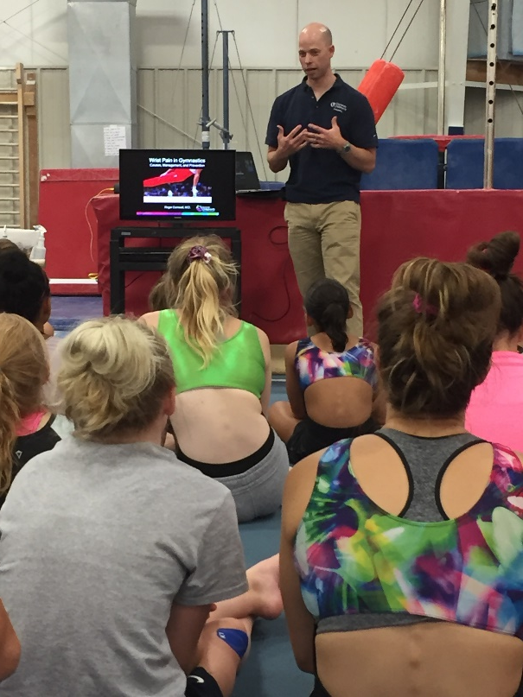
Reducing Risk of Injury
ALL levels of gymnasts can benefit from
education!

Slide 39
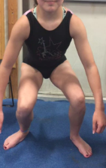
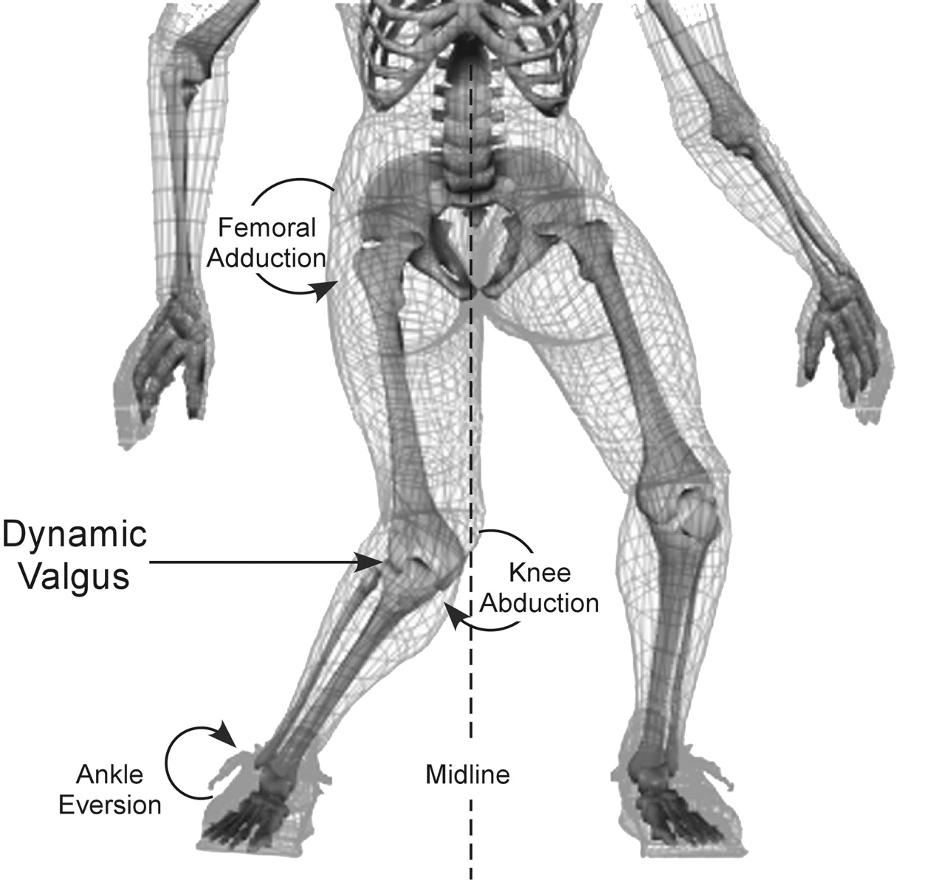
Injury affects movement!

Slide 40
Increased risk of…
Anterior knee pain
Patellofemoral syndrome
(jumper’s knee)
Shin splints
Various tendinitis injuries
of ankle, knee, hip
Low back pain
Plantar fasciitis/foot pain
Muscles strains
Fractures
Knee ligament/meniscal tears

Slide 41
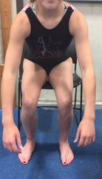
Cues/feedback can help
→
A gymnast that is feeling better and can physically do a skill does not necessarily equal recovery from injury…
Check QUALITY of movement!

Slide 42
References
Caine D, Knutzen K, Howe W, Keeler L, Sheppard L, Henrichs D, Fast J. A three-year epidemiological study of injuries affecting young female gymnasts. Physical Therapy in Sport. 2003;4(1):10-23.
Caine D, Maffulli N, Caine C. Epidemiology of injury in child and adolescent sports: Injury rates, risk factors, and prevention. Clin Sports Med. 2008;27(1):19-50.
Bogin B. Patterns of human growth. Science. 1995;268(5209):442-447.
Hart E, Meehan WP, Bae DS, d’Hemecourt P, Stracciolini A. The young injured gymnast: A literature review and discussion. Curr Sports Med Rep. 2018;17(11):366-375.
Jayanthi N, Pinkham C, Dugas L, Patrick B, LaBella C. Sports specialization in young athletes. Sports Health. 2013;5(3):251-257.
Kerr ZY, Hayden R, Barr M, Klossner DA, Dompier TP. Epidemiology of national collegiate athletic association women’s gymnastics injuries, 2009-2010 through 2013-2014. J Athl Train. 2015;50(8):870-878.
Lindner KJ, Caine DJ. Injury patterns of female competitive club gymnasts. Can J Sport Sci. 1990;15(4):254-261.
Myer GD, Jayanthi N, Faigenbaum AD, Kiefer AW, Logerstedt D, Micheli LJ. Sport specialization, part I: Does early sport specialization increase negative outcomes and reduce the opportunity for success in young athletes? Sports Health. 2015;7(5):437-442.
O’Kane JW, Levy MR, Pietila KE, Caine DJ, Schiff MA. Survey of injuries in Seattle area levels 4 to 10 female club gymnasts. Clin J Sport Med. 2011;21(6):486-492.
Saluan P, Styron J, Ackley JF, Prinzbach A, Billow D. Injury types and incidence rates in precollegiate female gymnasts. Orthop J Sports Med. 2015;3(4):1-6. doi: 10.4085/1062-6050-50.7.02
Thomas RE, Thomas BC. A systematic review of injuries in gymnastics. The Physician and Sportsmedicine. 2018;47(1):96-121.

Slide 43
Thank you!
Any questions?
Go to https://www.cincinnatichildrens.org/service/s/sports-medicine for more info about Athletic Training at Cincinnati Children’s Hospital Medical Center.

