Slide 1
Delta Upsilon Associate Member Education
Session 9:
Ritual Preparation

Slide 2
Ritual

Slide 3
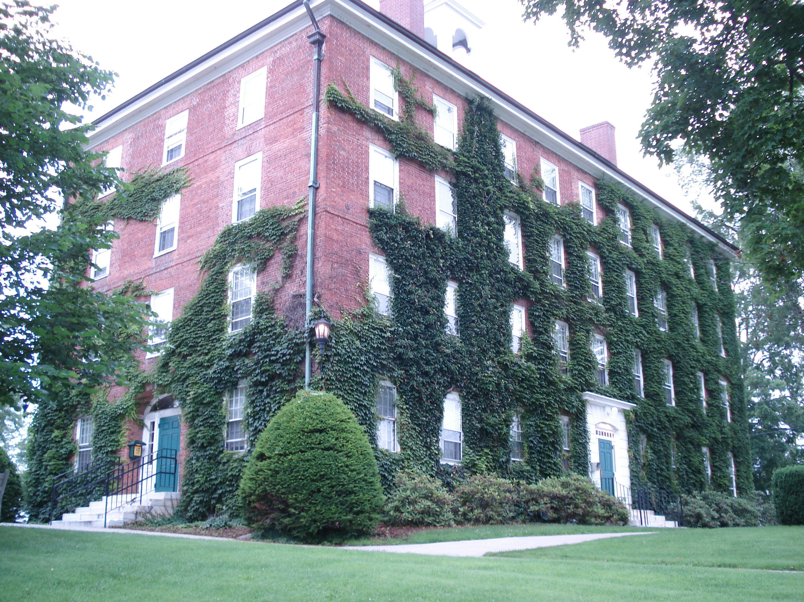
Why do we want to better understand leadership?
How would you define Leadership?

Slide 4
Ouden Adelon
Nothing Secret

Slide 5
DELTA UPSILON OATH OF INITIATION
I, of my own free will and accord, in the presence of God and of these witnesses, do hereby solemnly declare that the principles of this Fraternity as they have been explained to me accord entirely with my own views; and I solemnly promise that as a member of this Fraternity I will faithfully adhere to those principles, endeavoring in every way to perfect myself morally, intellectually, and socially, and endeavoring also to act towards others according to that high standard of conduct required by the Fraternity.
I solemnly promise that I will be loyal to the Delta Upsilon Fraternity and to this Chapter, abiding by their rules, discharging my obligations to them faithfully, and using all honorable means to promote their interests.
I solemnly promise that I will share with my brothers the duties of my chapter; that I will uphold and encourage them in all that is honorable and right; that I will ever extend to each brother the right hand of sympathy; and that at all times and in all circumstances I will endeavor to cultivate those sentiments which should ever exist between brothers.
All this I solemnly promise upon my honor, without any equivocation, mental reservation, or secret evasion of mind whatsoever.

Slide 6
Why do we want to better understand leadership?
How would you define Leadership?

Slide 7
Relational Leadership Model
(Insert details for Ritual Ceremony here)

