Slide 4
Speaking Points

Slide 5
Speaking Points

Slide 6
Speaking Points

Slide 7
Speaking Points

Slide 8
SOURCE: Jacobs Media 2022 | Adults 18+, USA, Total Respondents: 1,655

Slide 9
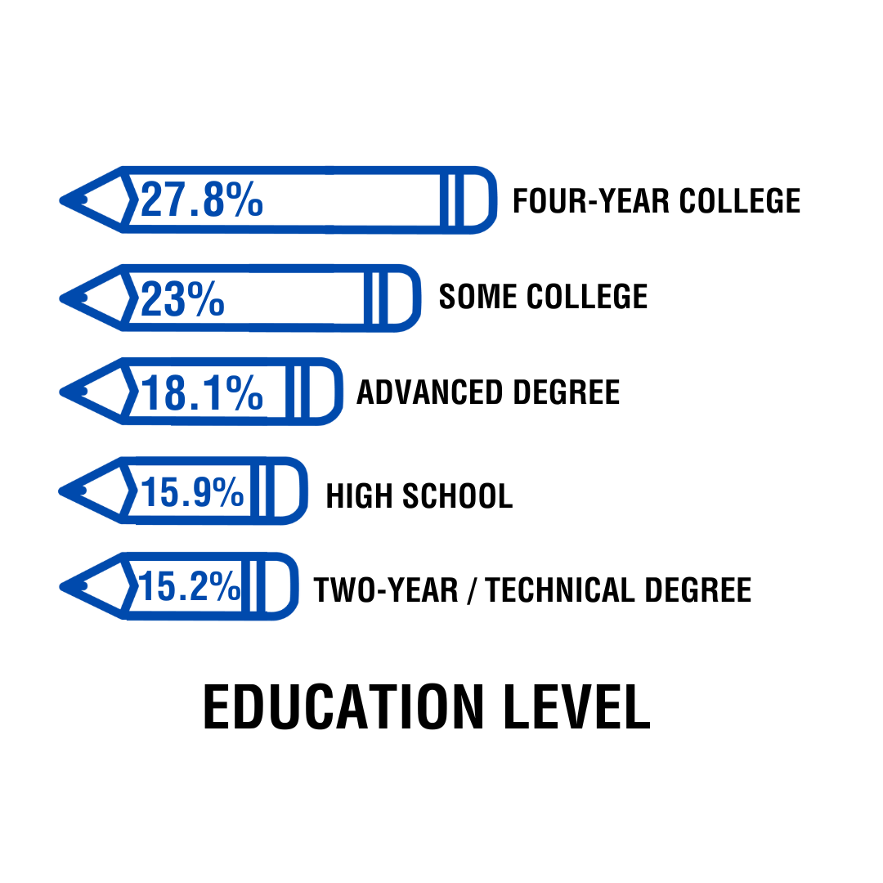
SOURCE: Jacobs Media 2022 | Adults 18+, USA, Total Respondents: 1,655

Slide 10
SOURCE: Jacobs Media 2022 | Adults 18+, USA, Total Respondents: 1,655

Slide 11
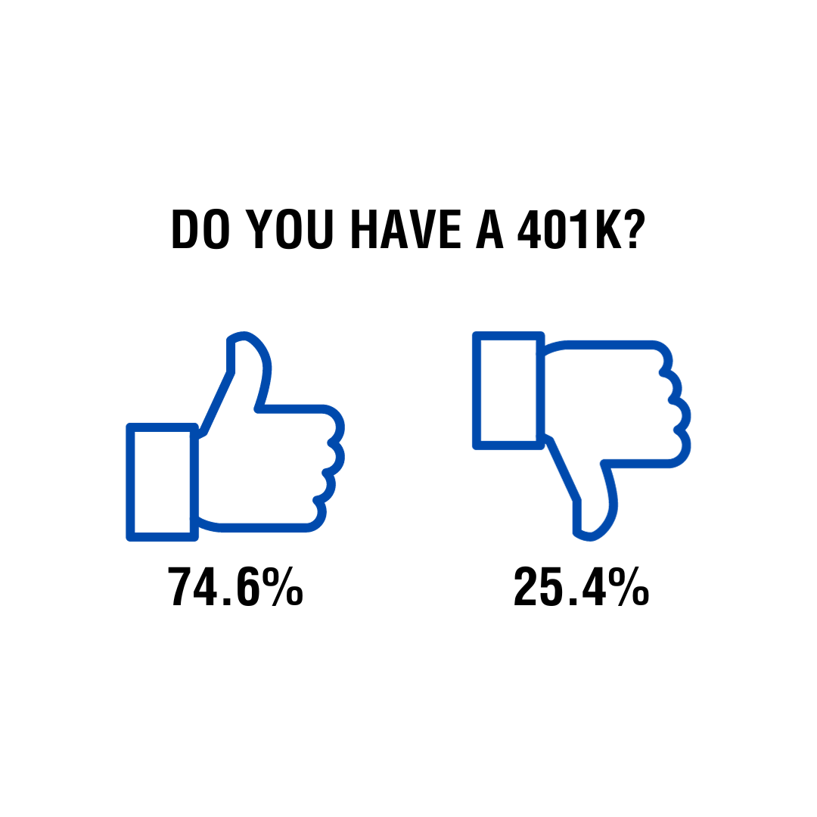
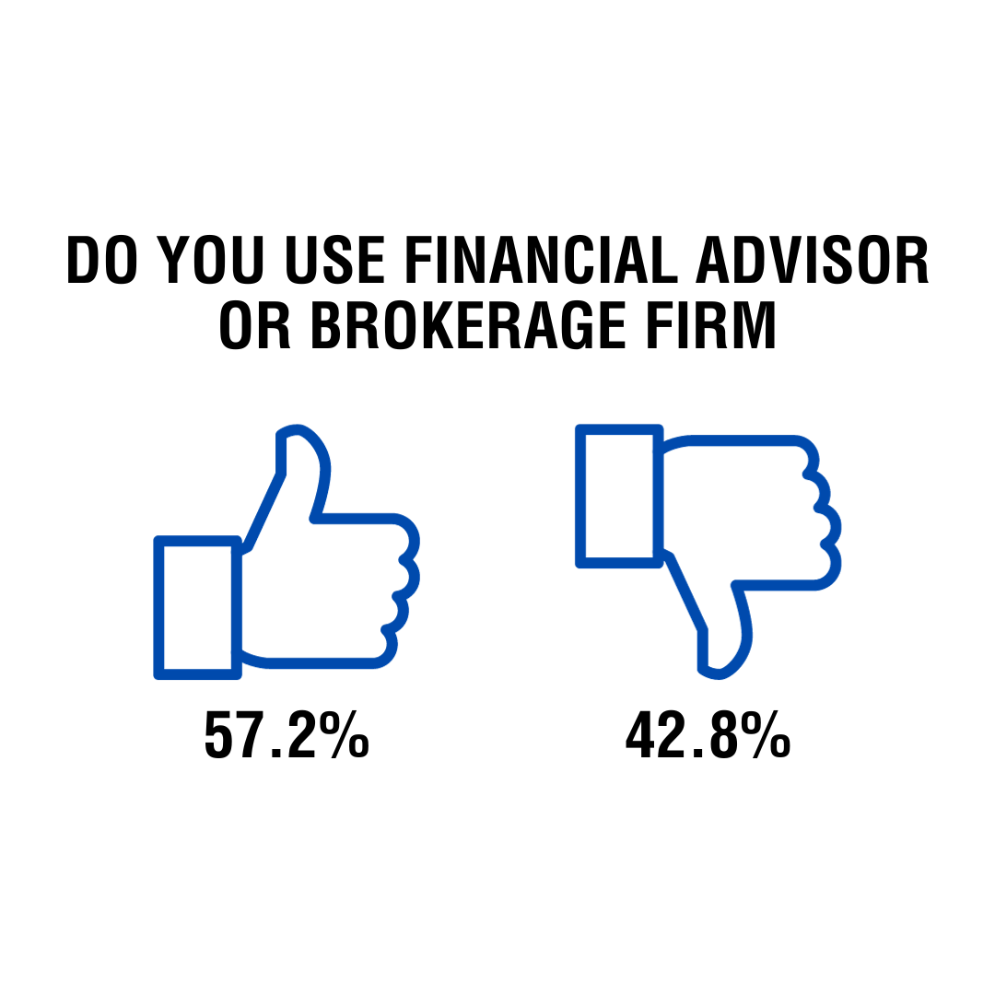
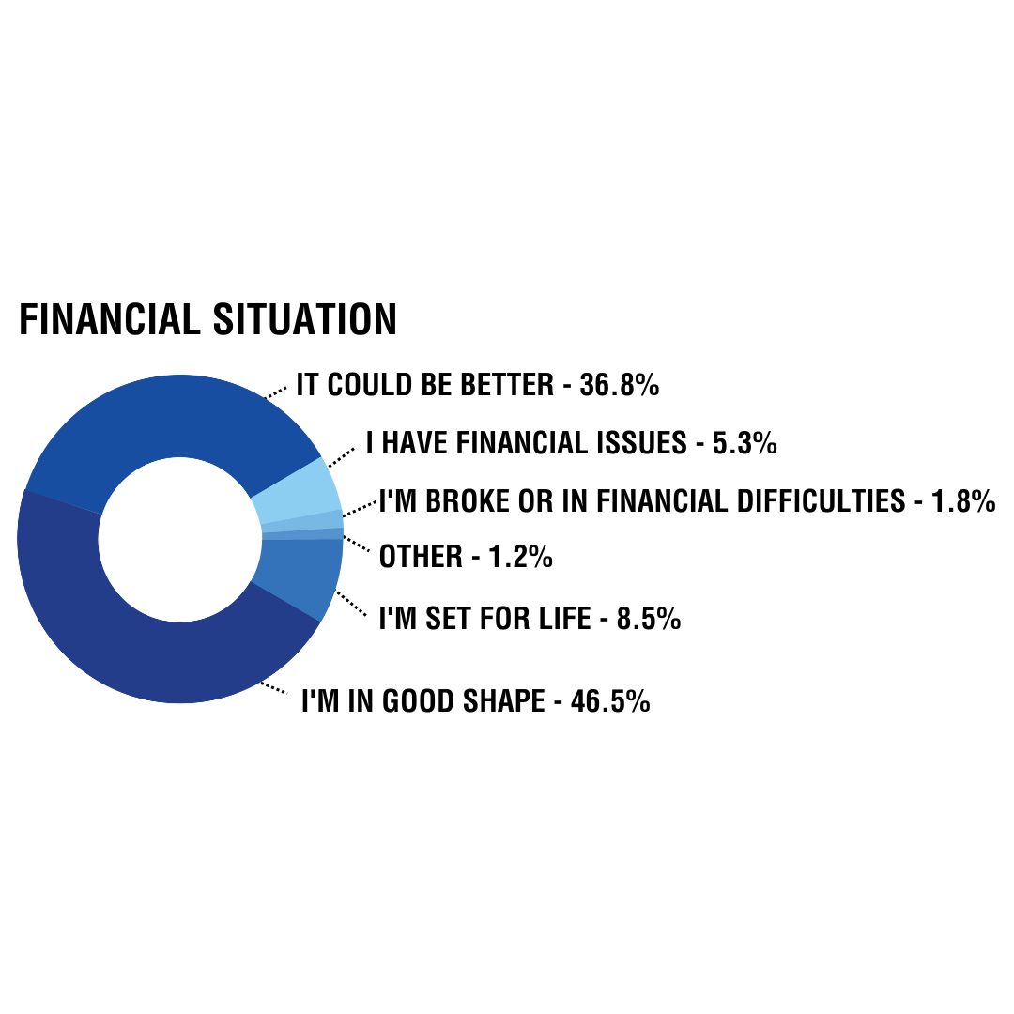
SOURCE: Jacobs Media 2022 | Adults 18+, USA, Total Respondents: 1,655

